Slide 1
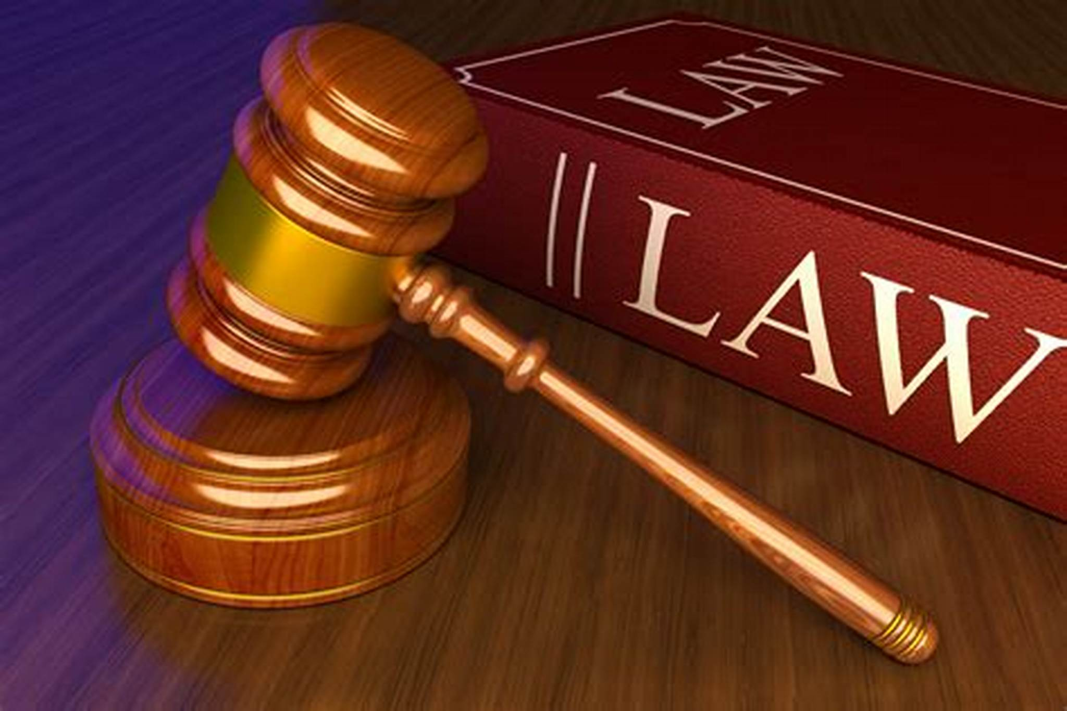
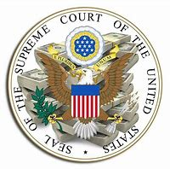
The Judiciary Branch

Slide 2
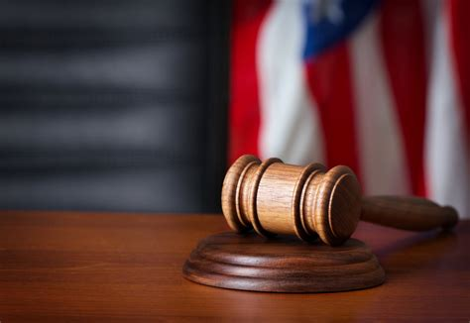
The Supreme Court of the United States
It is the third branch of government in the United States. It acts as a referee in disputes between states, between the government and any of the states as well as between the federal government and any US citizen.
It gets its powers in article three of the US Constitution. It gives the Supreme Court the right to interpret laws past by Congress and determines if these laws are constitutional (adhere to the constitution). If Congress passes a law violating the US Constitution, the court can strike the law down.
Because human beings act as judges, not every judge will rule the same way in any case. Some judges have been accused of “making laws” by interpreting laws in such a way as to grant powers to individuals, levels of government, organizations or even businesses. Therefore, in recent years, some politicians have argued that judges should only interpret exactly what was granted by the constitution and nothing more.

Slide 3
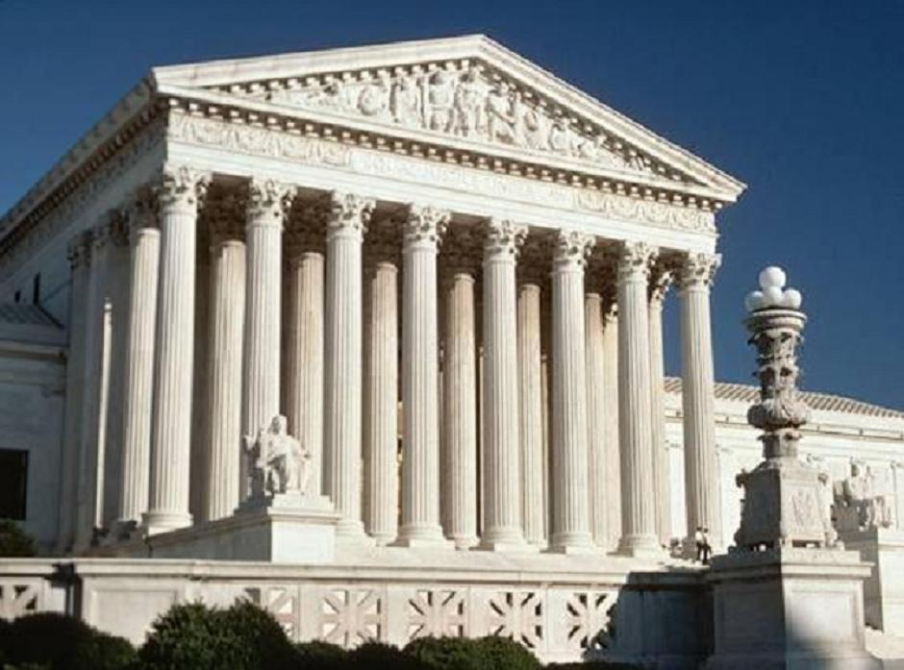
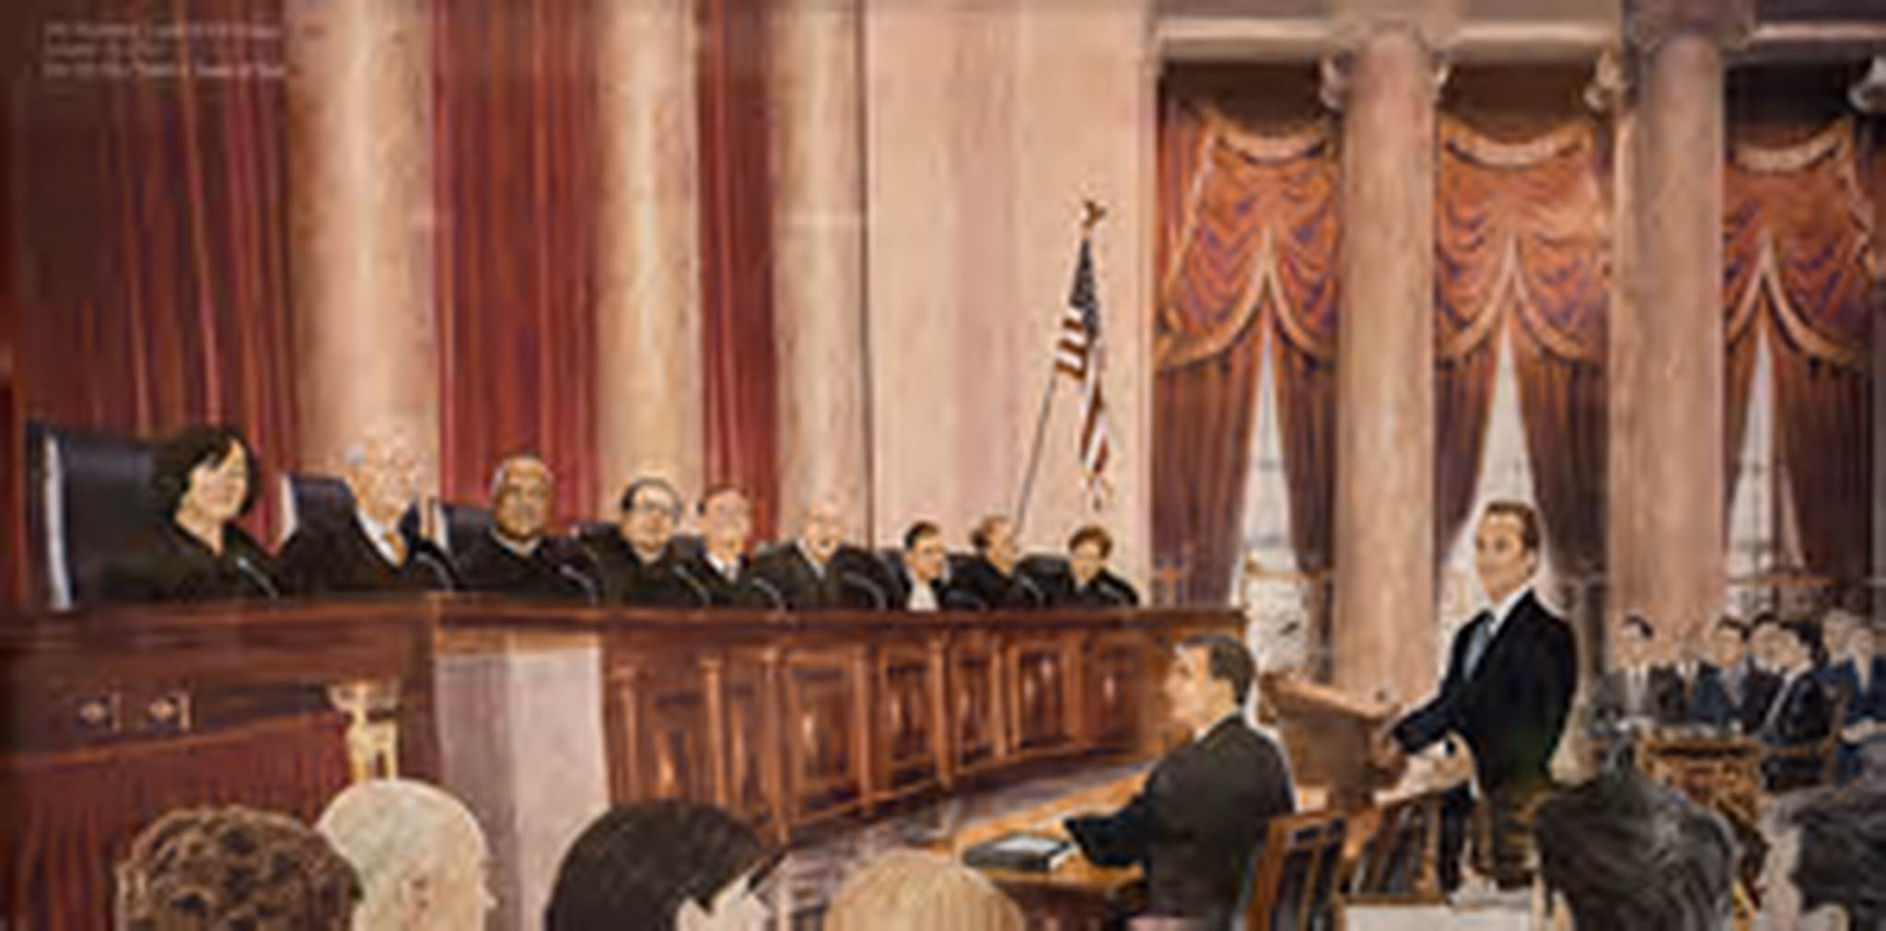
The Supreme Court Acts as a Check on the Congress and the President.
The Court acts as a check on Congress as the court can strike down any law that it deems to violate the constitution of the United States.
It acts as a check on the president by way of striking down any presidential action which may violate the constitution.

