Slide 1
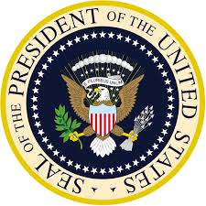
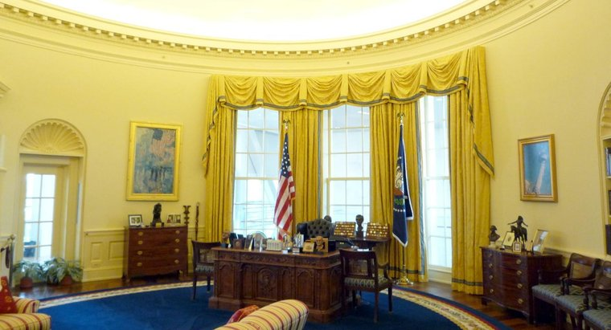
The Executive Branch of the Federal Government

Slide 2
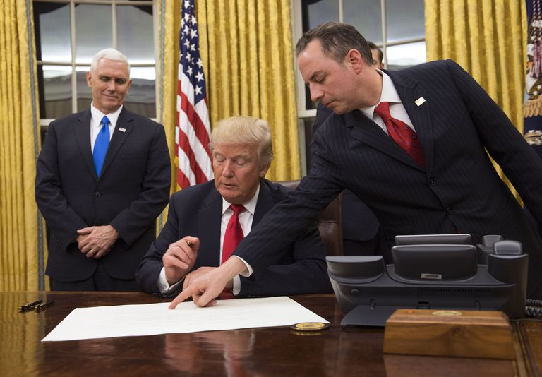
The Office of the President
The president is the head of the US Government. It is the highest office in the nation.
The president has the power to set the agenda. He or she can influence what legislation gets debated in the Congress, but the Congress can agree or disagree to support the president’s agenda. They need to work together.
The president is the commander and chief of the armed forces and can direct the military to respond to any threats at home or abroad. However, only the Congress can declare war and approve the money needed to fight a conflict.
The president has the power to veto any Congressional legislation, which is a very powerful tool that is limited to a Congressional override, though rare, it has happened many times throughout US history.
The president can appoint any public official to office so long as these appointments are approved by the Senate.

Slide 3
The President is a check on the Congress and the Supreme Court
The president of the United States has a lot of power, but like the Congress or the Supreme Court, he/she does not have absolute power. Nevertheless, the president does act as a check on Congress by:
Vetoing any legislation.
Has the power to make all federal government appointments, including heads of government departments including all appointments to the supreme court.
Has the power to initiate legislation that may become law and usually gets a member of Congress to introduce any bills he would like to have debated and become law.
Does have limited presidential order powers that can authorize the president to take necessary actions to protect the nation through issuing national emergencies. Example: Funding for the border wall or money for national disasters, like hurricanes.
Can initiate a government shut down since presidential approval is required for all bills to become law unless Congress can get the support to override the president.

