Slide 1
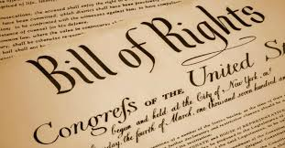
The Bill of Rights

Slide 2
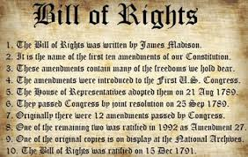
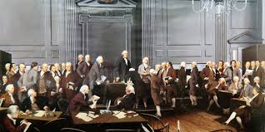
The Rights of “the People”
Following the creation of the United States at the end of the Revolutionary War with Britain in 1783, the new United States argued on what was the best way to protect the rights of the people against the power of government. At the center of the debate:
1. Should the United States have a strong or weak National Government?
2. Should the new nation have a Bill of Rights for the people?
Philadelphia Convention 1787

Slide 3
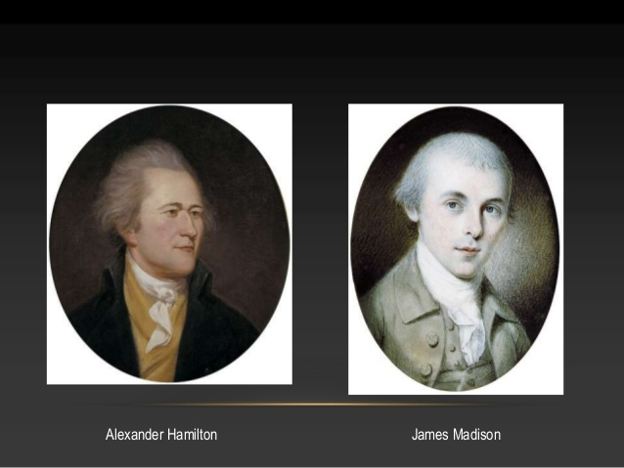
The Pros of a Strong National Government
As you already know, some people wanted a strong government. These people were called Federalists. They felt that our first constitution was a failure because the federal government was too weak. It could not protect the nation. Some of the most famous people in this group were: Alexander Hamilton, and Former US president James Madison.

Slide 4
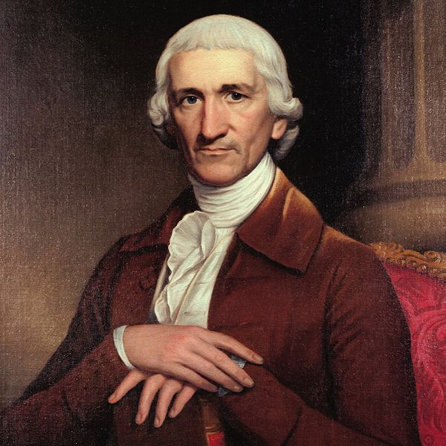
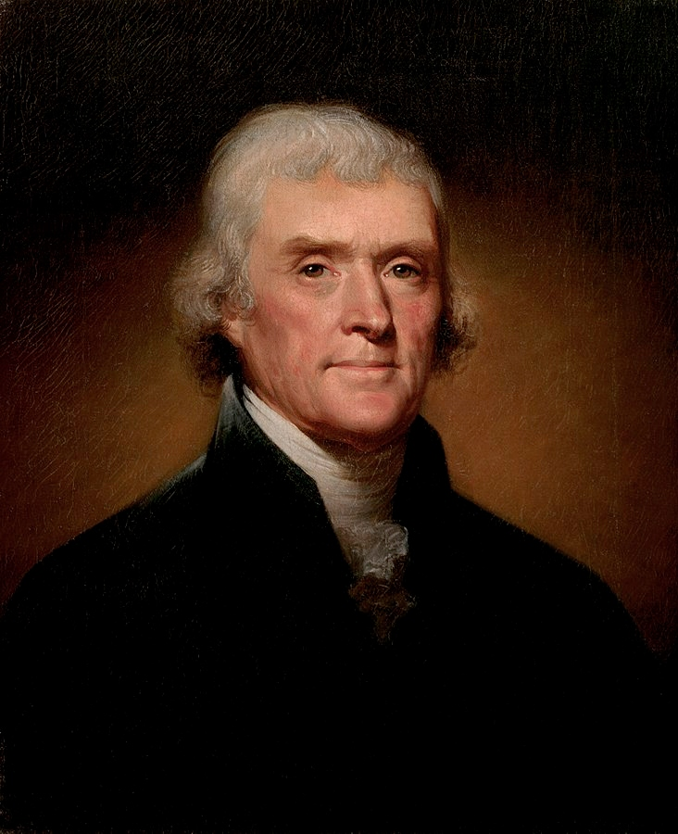
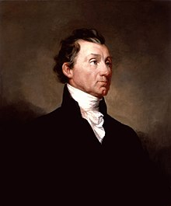
The “Cons” of a Strong National Government
Other people worried that a strong national government would take away the rights and freedoms of citizens. These people were called Anti-federalists. They feared that the new president would become a king, if the new government was made strong! Some of the most famous anti-federalists were: Samuel Adams, Thomas Jefferson and former US president James Monroe.
Samuel Adams, Thomas Jefferson and James Monroe

Slide 5
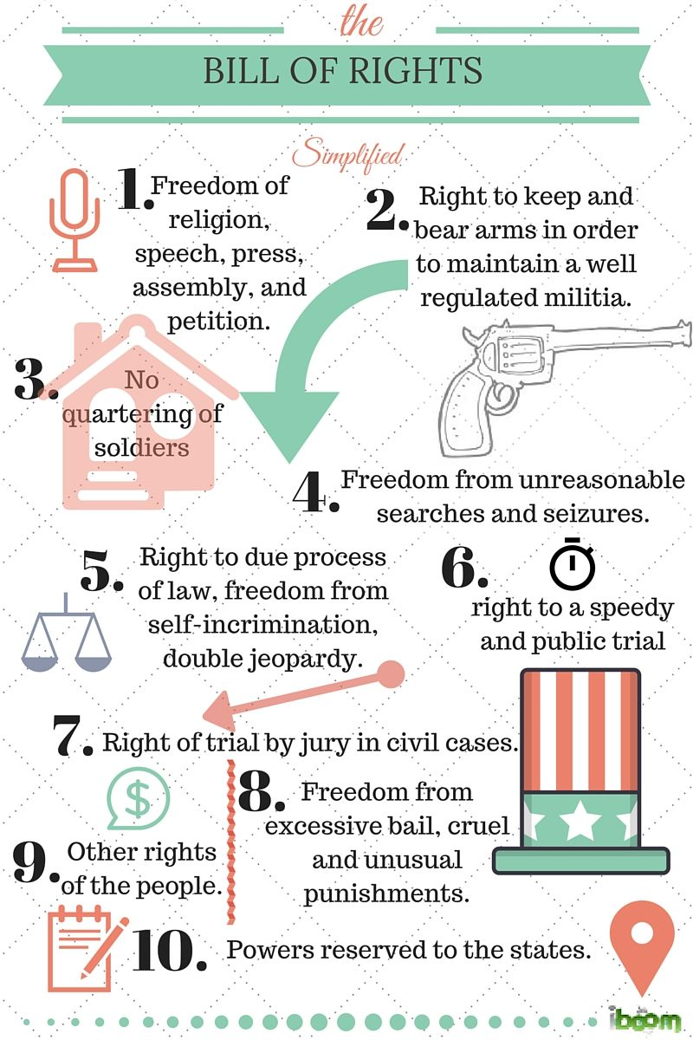
The Bill of Rights- A Compromise….sort of??
Eventually, a compromise was made. Those who favored a strong government (Federalists) would have it… but there would be checks and balances on government power. Those who wanted a weak government (Anti-Federalists) would have a government that had a lot of checks and balances built in and they would also have 10 new amendments added to the constitution that we now call the Bill of Rights!

Slide 6
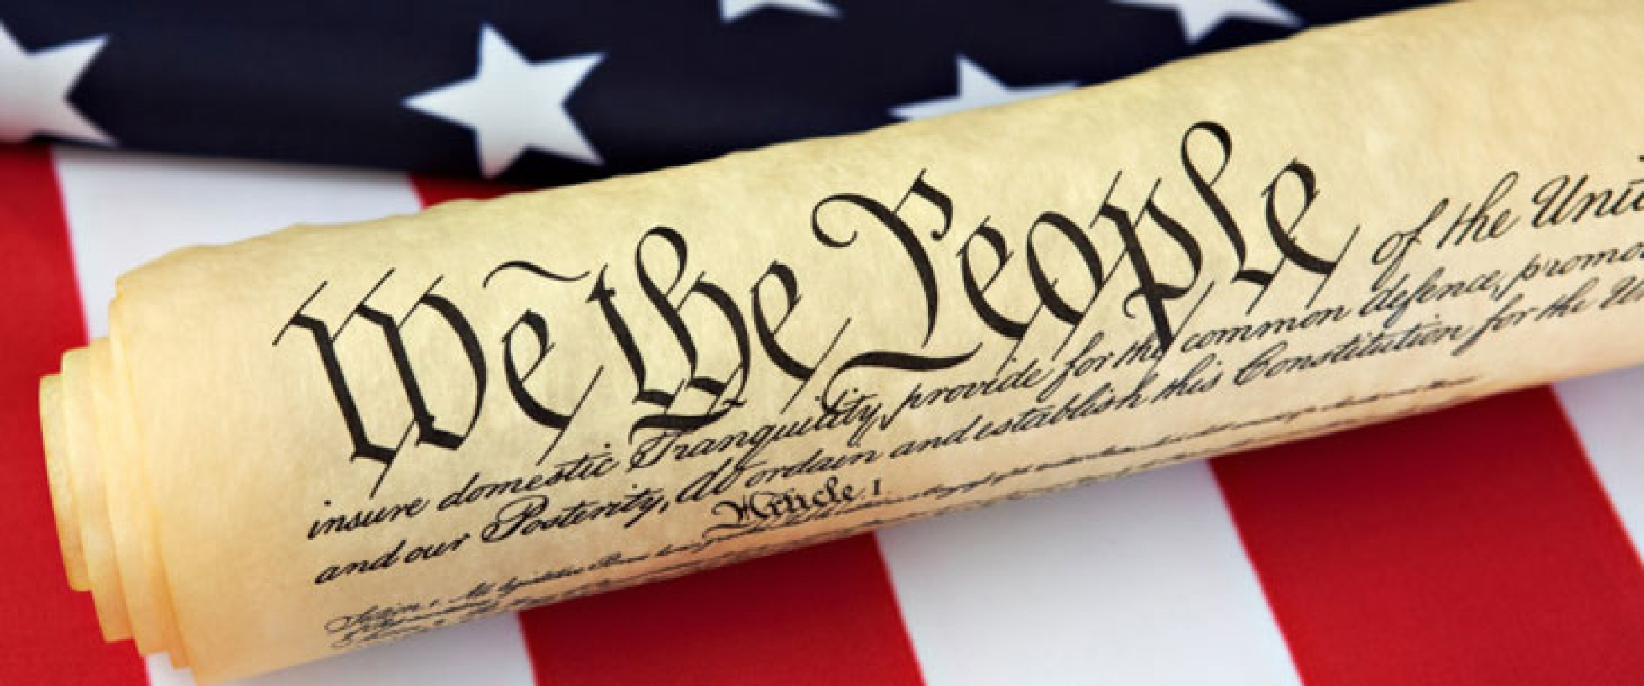
The First Amendment
Congress shall make no law respecting an establishment of religion, or prohibiting the free exercise thereof; or abridging the freedom of speech, or of the press; or the right of the people peaceably to assemble, and to petition the Government for a redress of grievances.
First Amendment Video
http://content.time.com/time/video/player/0,32068,1027382448001_2080291,00.html
.

Slide 7
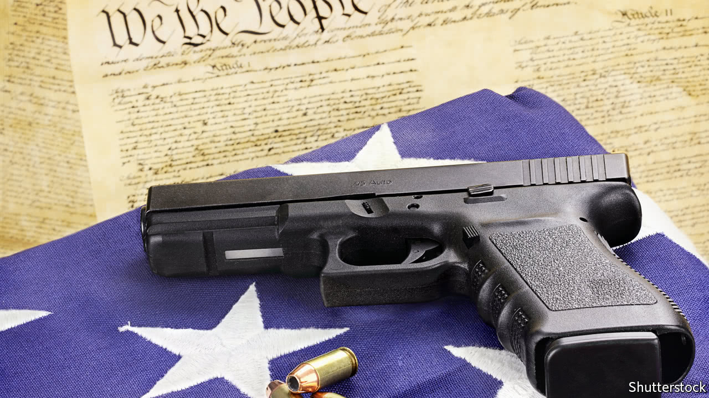
The Second Amendment
A well regulated Militia, being necessary to the security of a free State, the right of the people to keep and bear Arms, shall not be infringed.
Video: http://content.time.com/time/video/player/0,32068,1032435604001_2080292,00.html

Slide 8
Amendment Three
No Soldier shall, in time of peace be quartered in any house, without the consent of the Owner, nor in time of war, but in a manner to be prescribed by law.

Slide 9
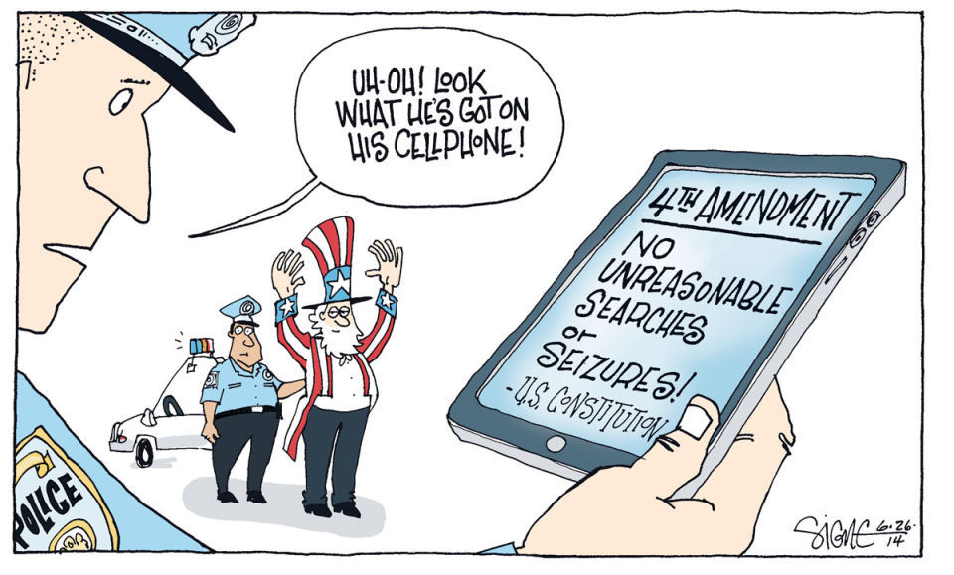
Amendment Four
The right of the people to be secure in their persons, houses, papers, and effects, against unreasonable searches and seizures, No Warrants shall be issued without probable cause, supported by Oath or affirmation, and particularly describing the place to be searched, and the persons or things to be seized.
Video: http://content.time.com/time/video/player/0,32068,1027506447001_2080296,00.html

Slide 10
Amendment 5
No person shall be held to answer for an infamous crime, unless presented with an indictment of a Grand Jury, nor shall any person be subject for the same offence twice; nor shall any person be compelled to be a witness against himself, nor be deprived of life, liberty, or property, without due process of law; nor shall private property be taken for public use, without proper compensation.(This is called eminent domain)
Video: http://content.time.com/time/video/player/0,32068,1027130599001_2080298,00.html

Slide 11
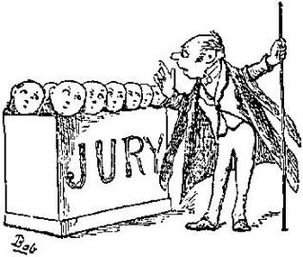
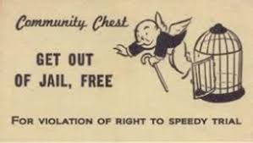
Amendment 6
In all criminal prosecutions, the accused shall enjoy the right to a speedy and public trial, by an impartial jury of the State and district wherein the crime shall have been committed, and to be informed of the nature and cause of the accusation; to be confronted with the witnesses against him; to obtain witnesses or evidence to support his case and be presented with a lawyer for his defense.
http://content.time.com/time/video/player/0,32068,1026381361001_2080300,00.html

Slide 12
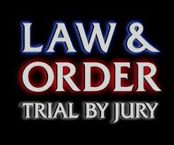
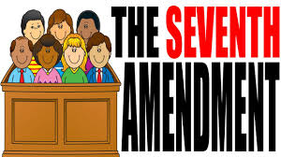
Amendment 7
You have the right to a trial by judge and jury.
http://content.time.com/time/video/player/0,32068,1027561275001_2080301,00.html

Slide 13
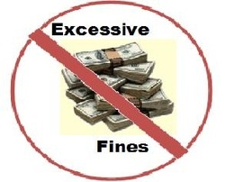
Amendment 8
You have the right not to receive excessive or cruel and unusual punishment for crimes where you have been proven juilty of having had committed.
http://content.time.com/time/video/player/0,32068,1026395306001_2080302,00.html

Slide 14
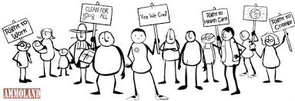
Ninth Amendment
The enumeration in the Constitution, of certain rights, shall not be construed to deny or disparage others retained by the people.
“People have more rights than those listed in the constitution and the states may provide more rights, just not less than those found in US Constitution.”
http://content.time.com/time/video/player/0,32068,1026381364001_2080303,00.html

Slide 15
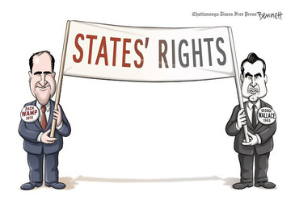
The 10th Amendment
The powers not delegated to the United States by the Constitution, nor prohibited by it to the States, are reserved to the States respectively, or to the people
http://content.time.com/time/video/player/0,32068,1026395309001_2080304,00.html

Slide 16
The Bill of Rights…a Compromise between the needs of society and the individual.
The Bill of Rights was, in some way, a compromise between making sure that the people didn’t give up their rights under a strong federal government, while at the same time limiting what the federal government was allowed to do under the new constitution. While there are other rights in later amendments, the first 10 are in many ways the most important legal rights that are important in American society. The video below is a summary of the 10 amendments that make up your rights.
Bill of Rights Memory Aid Video
https://youtu.be/XgD1E3gBTWU

