Slide 1
The Beginning of the US Constitution

Slide 2
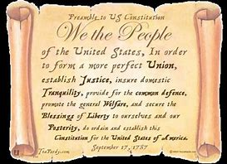
The Preamble of the US Constitution
The Preamble of the US Constitution is one of the most quoted documents in world history. At the time it was adopted by the new United States, it was truly “revolutionary”. It was different and it would serve as the model for how democratic governments should be structured around the world.

Slide 3
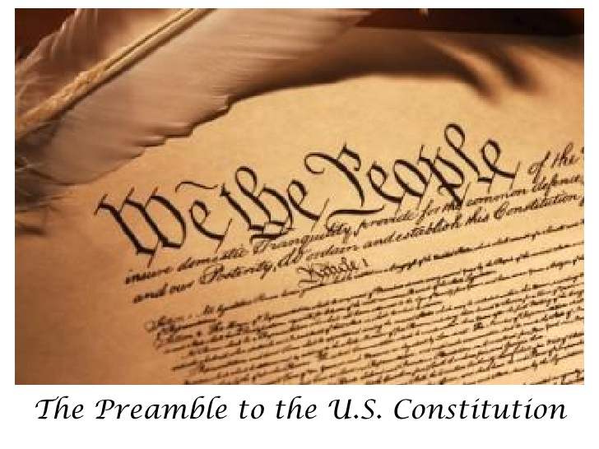
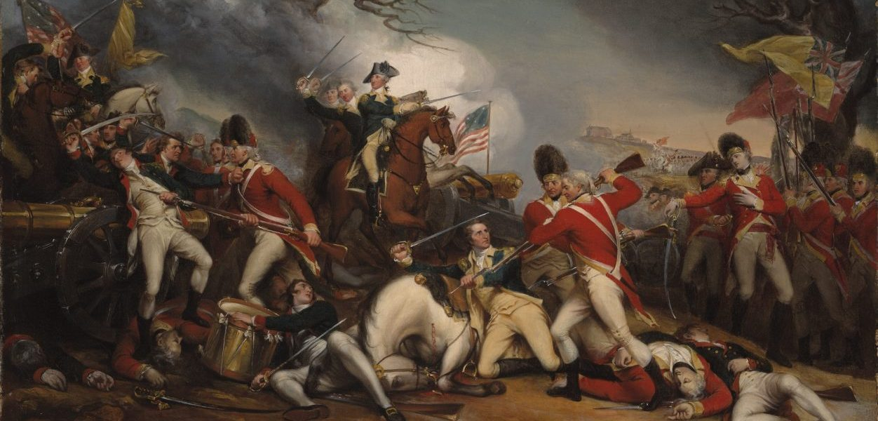
Why was it so “revolutionary?
The idea that people should live “free” and be able to control their own lives was just not how the world worked when the US was created. Only the rich and powerful people had a say in what happened to them. Ordinary people were told what to do and how to live…and that was that. So when the American colonies decided to challenge the British Government in a war which would determine if the colonies could live free, Americans didn’t take this war lightly. They knew it would be tough and they didn’t know if they could win a war against such a powerful country. Many in the colonies new that it was a war that needed to be fought in order to secure the freedoms that many people believed had belonged to everyone…and no government or ruler could take that freedom away. It would be a long hard fight that would come at a heavy price…and so that is why the preamble of the constitution is so important!!

Slide 4
The Preamble has six important principles!
“We the People of the United States, in Order to form a more perfect Union, establish Justice, insure domestic tranquility, provide for the common defence, promote the general welfare, and secure the blessings of liberty to ourselves and our posterity, do ordain and establish this Constitution for the United States of America.”

Slide 5
The meaning of the six principles of the constitution.
In the preamble of the constitution, we have six basic rules that are necessary for the United States to function as a truly free country.
Purpose of government is to make the new country better for everyone in it…not just a chosen few.
Make a government that is honest and fair and that works for everyone.
Make sure there is peace in the country.
Make sure the country is secure against other countries or people that might want to harm us.
Help to promote the conditions whereby everyone can have an opportunity for a good life.
The purpose of a democratic government is to secure the freedoms for the people who are alive today and for those generations that will come afterwards.

Slide 6
Why is the preamble so important today
The Preamble basically sets out the guiding or big ideas for the goal and purpose of a democratic government. All laws that would follow…all changes to the constitution as it was originally drawn up, would be done by following the six basic goals of the government.

