Slide 1
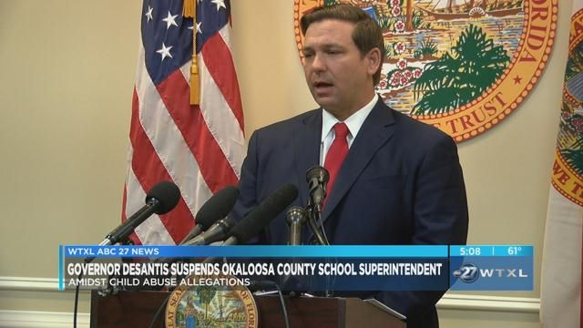
State and Local Governments

Slide 2
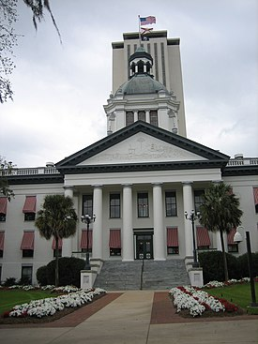
State Government: Legislative Branch
Bicameral or two house legislatures in most states. The state of Nebraska is the only state that has a one house legislature.
Passage of laws at the state level are similar to that of the US Congress.
State legislatures have both a House of Representatives and a Senate. There are 120 House Reps and 40 Senators representing all of Florida’s counties.

Slide 3
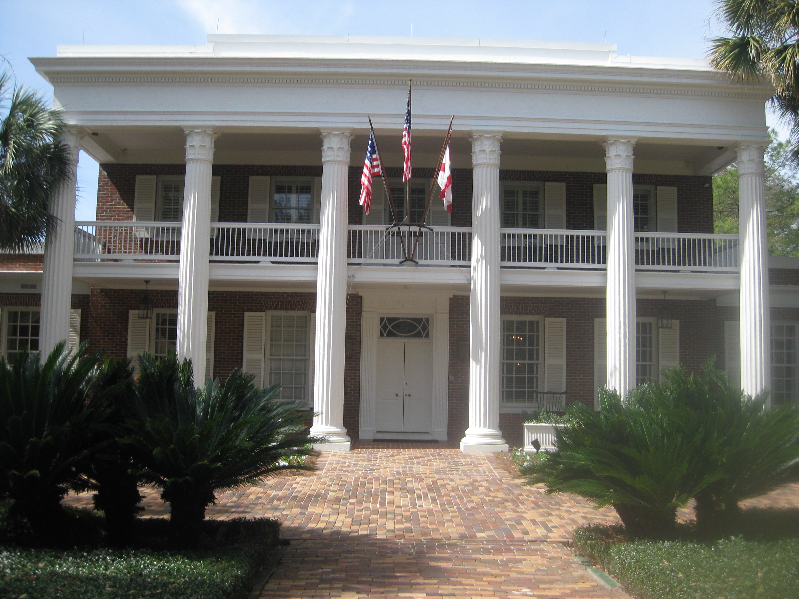
State Government- Executive Branch
Executive Branch: The Governor is head of the Executive Branch of a state with similar powers to that of the president. He is head of government for the state and has similar law making and executive functions of the president. Govenors can:
Propose new laws for the state
They can issue executive orders that are necessary for the functioning of the state. Example: states of emergency.
They can veto legislation from the state legislatures.
They can appoint state level superior court judges.

Slide 4
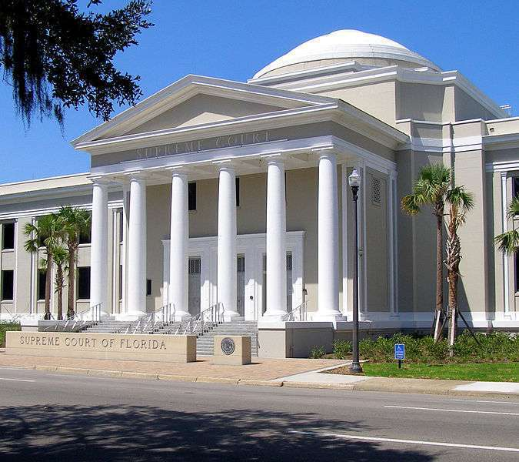
State Government: Judicial Branch
Judges are appointed at the Supreme Court of Florida level. Seven judges sit on the Supreme Court.
Florida has lower level courts such as the Superior Court- where trials are held at the Supreme Court level.
County and city judges are elected.
Supreme Court of Florida has the right to overrule lower court judges within the state of Florida.
Supreme Court of Florida can also review laws passed by the Florida legislature.

Slide 5
Local Governments
City and County governments are created by the states.
Counties are allowed to collect taxes that are necessary to run government services.
There are two types of local governments: municipalities (cities) and counties.
Local governments pass laws called ordinances. They are debated and passed by local government councils and deal with many of the issues that affect residents within their communities such as laws regulating building codes, roads, policing and garbage collection.

Slide 6
Federalism: Shared responsibilities by all levels of government
Power sharing is an important part of understanding the concept of federalism. When the constitution was drawn up, specific powers were granted to the new national government. Example: military and postal services. However, very little was said about the powers of the states beyond, for example, the rules, time and place for the election of Congress. So, the 10th Amendment to the Constitution was passed to reserve any powers, not specifically given to the federal government by the Constitution, to the states.

Slide 7
The differences between federal, state, and local powers.
Enumerated Powers: (Federal Powers) are the powers given to the federal government by the US Constitution. They include any powers that are necessary to provide for the safety and welfare of the whole country. Example: military
Reserved Powers: (State Powers) are any powers not specifically given to the federal government, such as establishing rules for state businesses, licenses for teachers as well as state law and fire services. States also have the right to set up local governments to provide services such as roads, local policing and fire services. The states were given the power to set up local governments by the 10th Amendment.

