Slide 1
How can the United States Constitution be amended? Why is the amendment process difficult?
SS.7.C.3.5: Explain the constitutional amendment process.

Slide 2
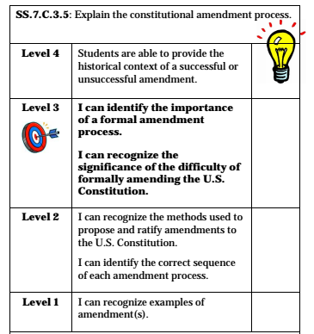

Slide 3
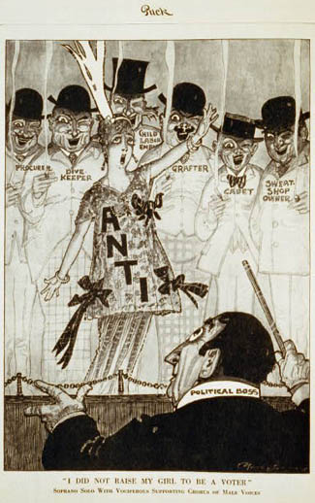
Bellwork: Using the political cartoon, analyze the cartoon and record your responses on your Viewing Guide activity sheet.
Notes:
An anti-suffragist sings in the foreground, directed by a political boss and accompanied by a procurer, a dive keeper, a child labor employer, a grafter, a cadet, and a sweat-shop owner. Caption: "'I did not raise my girl to be a voter’; soprano solo with vociferous supporting chorus of male voices." (1915)
(Library of Congress Prints and Photographs Division, LC-USZC2-1196) http://www.nwhm.org/online-exhibits/rightsforwomen/cartoons.html

Slide 4
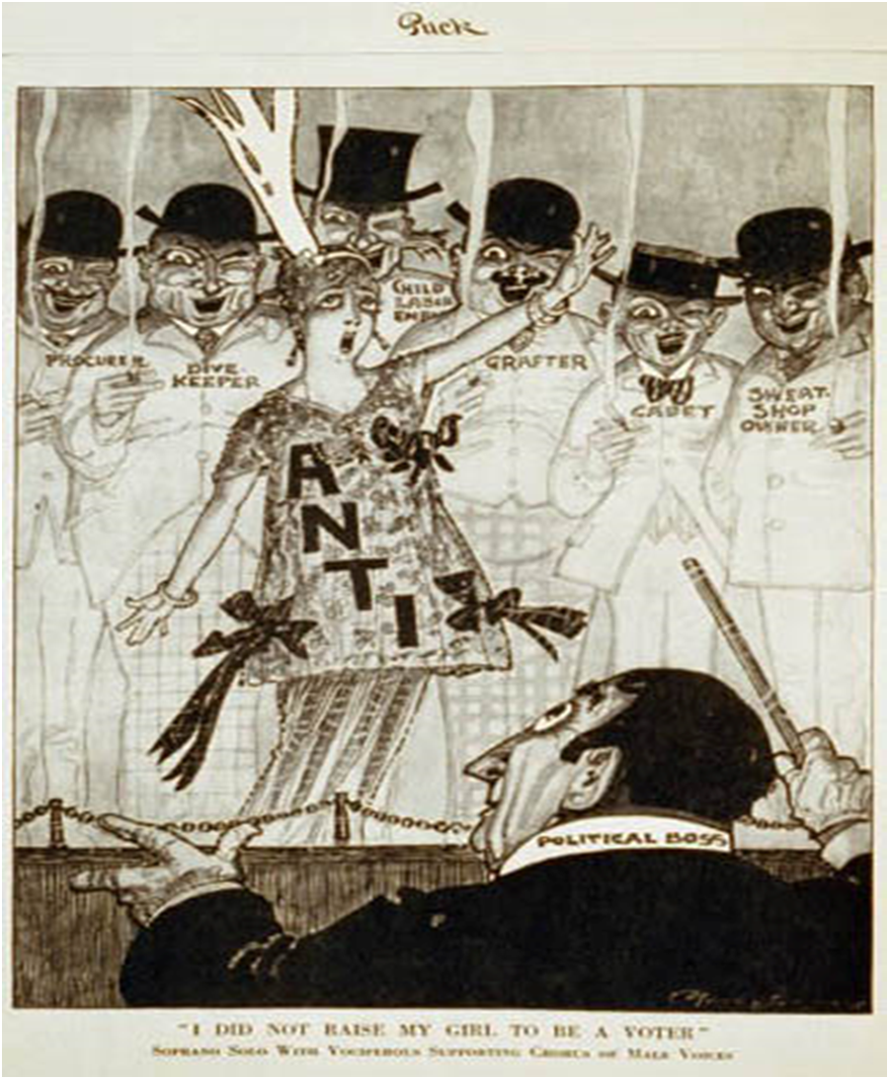

Slide 5
After discussing your responses with your team, add any additional notes or evidence to your graphic organizer.

Slide 6
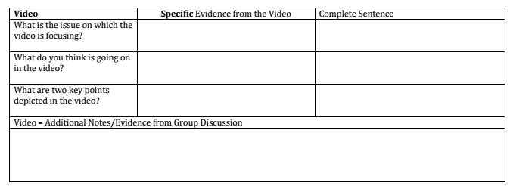
As we watch the video, jot down specific evidence that helps you answer each question.
Notes:
Note – Bad Romance Til We Have Women’s Suffrage won an Emmy.

Slide 7
Notes:
Note – Bad Romance Til We Have Women’s Suffrage won an Emmy.

Slide 8
As we watch the video, jot down specific evidence that helps you answer each question.
“votes are ours”
“It’s gotten ugly, they’ve passed the 15th…”
Notes:
Note – Bad Romance Til We Have Women’s Suffrage won an Emmy.

Slide 9
After viewing, use your evidence collected to summarize your responses in one complete sentence on your activity sheet.
Notes:
Note – Bad Romance Til We Have Women’s Suffrage won an Emmy.

Slide 10
Video Viewing Guide
Using information from our class discussion, jot down your biggest takeaways on your video viewing guide in the additional notes section.

Slide 11
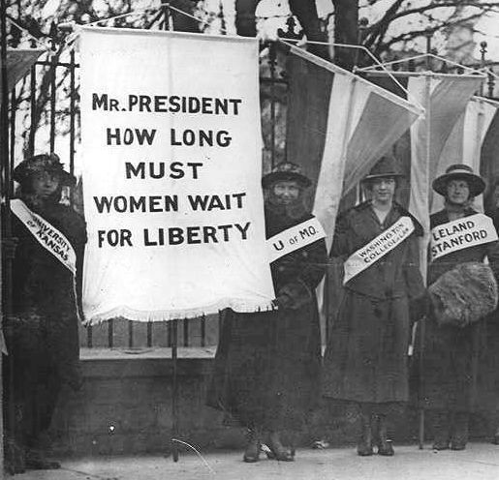
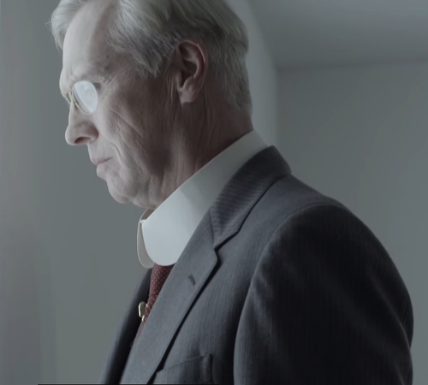
Bad Romance
The video depicts the struggle for women’s suffrage in the early 20th century, resulting in the passage of the 19th Amendment that gave women the right to vote.
The U.S. President was a silent observer of the events because the President does not vote on constitutional amendments.

Slide 12
Bad Romance
The video depicts methods of civil disobedience used by women’s suffrage activists and the treatment to which they were subjected.
The video also references passage of the 14th and 15th Amendments as part of the evolution of voting rights in the United States.

Slide 13
Bad Romance
The video depicts a group of Tennessee state legislators arguing before they voted on the amendment; this is an example of a caucus, a meeting to select a candidate or promote a policy.

Slide 14
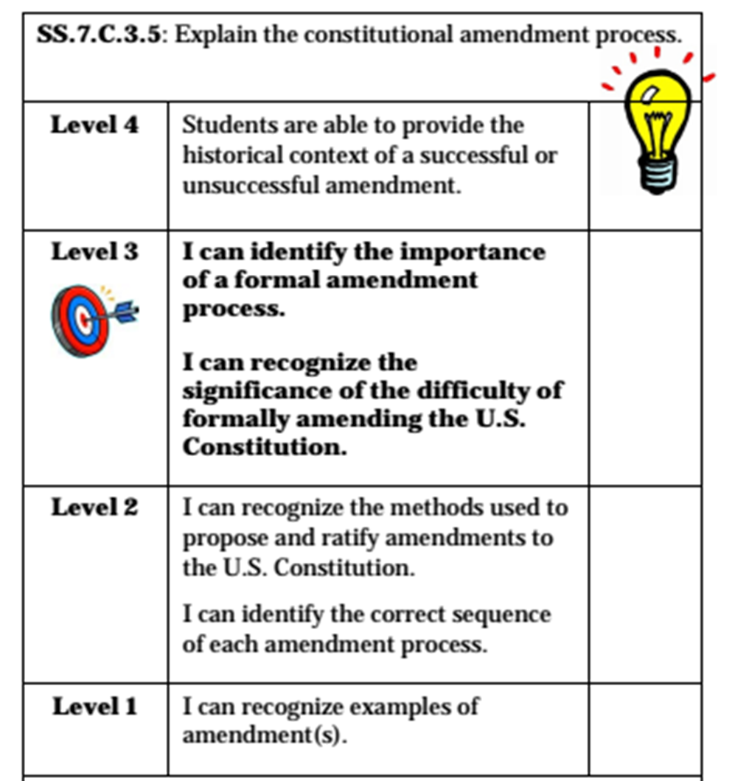
Both the political cartoon and video represent a specific amendment. We will examine the methods to propose and ratify amendments to the United States Constitution.

Slide 15
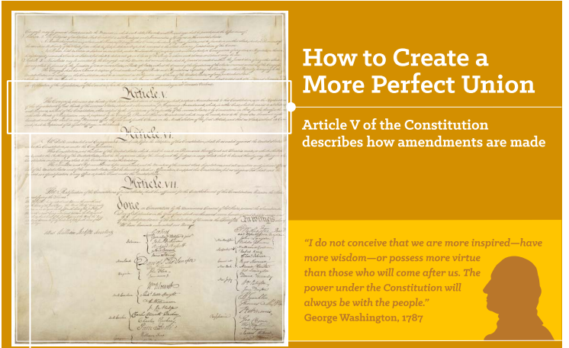

Slide 16
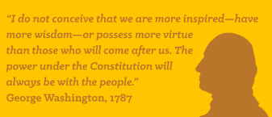
Discuss…What is the importance of Washington’s quote? Why is this important to consider?
Timed-Pair-Share

Slide 17
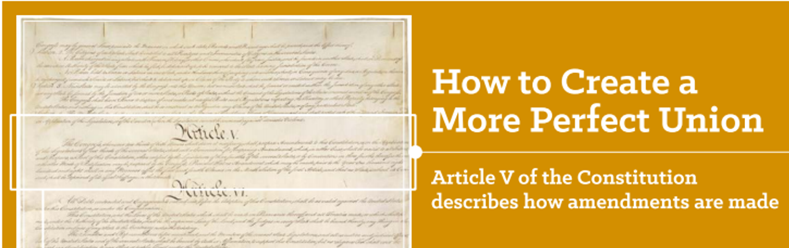
Amendment Process
Article V of the Constitution also explains the two possible processes for amending the Constitution.

Slide 18
We will examine the methods to propose and ratify amendments to the United States Constitution. Methods and Sequence make numbers important to our understanding….

Slide 19
As I read, circle any numbers that are important as part of the amendment process.

Slide 20
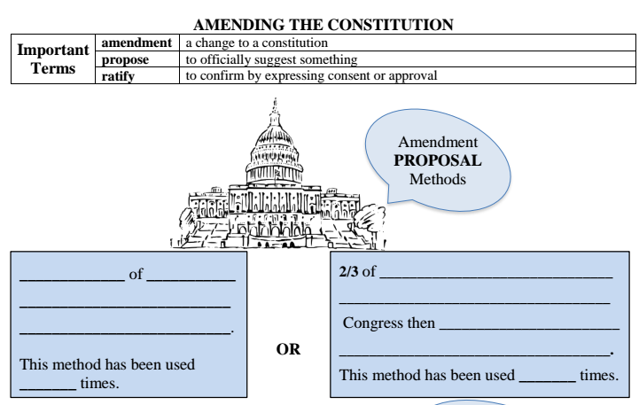

Slide 21
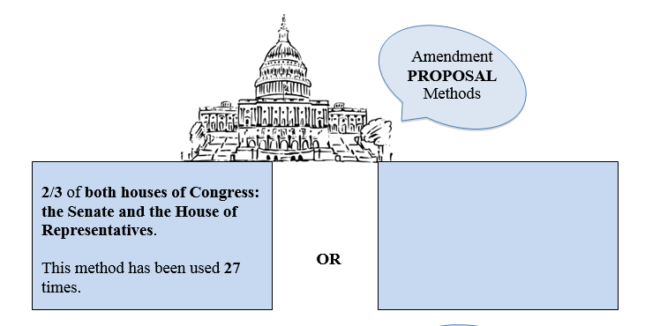

Slide 22
Read with your shoulder partner and come to consensus on a response.

Slide 23
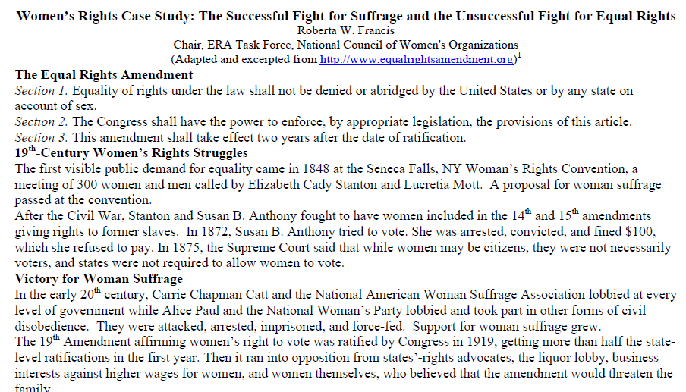
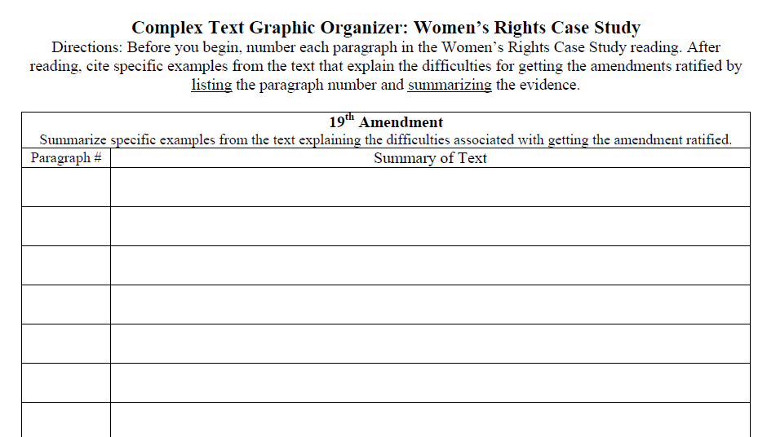

Slide 25
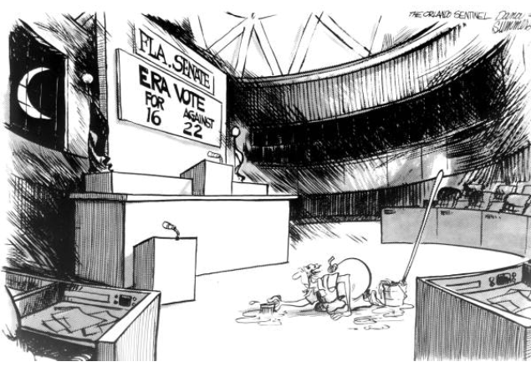
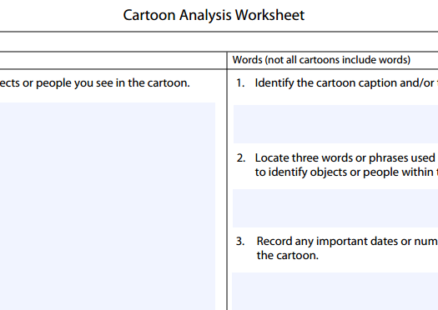

Slide 26
Monitoring and Assessment Options
Write a well-crafted informative response using one of the following prompts:
Prompt 1
The U.S. Constitution has been amended 27 times out of over 11,000 proposals introduced. Based on what you have learned and citing specific examples from the “Bad Romance Women’s Suffrage” video, “How to Create a More Perfect Union” infographic and the “Women’s Rights Case Study,” write to explain why there is a low success rate of amending the U.S. Constitution.
Prompt 2
How do the “Bad Roman Women’s Suffrage” video, “How to Create a More Perfect Union” infographic, and “Women’s Rights Case Study” support the idea that it is difficult to make a change to the U.S. Constitution? Support your writing with specific examples from each source.

