Slide 1
Benchmark 3.10 Sources and Types of Law

Slide 2
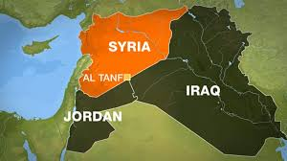
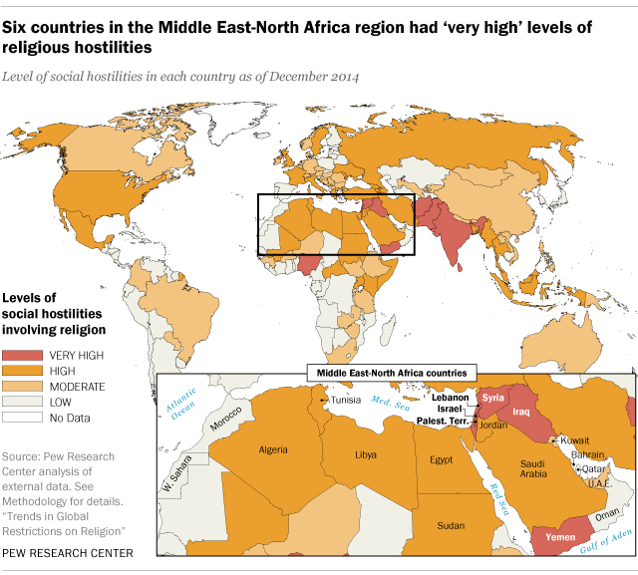
Where did the idea of laws come from?
Hammurabi's Code- Hammurabi was an ancient ruler in the ancient city of Babylon back in 1772 BC in what is present day Iraq and Syria. Hammurabi, which you may remember from world history, wrote down a code of 282 laws dealing with every day life. It was the first time laws were written down and became one of the inspirations for the US Constitution many years later.
Video Clip: https://www.youtube.com/watch?v=BsPbqmYwxso

Slide 3
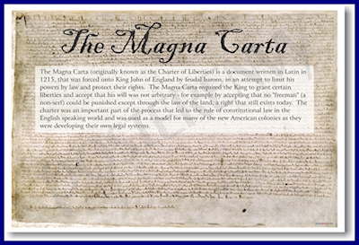
Where do laws come from?
The Magna Carta- The Magna Carta was the first time that a king’s power was limited by a set of laws. It was passed in the year 1215 by King John of England. It was meant as a peace offering to the King’s Nobles who guaranteed to support him in exchange for some rights such as the right to a fair and speedy trial. This document would influence our own US Constitution years later.

Slide 4
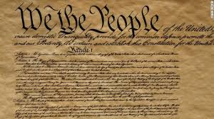
Sources of Law: Constitutions
The US Constitution
Statutes and Ordinances
The first source of our laws is the US Constitution. It is the supreme law of the land of the United States and all other state constitutions and sources of law must abide by it. The idea of a constitution is that government power is limited by the rule of law!
There are also state constitutions which must follow the US constitution, but are the highest form of law in each of the states.
Regulations
Judge Made Laws
Common Laws

Slide 5
Sources of Law: Statutes and ordinances
The US Constitution
Statutes and Ordinances
The third and most common source of law are called statutes. Statutes are the most common sources of law that most people think about and are passed by either the Congress of the United States and state legislatures across the country and deal with what people can and cannot do in the country.
Local governments pass local laws called ordinances and affect people in the small towns and large cities that they live in. Example: garbage collection.
Regulations
Judge Made Laws
Common Laws

Slide 6
Sources of Law: Regulations
The US Constitution
Regulations are not really laws. They are more like the procedures that tell us what we CAN do and what we CANNOT do in our society. Regulations are put in place by government agencies that are created by the executive branch of government to carry out the laws passed by the legislative branch: Example there laws in Florida about what we are allowed to do in the natural environment. We are not allowed to capture or hunt sea turtles. If we do hunt them and are caught, it is the job of Florida Fish and Wildlife to carry out the law about hunting sea turtles.
Statutes and Ordinances
Regulations
Judge made law- Case law
Common law

Slide 7
Sources of Law: Judge Made Laws
The US Constitution
Statutes and Ordinances
Judge Made Law or Case Law: are laws made by judges who have to interpret the meaning behind laws and the meaning behind sections of a constitution. This is because laws and constitutions are written to be as general as possible in order to deal with the changes in society over time. Example: Sometimes a law may use the word “Communications” but does not say “cell phones or the internet” so that judges can decide if a law deals with all types of communications. Judges will then rule on what is allowed and not allowed in society by “interpreting” the law.
Regulations
Judge Made Laws or Case Law
Common Law

Slide 8
Sources of Law: Common Law
The US/State Constitutions
Federal/State Laws
Common Laws: When a judge rules in a specific case, especially on a new topic that hasn’t been dealt with, future judges can use past decisions in similar cases and use the ruling to help them decide a future case that is very similar. Example: Brown vs. Board of Education in 1954 ruled that blacks can go to schools where mostly whites attend. Whenever a future case comes up that deals with discrimination based on color, courts may use the Brown case as the reason for their decision.
Regulations
Judge Made Laws
Common Law

Slide 9
Types of Laws
There are many types of laws in our country. They are summarized here:
Criminal laws are those laws that deal with protecting people or property from harm done by another person or group of people.
Civil Laws are those laws that deal with contracts and regulations between people and are put in place to cover all types of issues that allow our society to function properly. Example: marriage and family laws, buying and selling a home, getting licences in a particular state. When people don’t follow the rules properly, people can go to court to solve their disputes.
Constitutional law: deals with the powers between states and the relationship between the government and its citizens.
Military law: this type of law deals with members of the military and does not apply to civilians.
Juvenile law: This type of law is for anyone who is under the age of 18.

Slide 10
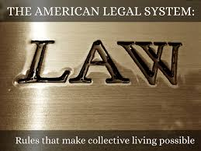
Systems of Law
General Legal System: This is the regular legal system for everyone in the country over the age of 18. It is broken down into criminal law (deals with crimes against people and property) and civil law (contracts between people and are non-criminal). Also known as “administrative law”.

Slide 11
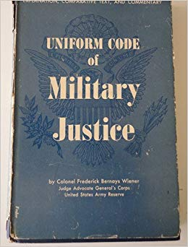
Systems of Law:
Military Law: This is a code of laws that governs people who work in the military. It is a stricter form of laws and justice that for civilians who are not in the military and is often a higher standard of behavior because these people represent our country and as such the importance of following orders and discipline are necessary to keep the country safe.

Slide 12
Systems of Law
Juvenile Justice System: This is a separate justice system for people under the age of 18 in the United States. This is because young people are often less mature than adults and therefore should not be treated the same as adults. It allows the judge to take life situations of a child into account when deciding a sentence for those students who break the law.

