Slide 1
Rule of Law

Slide 2
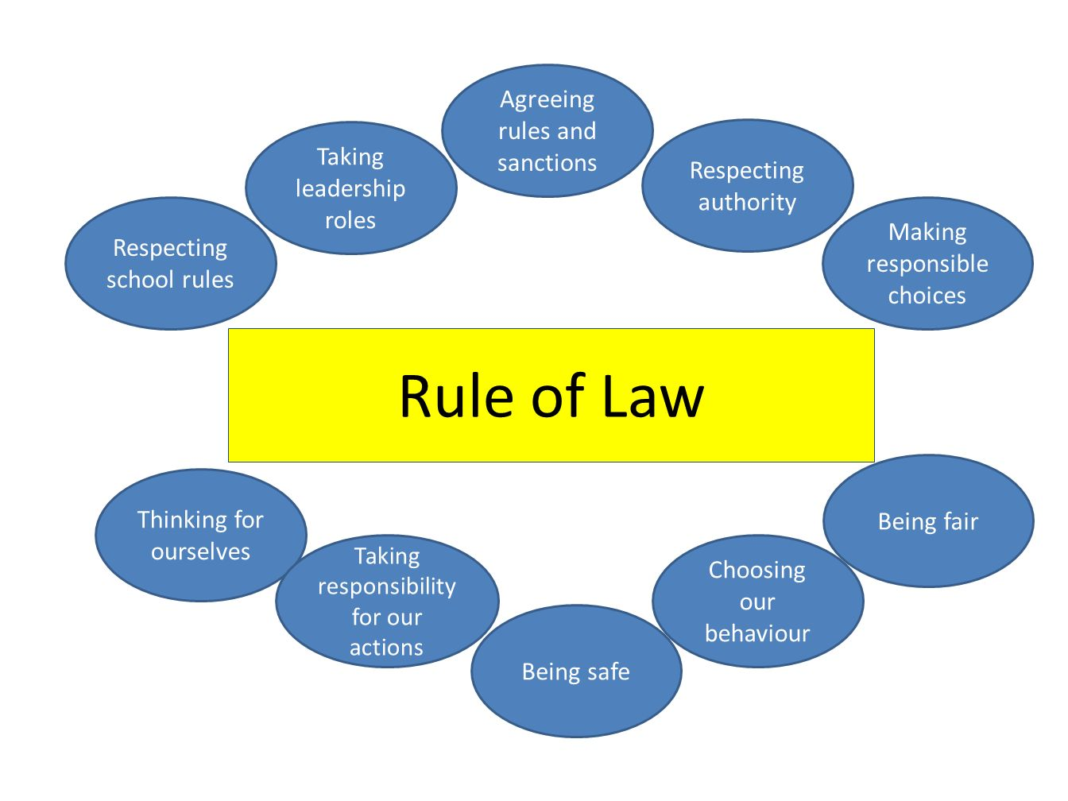
Democracies rely on the Rule of Law
Laws are supreme! This means that no matter who the person is, an ordinary person or a public official, everyone is treated equally under and before the law!

Slide 3
Rule of law promotes a safer society for all!
Having a system of rules that apply equally to everyone, regardless of who the people are or the rolls they occupy, means that people can feel safe and know that they will be treated fairly when there are problems that have to be solved.
Rule of law promotes security.
Rule of law promotes fairness.
Rule of law promotes predictability of behavior through a system of agreed laws that everyone must follow and an agreed system of consequences for not following these laws.

Slide 4
The United States has lots of examples of the rule of law!
The United States constitution
Concept of limited government
Popular Sovereignty
Checks and Balances
Federalism
These are all examples of people following a set of agreed rules so that there can be relative peace and security in our society!!

Slide 5
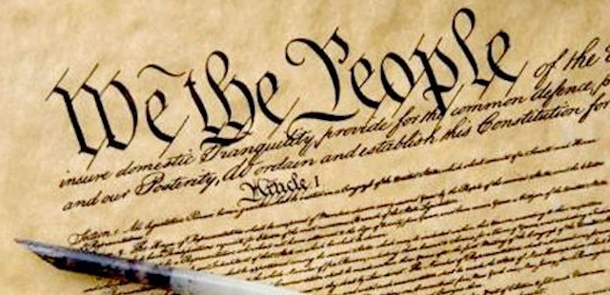
United States Constitution
It is the backbone of society. It is the supreme law of the land. All laws made in the country must conform to this basic set of rules that were agreed to when the country was formed. No matter what the law is, if it is a law on texting and driving…it must be able to stand up to a court challenge (freedom of speech). But if you are texting and driving, you are not respecting the rights of others. This means you may be making the rest of society unsafe. If the courts agree, then a law against texting and driving would stand!

Slide 6
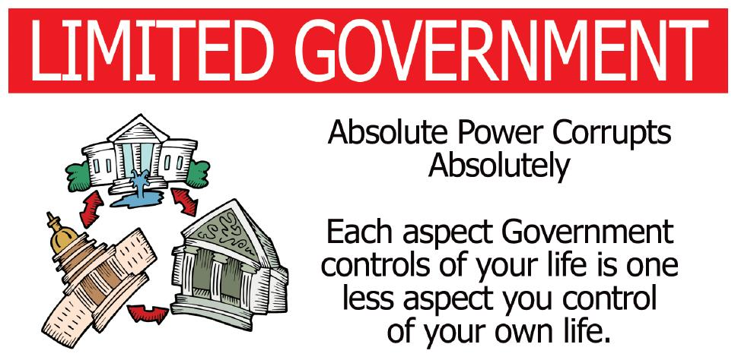
Limited Government
Some people think this means that the government can’t pass laws to tell you what to do. Well it can. However, the idea of limited government actually means that the government does not, and should not, have absolute power over the people. It should only make the kinds of laws that people want, and nothing more.

Slide 7
Popular Sovereignty!
Popular sovereignty means that the people have the ultimate right to rule the county and not an absolute ruler.

Slide 8
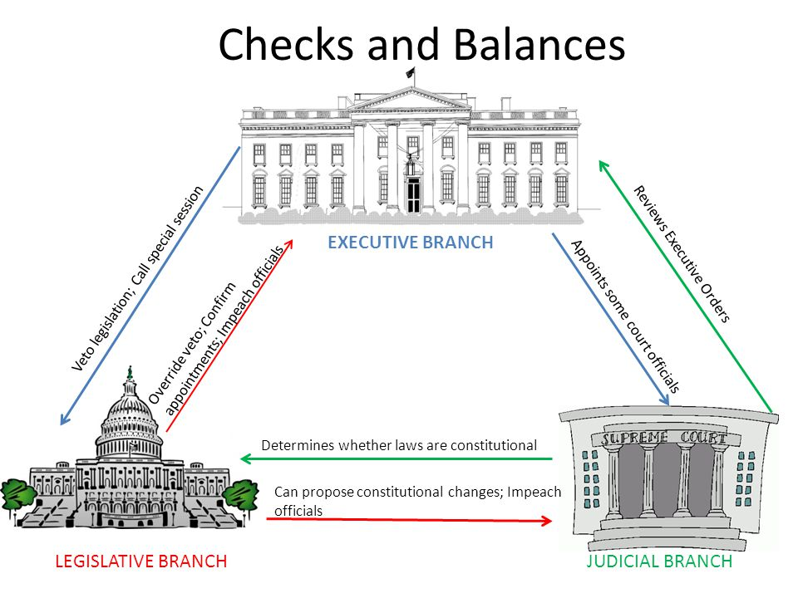
Checks and Balances
Checks and balances are an important part of making sure that people in privileged positions in society, follow the rule of law! When people get a taste of power, sometimes that power can go to their heads, after all, they are human! To try and limit people from abusing their power and no obeying the rule of law, the American system of government built in its own checks and balances so that that everyone in government would play by the rules!

Slide 9
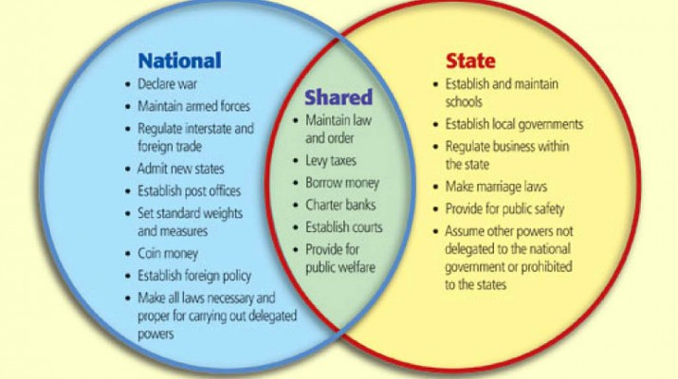
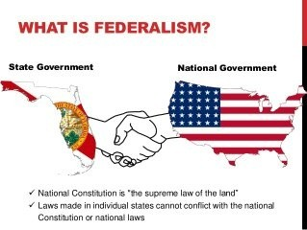
Federalism between the States and Washington DC!
Federalism is another form of the rule of law! It was built into the US constitution. This meant that both the state and federal governments would share powers. This would allow the country to be able to deal with issues related to the defense and welfare of the whole nation, while the states dealt with more local issues of the people in their own respective states. By working together and stating what powers belonged to the federal and state governments, a set of rules were put into place. If there were disagreements, they could be settled by the courts!

Slide 10
The Rule of Law is in everything you do!
Whether you are at home, in the community or at school there are “rules” or laws that you need to follow. Your student code of conduct in one such document of rules that you were given out at the beginning of the school year. It lays out the policies and procedures of students, teachers and administration. Each party has to follow this set of rules or there are consequences that follow for not following the rules. It makes it safer for everyone if people follow rules!
Video on rule of law: https://www.youtube.com/watch?v=DEFB8WBIw5A

