Slide 1
Public Opinion, the Media and Influencing Government

Slide 2
Public Opinion and the Government
You already know that in a democracy, the government is responsible to the needs of the people, or at least, it should be. But how does the government know what the people want? There are a few ways the government, the Congress and the President, find out. Here are just a few ways:
Public Opinion Polls- Everyday there are many different organizations and universities doing research into what is important to the public. Sometimes they will survey a group of people on an issue that the organization feels may be important. When the survey is complete, often they are released for the public to view. These surveys are on everything from gun control whether or not people should eat partially cooked steak! You name it, someone has done a survey on it. This information is then used by politicians to get ideas on what the public cares about.

Slide 3
Pros and Cons of Opinion Polls:
Pros- Some people believe that opinion polls are important because they tell the politicians what people think about certain issues. If the politicians are listening, they can then give the public what they want on a certain issue. This way, public opinion polls can have a direct link to how politicians make their decisions.
Cons- Some people however, believe that politicians will use these polls to tell people what they want to hear during election times and not necessarily do what they want when the election is over. Other people feel that opinion polls cause the public to vote or not to vote at election time. If they think the “other guy” is winning, then some people may just not bother to show up at the polls and cast a vote.

Slide 4
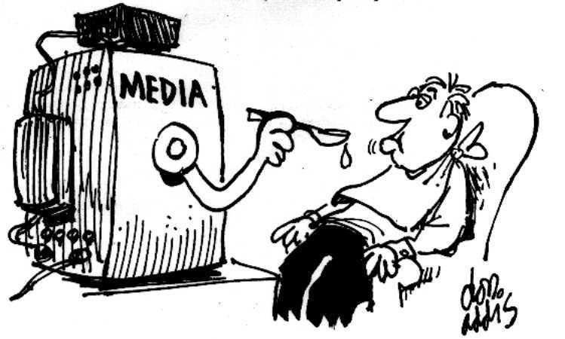
People’s personal Backgrounds and the Media:
Personal Backgrounds of different ethnic groups. America is made up of 310 million people. That’s a lot of different points of view on just about every topic imaginable. It is also from people from very different regions of the country. These people come from different cultural backgrounds and therefore have very different opinions on what is and what is not important to them.
The Mass Media. News organizations control almost everything you hear. Those news organizations are also controlled and owned by private individuals who hold their own views. Therefore, the big media stations have a large influence over what people hear and believe to be true!

Slide 5
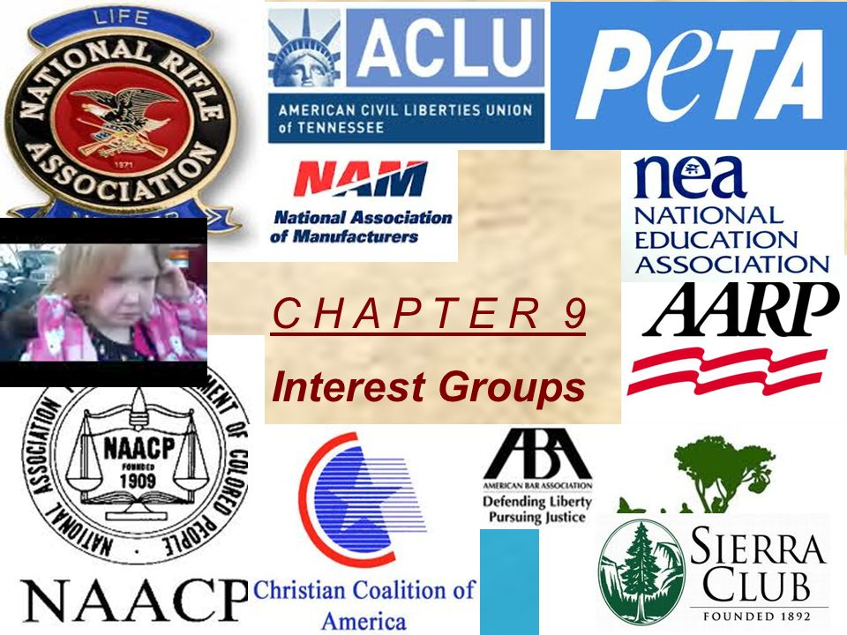
Interest groups and the government:
Interest Groups- Just like people, there are groups of individuals who share a common goal. This goal is to get public officials to listen to them and to pass laws that benefit the group’s interests. These organizations are called interest groups and many of them have a lot of money and are able to influence what the politicians say and do!

Slide 6
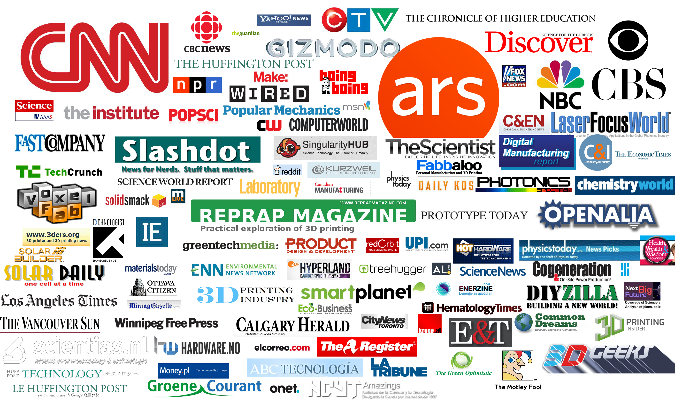
The Government, the Media and You
So as you can see, there are four main ways that politicians get the information they need about what the public is concerned about;
opinion polls,
views of different groups within the population,
the media,
and from interest groups.
However, the most powerful one of them all is the media. With so many different platforms today to get your message out. It can be difficult to determine which one is the best source for news. The best approach is a variety. However, beware that the media does much more than report the news. For many people in the USA, the media brand itself “is the news” and that can be very dangerous for a democracy. Can you think of how this might be true?

Slide 7
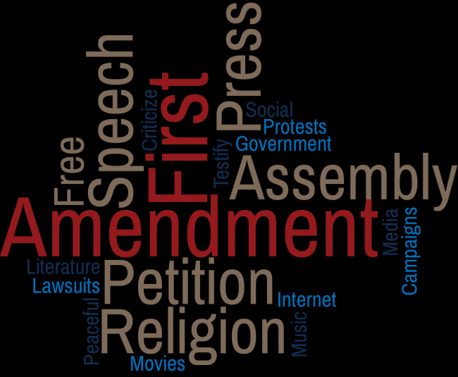
Traditional Media and Democracy
The Media’s traditional role has been that of a watch dog. That means, the media, in a democracy is supposed to be the voice of the people between election times. The media’s traditional role is to find out the true story about what the government is doing on a variety of issues. This would then act as a check on the government and would ensure that political figures would not be able to abuse their power. In America, protecting the media’s traditional roll as a watch dog has been very important. The framers of the constitution even made protecting the press, so important that it became part of the very first amendment to the US Constitution!

Slide 8
Mainstream Media: News “maker”
Today, most of the media outlets are private. That means they need to make a profit. That also means that station managers will decide what topics should make the news and in many cases, what side of the story to tell the viewers. As you can see here, what problems can come from having powerful private media corporations controlling what you hear every day?

Slide 9
Problems with today’s mass media
Profit drives the news. If the news station is private, than making money is the main focus. What makes money? Whatever the people will watch. If it’s terrifying, if it’s violent, or if it’s downright “maddening”, meaning, what you are watching makes you “angry” than people will watch. Eyeballs = profits!
Media bias: Let’s face it, everyone has their own point of view. The media is no different. Some media will be “pro-government” some will be “anti-government”
News maker: Rather than reporting the news, many major private news organizations will report stories or follow certain politicians because those stories and politicians are good for business. This means that media can have a huge impact on who gets elected and what gets reported and vis versa!

Slide 10
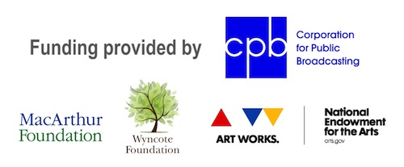
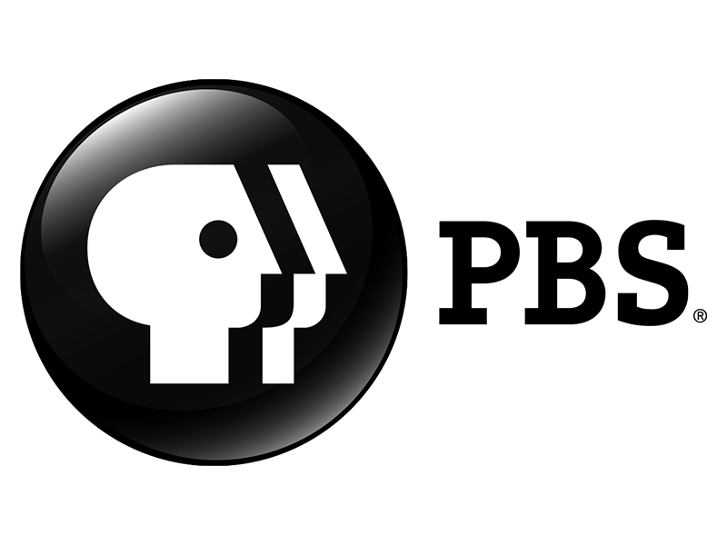
What stations do I watch? What websites do I read? How do I know I’m just getting the news?
Variety- The best approach is watching a variety of news sources. If you know that one station is biased one way, and another station “the other way”…watch them both! Watching both of them may give you the two sides of the story and then you can make up your own mind.
Public Based Media: Public based media are a second best source. The reason, they aren’t controlled by profit. In democratic countries like the United States, legislators brought these stations into being because they serve some form of the public good. They are also charged with giving both sides of an issue, not just one. That means that stories will be more “balanced” and those from private based media.

Slide 11
“Fake News”, Libel, Slander and Protecting the Freedom of the Press
The framers of the constitution saw a need for a free press in a democratic society. They felt that without a watch dog on politicians, society would not remain a democracy! However, with today’s trend of the phrase “fake news”…remember…there are laws against publishing any material that is untrue and which may damage people or company brands. So if you think the news may be false or untrue, remember to ask yourself the question: “has this corporation or company been sued for libel or slander?” If so, consider getting your news from another source.
Libel and Slander Laws: The US government will not and cannot punish people or corporations that publish news stories that are embarrassing or damaging if they are true, only if they are found to be untrue! This allows corporations and individuals the protection they need against people, companies, and government agencies who knowingly publish anything without checking to see if the story is real or “fake”.

Slide 12
Public Sphere, Public Agenda and Public Policy
The public sphere is where people talk about issues. It can be anywhere such as at the local coffee shop or restaurant to the local news media.
Public Agenda is created by the public sphere and it happens when the public largely talks about a few important issues that come up all the time in public discussions. It becomes like a “to do list” such as fixing healthcare or deciding who the next president should be.
Public policy is what happens after the government has heard from all important groups, such as the public itself, interest groups and even what is coming out in the media. Public policy is what the government officially does to deal with a particular issue that the public wants dealth with. Example: fixing healthcare.

