Slide 1
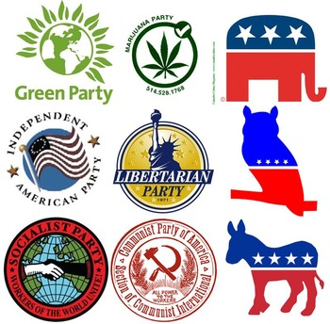
Political Parties and the United States

Slide 2
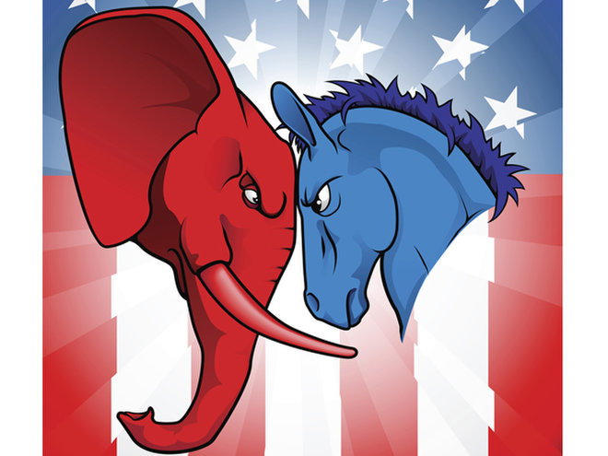
The United States is a two party system!
In the United States, there have been two political parties that have been dominate since the 1860’s, the Republicans and Democrats. There are other parties in the United States, such as the Greens and the Libertarian Parties, but they never get sufficient support to elect any representatives. There are three major reasons for the lack of public support for other political parties:
Money- it can cost as much as tens of millions of dollars to run in a federal or state election campaign in the United States, the kind of money that ordinary people just do not have access to even if they wanted to run for office. It also takes a lot of money to start up and to maintain a political party.
Domination of the political process by the established political parties. Basically, since the Democrats and Republicans have controlled the process since the 1860’s, they have figured out that they can control who gets on the ballot as a candidate in any of the 50 states. With lots of entry requirements, very few third party candidates even bother to run.
Winner take all system. Since all of the elected offices in the USA give total control and votes to the winner, there is no entry point for candidates who win a few votes. They either have to win the most votes or they are not successful at getting into office.

Slide 3
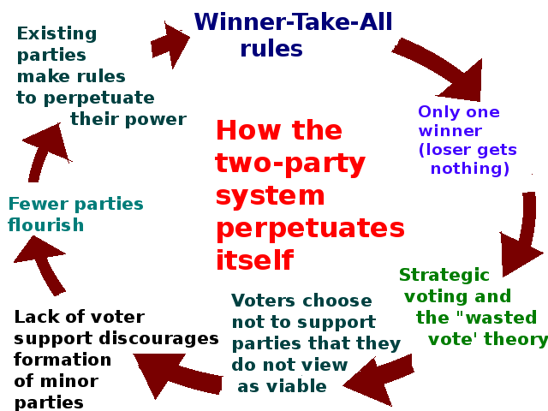
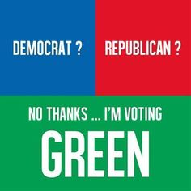
How does the two party system effect democracy?
Lack of alternative points of view. With just two parties, if you don’t care for the message in either of the two dominate political parties, you have nowhere else to go! This makes it difficult for real change to happen unless that change is supported by one of the major political parties.
Lower voter turnout. When people have no where to go but the two main political parties, sometimes this causes them to stay home. New voices and new possibilities for change can encourage people to vote in greater numbers. We saw this when President Obama ran for election in 2008. Even with just two major parties, because people felt like he was offering something different, they came out to vote in greater numbers.
Lower social mobility for those who are economically disadvantaged. Basically, human instinct makes us protect what we have. When political parties know that they have a great chance of forming government, they tend to pass laws which increase their likelihood of staying in power AND which benefit their own people at the expense of everyone else. Not only does this make it difficult for third parties to get into office, our two party system makes it very difficult for real societal change to happen. This makes it especially difficult for the poorest people among us. If people who see little hope of things changing, they stay home at election time. If people stay home, they don’t vote making it even more unlikely that change will occur!

Slide 4
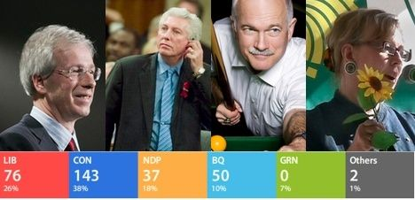
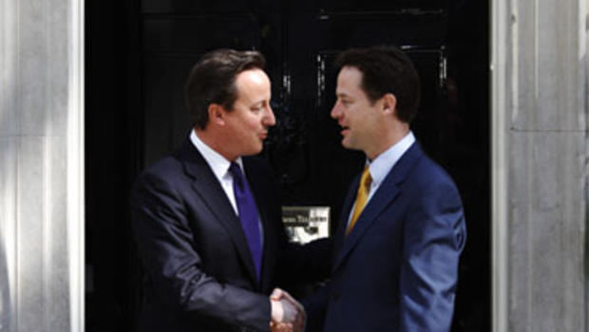
How do most other western countries do it?
Unlike the United States, other western countries have multiparty systems. That means there are at least three major parties that have a real chance at winning power. How do they do it?
Less money needed to run for office. Unlike in the USA where it can take tens of millions of dollars to run for office, in many western countries, you can get on the ballot as a candidate for much less money. It may still cost money to run for the top job but you can be an elected official in the country’s national legislature, but it is considerably less money and so it allows less wealthy people to run for office.
Rules allow for easier access for third parties. In most western countries, there are rules which allow candidates, who receive a small number of votes nationwide, the opportunity to have a few candidates elected to office instead of none. This allows for greater points of view to be represented than in a two party system as is the case in the United States.
Opportunity to share power. In many western countries, political parties sometimes have to share power with other parties in order to make laws and form a stable government. This is called a coalition. This is where political parties must join with other parties to get the necessary majority of seats in the national or state legislature in order to pass new laws. This forces parties to “work together” or risk having another costly election which no one in the country wants.
2011 Canadian election results (top) Notice multiple parties represented in final results.
British election results in a coalition government-this means that more than one political party has to work together to keep he government functioning (bottom picture, 2012)

Slide 5
The role of the Political Party in the lives of Individual Americans.
In many western countries, it is not required that you join a political party to vote for candidates who are running for state or national office. In the United States, however, the political party system is designed to encourage voters join a political party so that they can participate in the political process. What this means is that picking the leader of either of the two main political parties is a big deal in the United States. So much so that it is the first step for any candidate seeking to become the president of the United States. The public gets very involved in this process. This is different than in other western countries where picking a party leader is not done by the general public but by a small group of people who are really interested in the party. Once the leader is chosen, that person then runs in a general election and then the people can decide if they want him or her as the national leader.

Slide 6
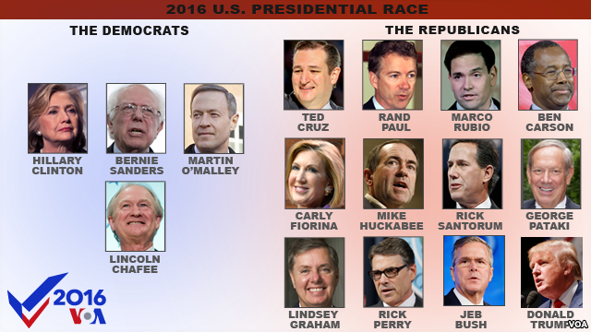
Party Politics in the Lives of Americans
A primary is the first stage of the presidential election process. People who live in “closed primary states” must register as a Republican or a Democrat in order to choose a leader of those parties. In “open primary states,” registered voters can vote for the leader of any of the major parties. Once a leader is chosen by the members of the party, they can then run as a candidate for that party in the presidential election that follows.

Slide 7
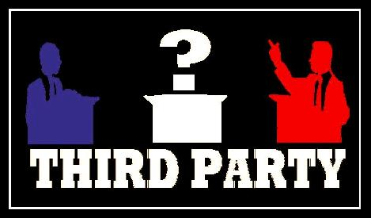
Voting for the “other guys” in the United States
The current political system in the United States encourages people to become a member of a party. This makes it less likely that people will vote for anyone else but their party candidate in the upcoming presidential election. Joining a political party makes it more likely that people will continue to vote for that party for their entire life. In other western countries, people tend to switch and vote in favor of “the other guys” when they get tired of the current party in power!

Slide 8
So how can we make real change in a two party system?
Vote. Change will not happen if you don’t get out and vote. People who vote in elections will typically vote for people who will help them keep things the same. If you don’t vote, your candidate will never win.
Petition Government. Signing a petition or even starting one is the best way to make change. It is less expensive and helps to support laws at the local level, which is where most of the impact on your life happens anyway.
Attend Public meetings. Again, not expensive to show up and have your voice heard. Local events make local changes. So showing up at civic meetings can have a real impact on your community.
Running for local office. The best way to get known is to run locally. It is less expensive and can help you get your foot in the door for elections on a state or national level.

Slide 9
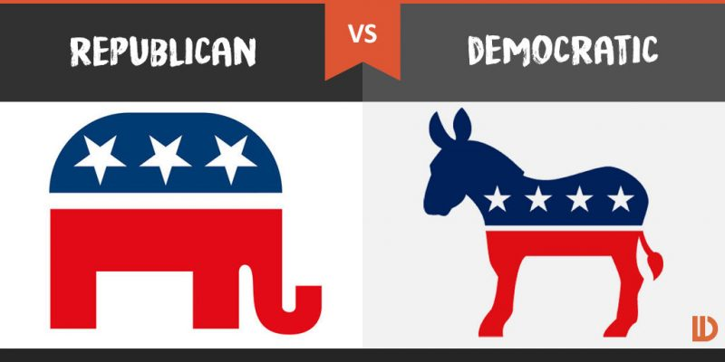
So how do I know which party to vote for?
Your parents will have an influence on you. If your parents vote, they likely vote for one of the major parties. If they have always voted that way, you may be influenced to do the same!
Your experiences and education level will matter. If you feel that society should help provide more opportunities (programs) which help less wealthy people have more chances to be successful in life, you are more likely to vote for the Democratic Party. If you feel that government is bad, and taxes just take money out of YOUR pocket, then you might be more likely to vote for the Republican Party.
Where you live and your ethnic background may matter. Sometimes where you live and the ethnic group that you identify with will impact which party you vote for.
Your current income level and social status. Depending on your situation and the party platform, you will cast a ballot for the party that you think will help make things better for you.

