Slide 1
Other Constitutional Amendments

Slide 2
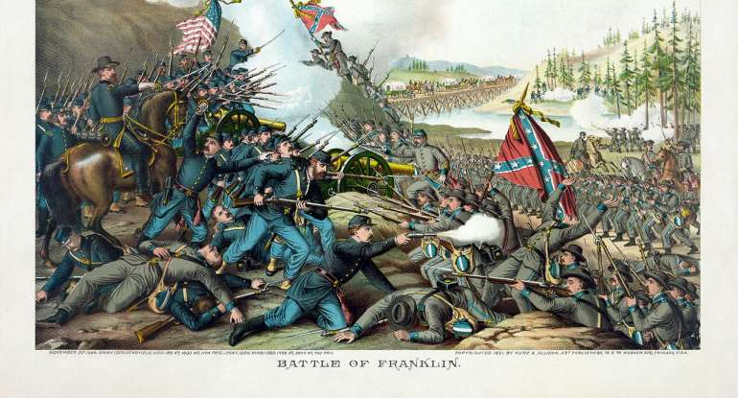
The Anti-Slavery Amendments: 13, 14, 15
Following the defeat of the Confederate States of America during the four year Civil War from 1861 to 1865, America sought to put itself back together as a “united” nation. This would prove to be more difficult than simply passing new changes to the Constitution. Nevertheless, the US Congress managed to pass three very important Amendments which would start to heal a very divided country. These Amendments are often referred to the “anti-slavery” amendments because they sought to give African Americans full citizenship within the United States. No longer could the southern states use African Americans as slaves. However, it would be about another 100 years until African Americans received full voting rights.

Slide 3
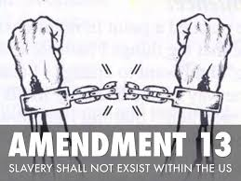
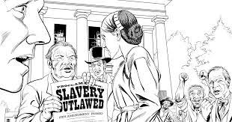
The Thirteenth Amendment
The 13th Amendment abolished slavery. Slaves were an important part of the economic labor of the southern states before and during the Civil War. The 13th Amendment, would change all this. To ensure that the Northern States won the war, the US government encouraged African Americans to fight the Confederacy to help win the war. Upon the conclusion of the war, the US Congress passed the 13th Amendment to the Constitution:
“Neither slavery nor involuntary servitude, except as a punishment for crime whereof the party shall have been duly convicted, shall exist within the United States, or any place subject to their jurisdiction.”

Slide 4
The 14th Amendment: A States Bill of Rights
The 14th Amendment passed Congress in 1868 and became one of the most important Amendments to the US Constitution. This is because this Amendment applied directly to the states. It became known as the “states bill of rights” and forbid states from passing laws that were discriminatory.
“All persons born or naturalized in the United States, and subject to the jurisdiction thereof, are citizens of the United States and of the State wherein they reside. No State shall make or enforce any law which shall abridge the privileges or immunities of citizens of the United States; nor shall any State deprive any person of life, liberty, or property, without due process of law; nor deny to any person within its jurisdiction the equal protection of the laws.”

Slide 5
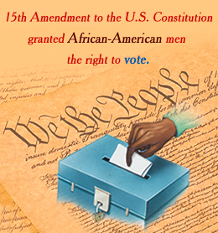
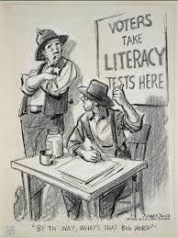
The 15th Amendment
The 15th Amendment was the last of the reconstruction amendments that was passed by Congress in 1870. It forbid Congress from disallowing any US citizens from being able to vote regardless of race. However, many states would come up with unique ways to try and take away a citizens right to vote. One of these ways was to introduce literacy tests prior to voting. Since many African Americans were illiterate, they were not able to pass the literacy test and therefore could not vote. It would not be until the Voting Rights Act of 1965, did African Americans finally get the right to vote.

Slide 6
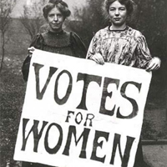
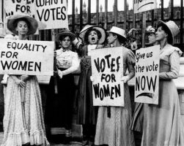
19th Amendment: Women Receive the right to Vote
On August 18th, 1920, Congress adopted the 19th Amendment to the US Constitution. It effectively ensured that all persons, regardless of their gender, would have the right to vote.

Slide 7
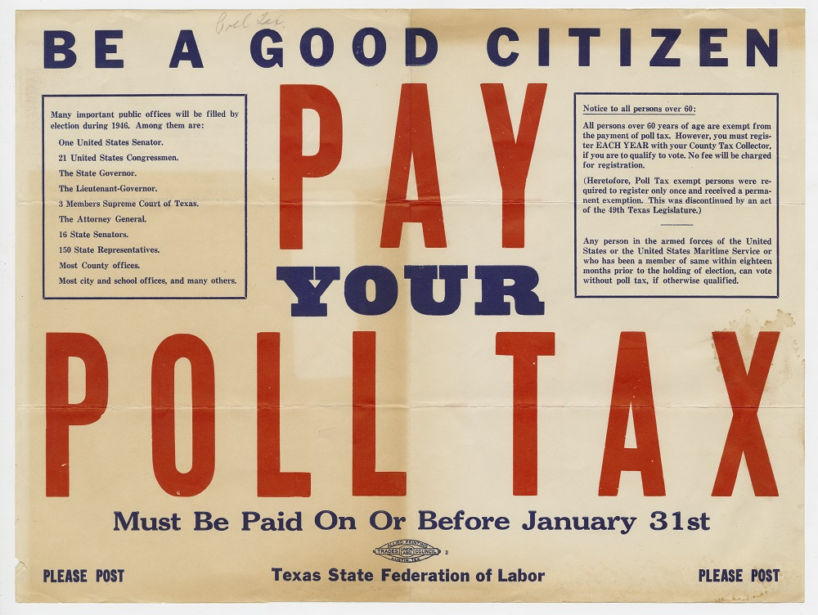
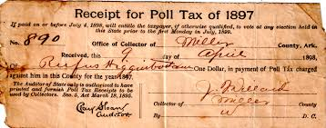
24th Amendment: End of the Poll Tax
Until the 1960’s, five states in the United States still had a poll tax. This tax was money that was to be paid in order for some people, the poor and non-white persons, to be able to vote. The 24th Amendment ended this practice. It allowed all US citizens to be able to vote in any election for local, state, and federal elections.

