Slide 1
Duties and Responsibilities of Citizens

Slide 2
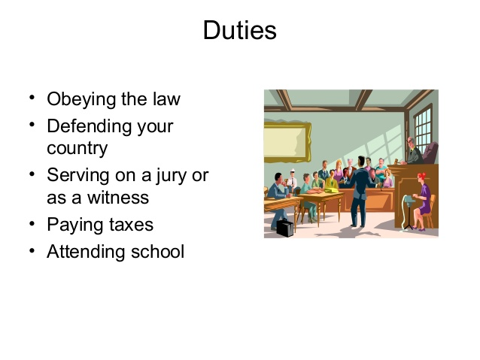
Duties (Obligations) of American citizens!
A duty is something we “must” do. It is not a choice. It is not an option. The duties of all American citizens include the following:
Obey the laws. This includes ordinary people and those who hold public office. The idea here is simple: in a democracy, no one is above the rule of law.
Pay taxes. Taxes provide much of the money needed to provide public services, such as libraries, schools, old age security, many emergency services as well as funding for the military. Although there are arguments for and against the need to pay taxes, it is a duty of all American citizens and permanent residents.
Defending the Nation. If required, all US citizens between the ages of 18 and 25 may be called upon to defend the nation, if it is attacked. There is no compulsory military service for US citizens but 25 other countries around the world require their citizens to take military training. These include many European and Asian countries.
Serve in Court. If summoned, you must serve as a juror in a jury trial.
Attend school. Attending school is mandatory from the ages of 7 to 16 in the United States. Schooling is necessary for people to have the skills needed to be able to seek employment once they reach the age of 18.

Slide 3
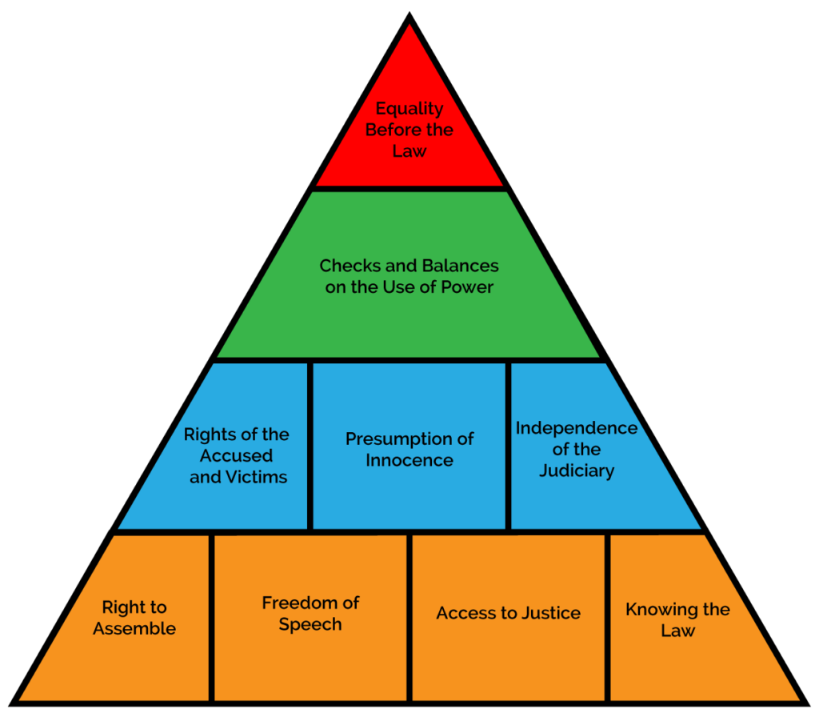
Everyone must obey the law!
In-order to have a democracy, all people living in that society, whether you are a citizen or not, must obey the laws. This includes: citizens, permanent residents and non-resident aliens or visitors to the United States.
Public officials also must obey the laws. The idea here is that “law” not the individual, is “supreme”. Therefore, everyone is “equal” under the law! Laws allow everyone to live in peace and have some predictability of what others can and cannot do in their communities.

Slide 4
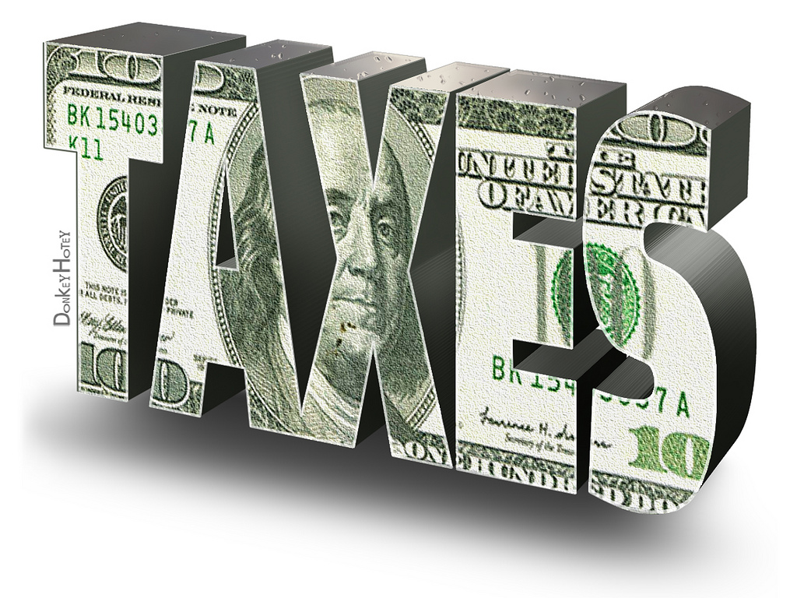
Paying Taxes is your duty!
Taxes is an important part of making sure that governments can pay for the services that everyone wants but can’t afford to pay for by themselves. Example, schools and paving roads. People pay payroll and property tax (money) to ensure that everyone gets necessary government services. Two schools of thought here:
Taxes take money out of people’s pockets. Thereby lessening the money they have to pay for everyday things. Makes it harder for employers to hirer new employees because owners need to pay more out of their own pockets. Therefore there is less money to hire new staff.
Paying a little more in taxes means more people get the services they need! Spreading out the wealth, by asking people pay a little more, means that more people get services, such as pensions, medi-care and education. Without taxes, people would be paying a lot more for these services when they need them. So the bottom line is, either everyone pays a little or some people pay a lot.
You decide if paying more or less taxes is better or worse for American society?

Slide 5
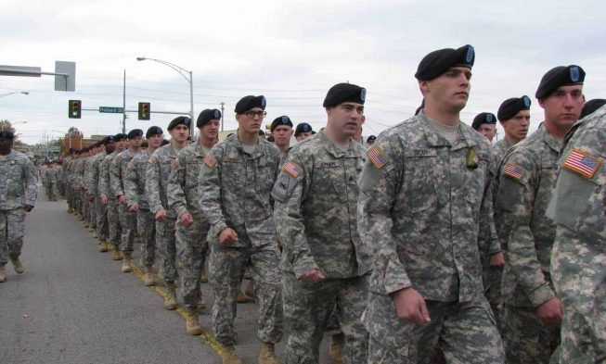
Defend the Nation
Every male citizen of the United States must, at the age of 18, register with the Selective Service System within 30 days of their 18th birthday. This does not mean that you must serve in the military for a select period of time. However, it does mean that you have the duty to serve should the nation ask you to do so. The last time that citizens were called up to serve was in 1973. Most of the time, thousands of volunteers have joined up and due to this, there has not been a required draft by the US military. However, it is always a possibility and if called, you must serve.

Slide 6
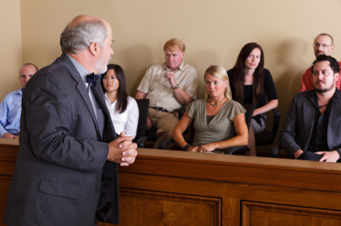
Serve in Court
All adult citizens may be required to serve on a jury. With the possible exceptions due to medical or financial hardship, and only with the permission of a judge, every adult citizen is required to serve on a jury if called to do so.

Slide 7
Attend School
Every citizen and permeant resident that is living in the United States is required to attend school between the ages of 7 and 16 years of age. There is no requirement to attend school beyond this age. However, it is required so that you have the skills and knowledge necessary to get a job and be a productive member of your community.

Slide 8
Responsibilities of American citizens!
Responsibilities are not the same as duties. Responsibilities are things you should do but are not required to do! These responsibilities include:
Be an informed citizen! You have a responsibility to know what your government is doing. That way you can make a choice on what it should do, and thereby allowing you to have a say!
Voting and becoming politically engaged in your community. Voting allows you to have a say in what the government is doing that affects your life. Similarly, running for public office allows you the best chance at making changes to improve the lives of people in your community.
Respecting the rights of others! Your opinions and beliefs may be different from others but that’s ok. This an important value of being an American.
Contribute to the Common Good. We live in a community with other people. If you don’t really care about that, then you are not contributing to the common good. You can contribute by volunteering your time. The goal here is to improve community well-being, have good schools, safe streets and build social cohesion by caring about and helping to solve socitial problems, such as homelessness.

Slide 9
You have the responsibility to be informed!
In order to make good decisions about who should run the country and about who should be elected to office, you have a responsibility to be as informed as is possible. You can do this by continuing to go to school, joining community organizations, and by being politically and socially active. Watching the news from a variety of news sources, travelling if you can to other countries, helps you to gain a point of view that is globally based. That way, you can take new ideas into your community with the goal of making it better. Always seek to improve yourself and have an open mind to “different” ideas!

Slide 10
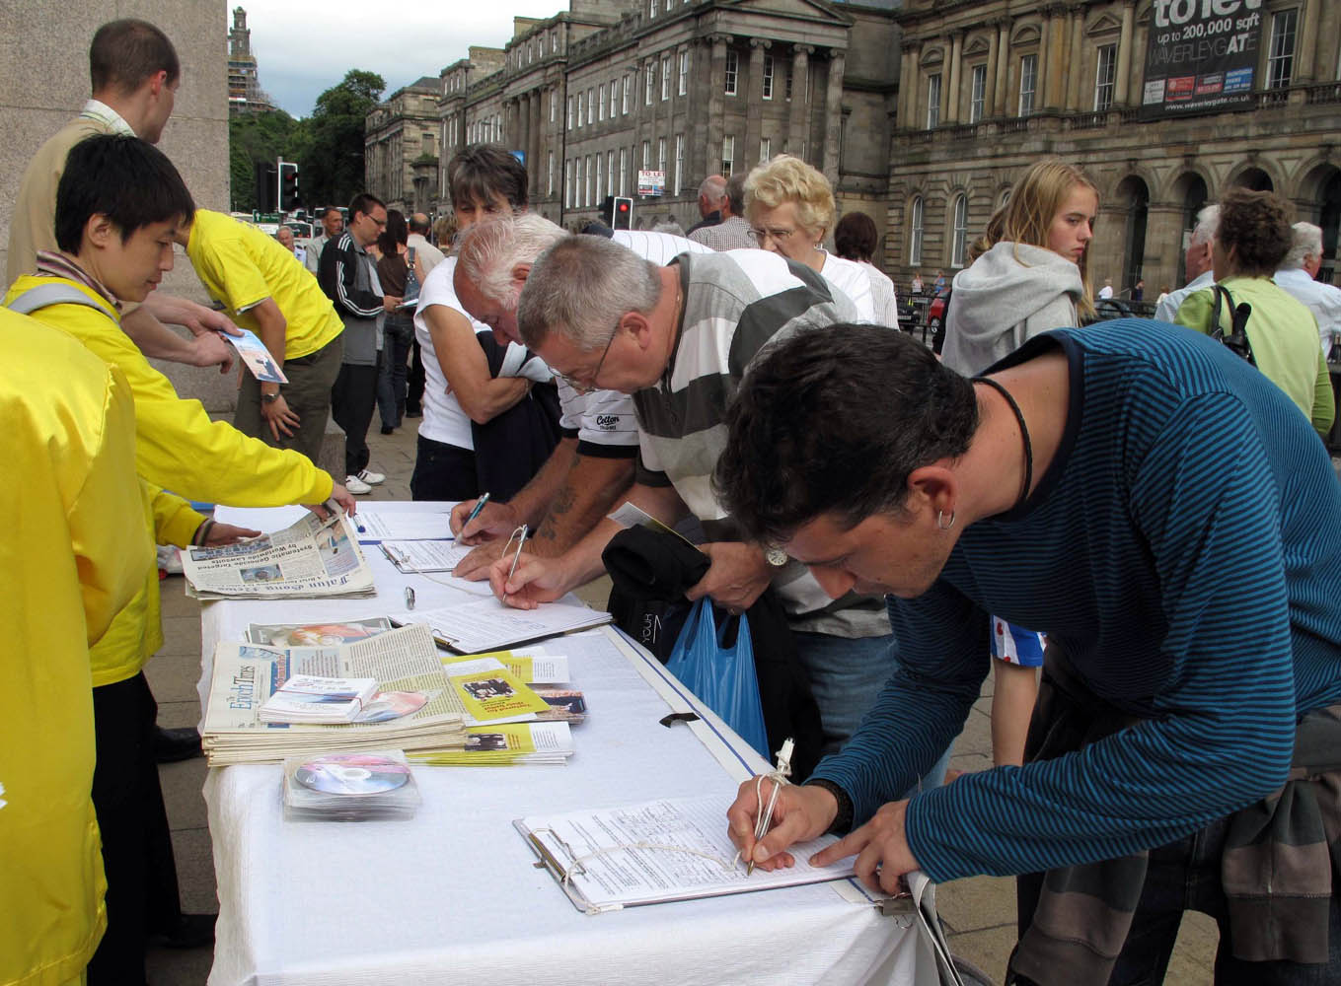
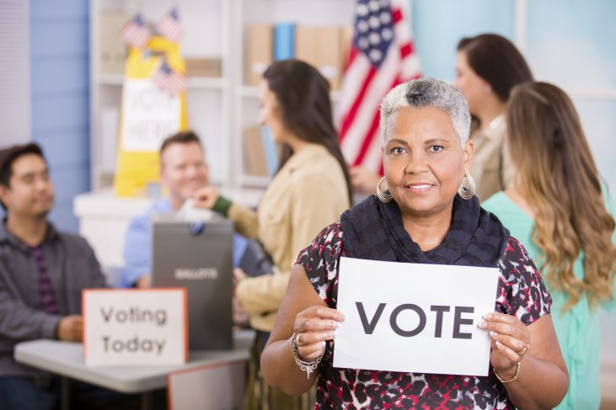
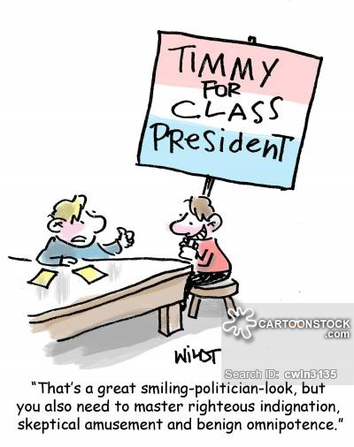
Voting and Being Politically engaged!
Voting in Elections, signing petitions, attending public/civic meetings and running for office are all excellent ways to be politically engaged in your community. You should want to participate in some way to make things better for you and others. If you don’t, then in a sense, you don’t have the right to complain when things happen that you don’t really agree with.

Slide 11
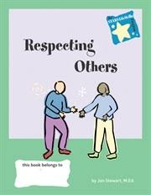
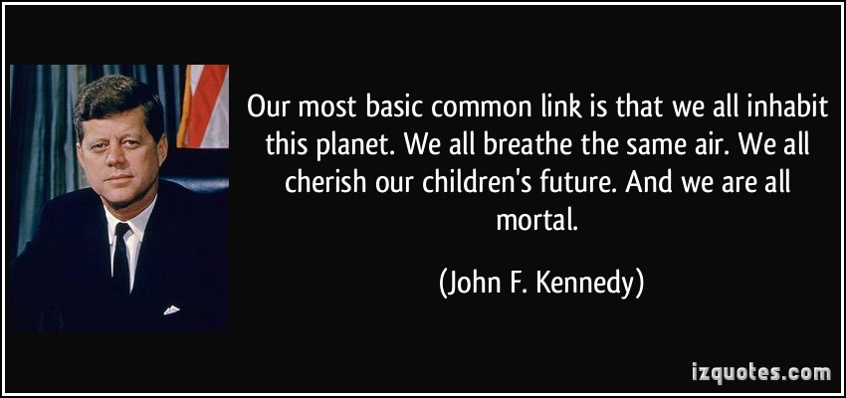
Respecting the rights of others!
Individual rights and freedoms are not really absolute! In order to have a society that functions well, we need to remember that we have to respect the rights of others. Have an open mind, even if you do not agree with someone’s point of view, they have a right to have it, as you have a right to have yours.

Slide 12
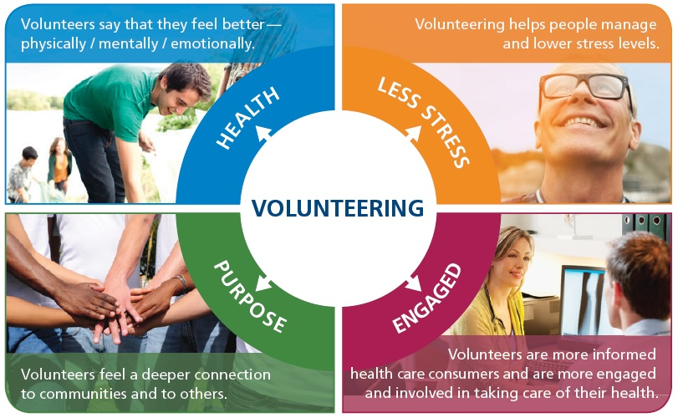
Contributing to the Common Good builds Social Cohesion
An important part of being an American means that people should contribute their time, effort and if possible, their money to help make the community they live in, a better place to be. Like voting, community service allows everyone to feel like the people in the community care about one another. The more we care, the stronger our community bonds become.

Slide 13
Things to Consider….
What was the lasting impact of the American Revolution on how Americans view their own government?
What is the purpose of government? Is it good or is it something we just have to live with? (A necessary evil)
How does the perception of government influence how people vote, chose to obey or disobey laws..etc?
How can understanding the benefits of living in a democracy, and becoming politically engaged, change our opinions on government and out overall outlook on life?

