Slide 1
Legislative Branch of the Federal Government

Slide 2
The US Congress
The place where US representatives go to debate issues and pass laws is called the Congress
Two houses- the House of Representatives and the Senate.
Each house has the power to pass laws but each house also has its own set of unique powers. The reason for this is to make sure no politician or group of politicians can have too much power over the government. (checks and balances)
Unique fact-The US Congress is the only legislature in the world that has the power to govern and pass laws all by itself, without the need for a national leader. Example; a president or a prime minister.
Only the congress can pass laws at the federal government level.
Congress can only pass laws of national importance, such as international trade and defense of the nation and making money. All other powers, not given to the Congress by the constitution, are give to the states.
Only the Congress can declare war on another country.

Slide 3
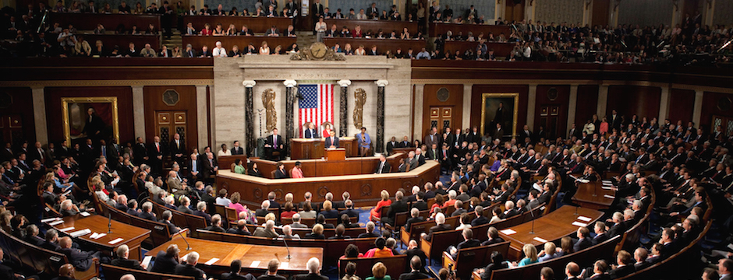
The House of Representatives
This is the peoples house. There is approximately 454 members in this chamber, each member represents at least one community or precinct within the United States. The amount of representatives from each state depends on the population in that state. As the population increases or decrease, so does the number of representatives for that state.
All money bills (taxes) must start in the House of Representatives
The leader of the House is called the Speaker. He or she is the head of the political party that won the most seats in the last US election.
House members sit for 2 year terms
You must be 25 years of age and a US citizen for at least seven years prior to your election win.
The House of Representatives is the only chamber that can lay charges against a sitting president for high crimes and misdemeanors.

Slide 4
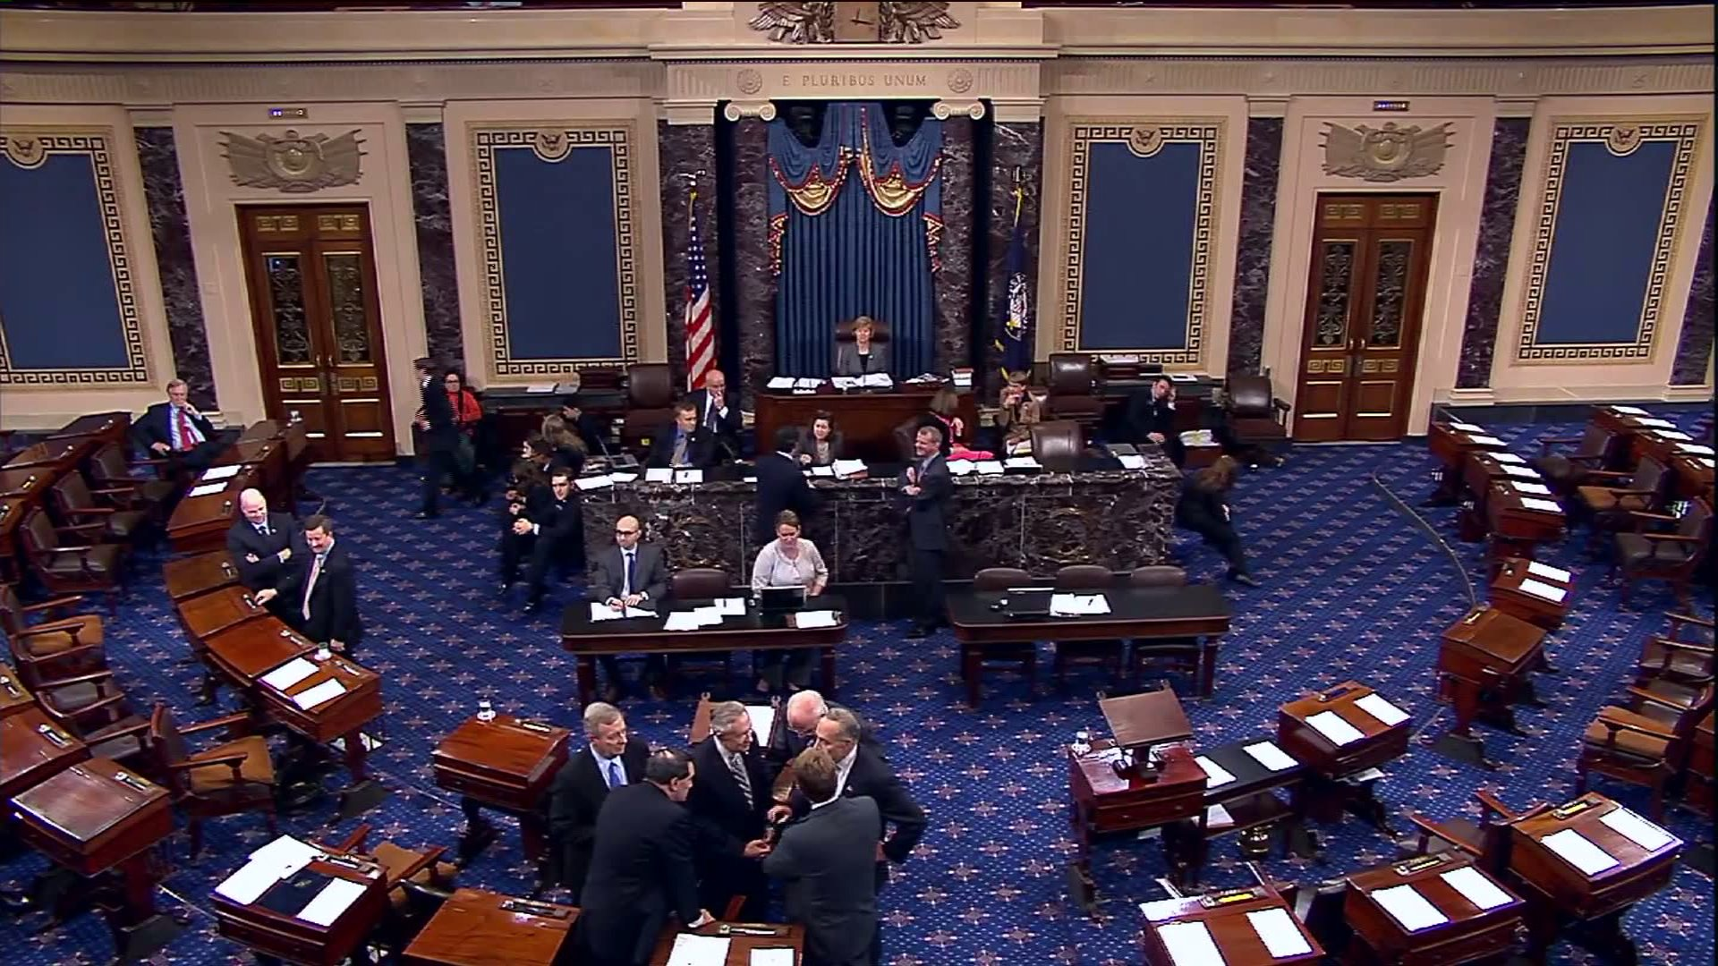
The US Senate
There are 100 senators, 2 from each state.
The senate has the right to approve or reject all official appointments by the president.
The senate may debate, make changes to, and pass any laws that are also passed by the House of Representatives. However, the Senate cannot initiate any new money bills (taxes).
The Senate must hold a trial if any charges are laid by the House of Representatives of a sitting US president.
Senators must be at least 30 years old and be nine years a citizen at the time of their election. Senators sit for 6 year terms and are elected on a staggering basis every two years.

Slide 5
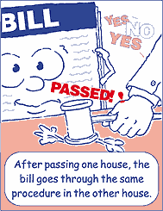
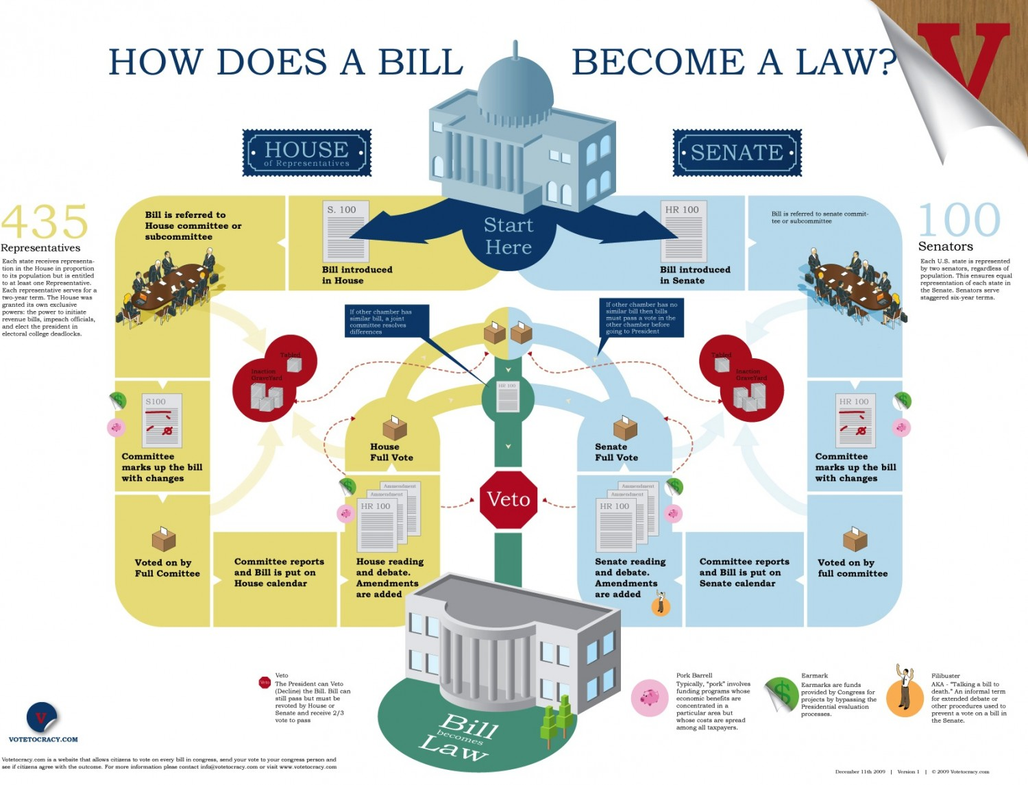
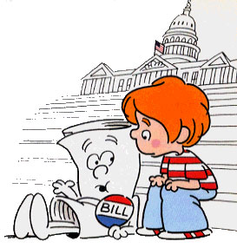
Passing Laws
All proposed laws can start in either the House or Senate, with the exception of taxes. These bills must start in the House.
All proposed laws are called bills. They must pass each house by a simple majority (50% plus 1).
Once a bill has passed both houses, it must be sent to the president who has 10 days to sign or veto the bill. If not signed, the bill will become law after that time. If it is vetoed, the bill will go back to Congress. If the Congress wants to pass the bill as is, it now must have a 2/3 majority (68%) of the members present. If not, the bill will not become law unless it is signed by the president.

Slide 6
Check on the president and the Supreme Court.
The Congress can act as a check on the president by overriding any presidential veto of bills that the Congress wants to become law. Although it is quite rare, it has happened many times in US history.
Only the Congress, through the Senate, has the power to approve any presidential nominations for public office.
Though the president is commander and chief of the military, the Congress is the only branch of government that can declare war and can approve or deny money needed for the military to function.
The Congress can amend the powers of the court, other than those granted by the constitution and can change the number of judges that sit on the court.

