Slide 1
Impact of Constitutional Amendments in Landmark Cases in the USA

Slide 2
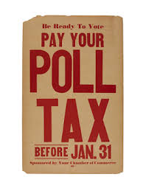
Anti Slavery Amendments
Amendments 13, 14 and 15 extended voting rights and citizenship to all African Americans who were once considered slaves following the end of the Civil War. Some states would try and pass laws that would restrict or take away the rights of many African Americans and more amendments were needed to ensure their rights were protected.

Slide 3
Extending Voting Rights
The 19th, 24 and 26th Amendments extended the rights to women, African Americans and to those 18 years of age and older. These amendments allowed more people to be able to vote. However, not all change to voting rights were done by amendments.
The Voting Rights Acts of 1964 and 1965 banned discrimination by local, state and federal government officials when it came to voting and other aspects of social life, such as in employment. It also eliminated the literacy tests!

Slide 4
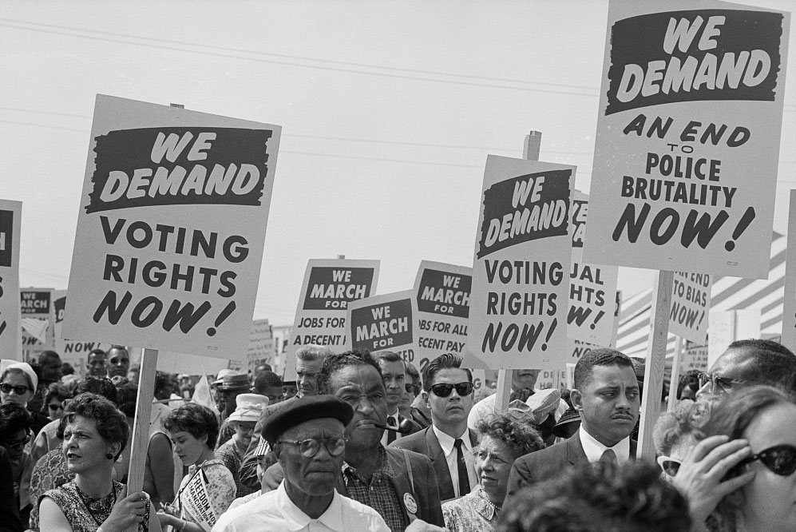
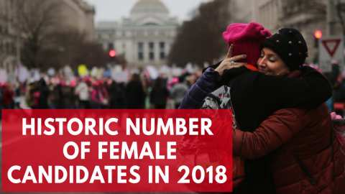
How Amendments affected Political Participation?
Changes to the constitution did change society. But it took a long time for people to accept these changes. The 15th Amendment gave the right of African Americans to vote but it did not say how they were able to vote. This mean that states could and did discriminate who could vote. This lead to protests and violence in the streets until the country did what was right!
Changes to laws allowed more people to vote and run for office than ever before!

Slide 5
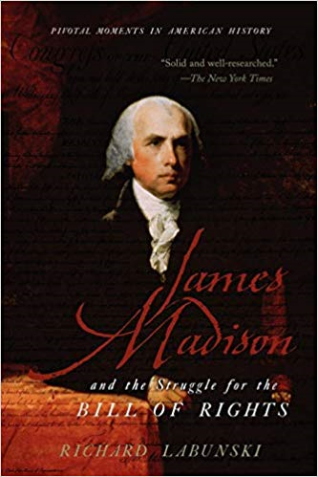
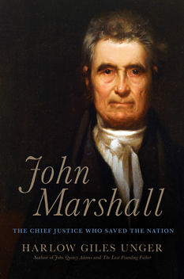
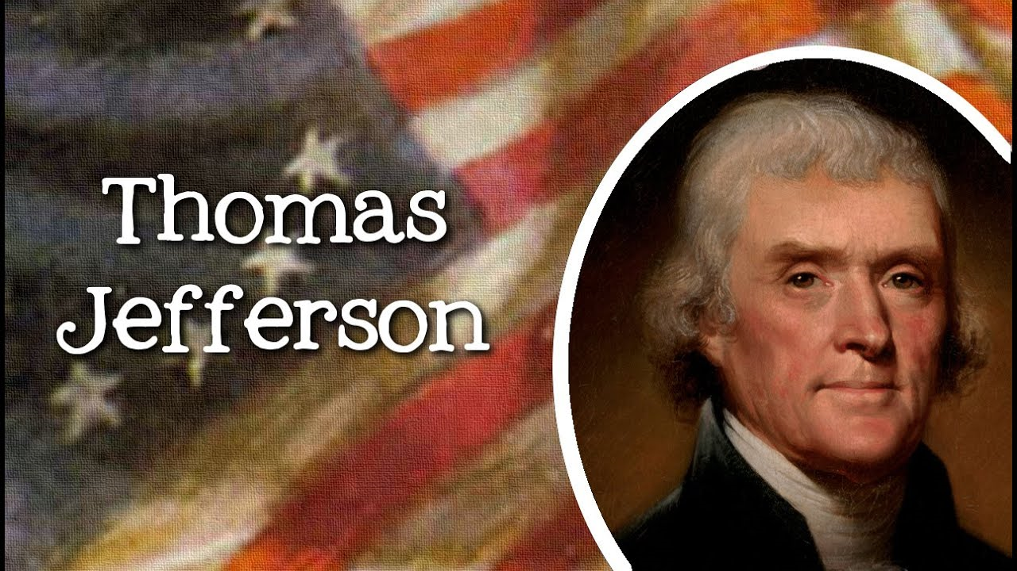
Famous Cases: Marbury Vs. Madison 1803
An important supreme court case that established forevermore that the Supreme Court had the right to declare laws unconstitutional. In this specific case, Secretary of State James Madison refused to issue a signed court appointment by former president, John Adams. He refused because, the new president, Thomas Jefferson, did not want Adams supports on the court. The refusal by Madison to issue the confirmed appointment, was illegal and therefore not constitutional.

Slide 6
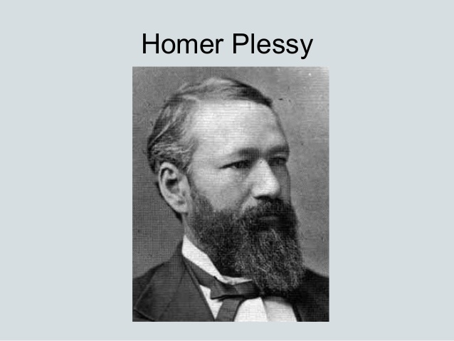
Famous Cases: Plessy vs. Ferguson 1896
This is a famous court case that ruled that “separate but equal” facilities (train cars) did not discriminate on the basis of race because the constitution only addresses legal discrimination, not social discrimination. As long as the “facilities were equal”, they were allowed to be “separate”. Years later, the decision in this case was overturned in Brown vs. Board saying that “separate but equal” facilities was a violation of the 14th Amendment because it treated blacks differently than whites. Therefore, the case violates the constitution.

Slide 7
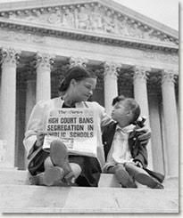
Famous Case: Brown v. Board of Education
The Plessy vs. Ferguson case was virtually overturned in this case. This is an example of case made law. Basically, in 1954, the Brown family sued the school board in their state because they said their school (for blacks) was not good quality and therefore was discriminatory because it was “unequal” to that of whites. The case when to the Supreme Court of the Untied States and the court agreed. This lead to the Civil Rights Acts of 1964 and 65. The case was discriminatory and violated the 14th Amendment.

Slide 8
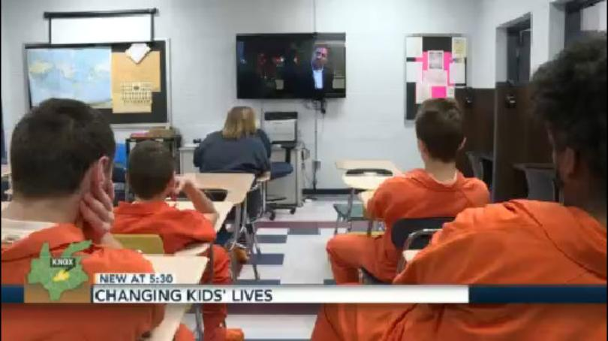
Famous Case: Gerald Gault Vs. United States
Gault was a young offender. He was accused of committing a crime but the court in his state said that he did not have the right to due process and was sentenced to 6 years in reform school. He sued and took his case to the Supreme Court of the United States. The Supreme Court of the United States said that his due process rights were violated under the 5th Amendment and said that the constitution was not just for adults, but minors as well!

Slide 9
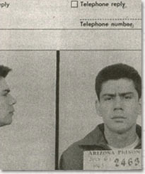
Miranda vs. Arizona-1966
In Maranda vs. Arizona, Ernesto Miranda was charged with kidnapping and rape of an 18 year old woman. When he was later arrested, police interrogated Miranda for two hours before getting him to write a signed confession to the crimes. When the case went to court, Miranda was found guilty and sentenced to 20+ years in jail. However, the case was appealed to the Arizona Supreme Court which ruled that Miranda was not told of his right to remain silent and therefore his fifth amendment rights were violeted. The case was thrown out! From now on, police were obligated to inform people of their rights before questioning!

Slide 10
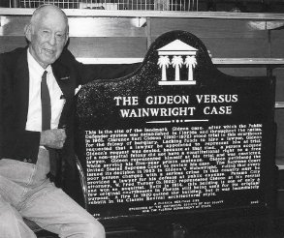
Gideon vs. Wainwright 1963
Clearance Gideon was force to represent himself in court after he was charged with several minor crimes, including break and enters. He went to court and was unable to afford a lawyer. The court refused to appoint one because the law indicated that lawyers were for federal capital cases and not for minor crimes. After he was found guilty, he appealed his case. The court said that his right to a fair and speedy trial was violated because he did not have a lawyer. From now on people charge with crimes would need to be appointed with a lawyer by the state.

