Slide 1
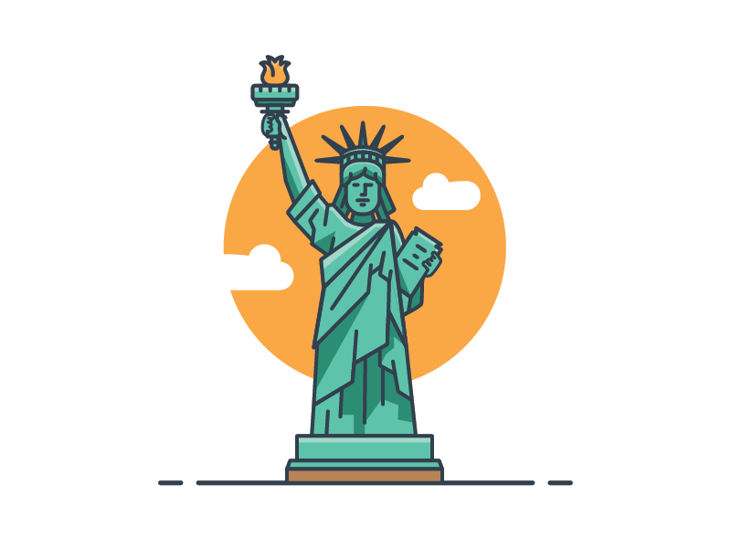
C.3.6 – IMPACT OF CONSTITUTIONAL RIGHTS
SS.7.C.3.6 – Evaluate constitutional rights and their impact on individuals and society.

Slide 2
EXAM PRACTICE #1
Why does the U.S. Supreme Court continue to debate states’ rights?
Because the Constitution can be amended
Because the Constitution allows judicial review
States’ rights are not mentioned in the Preamble.
States’ rights are not enumerated in the Bill of Rights.

Slide 3
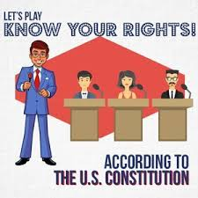
A LOOK AT THE BILL OF RIGHTS:
Which rights are about personal freedoms?
Which rights are related to those accused of crimes?
Which rights are focused on preventing the gov. from abusing power?

Slide 4
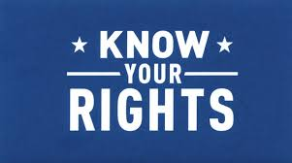
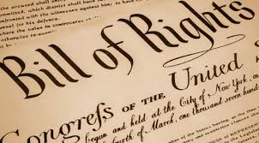

Slide 5
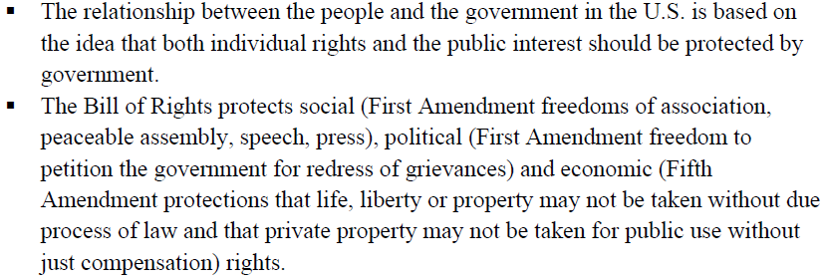
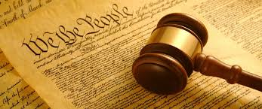

Slide 6
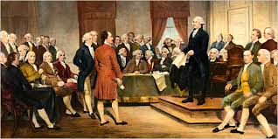

Slide 7
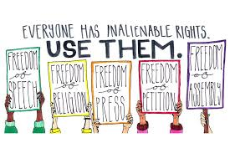
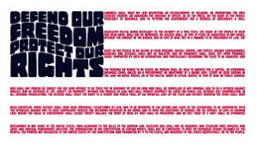

Slide 8
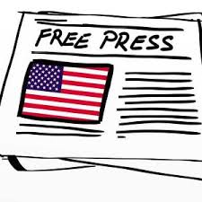
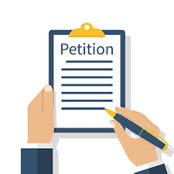

Slide 9
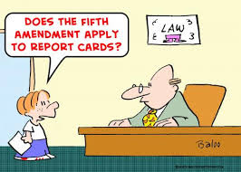
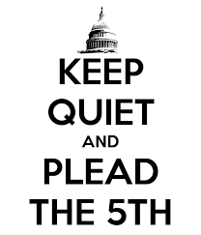
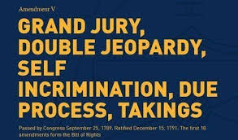

Slide 10
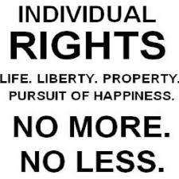
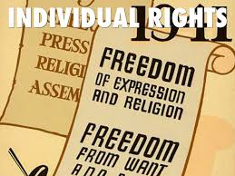
REMEMBER:
individual rights shape involvement in social, political, and economic systems…which are dependent upon individual rights.

Slide 11
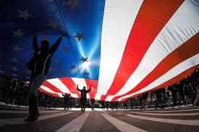
There is a delicate balance between a government protecting the rights of the individual & protecting society.
We will look at 3 cases in US history in which this balance was challenged.

Slide 12
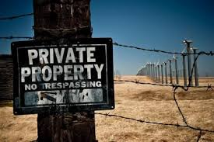
CASE STUDY 1: PROPERTY RIGHTS
Highlight key points in each definition.
Summarize the meaning in your words.

Slide 13
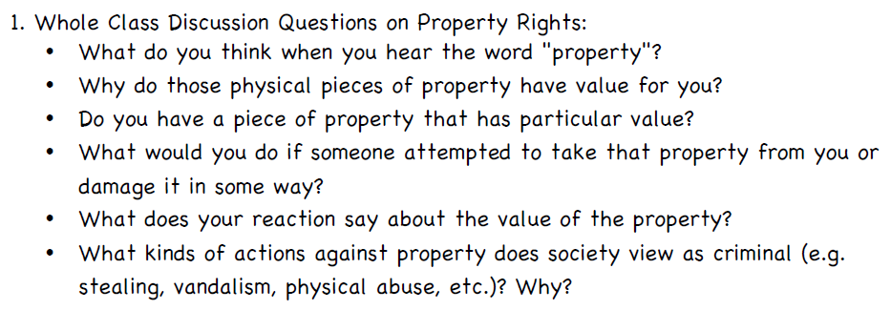

Slide 14
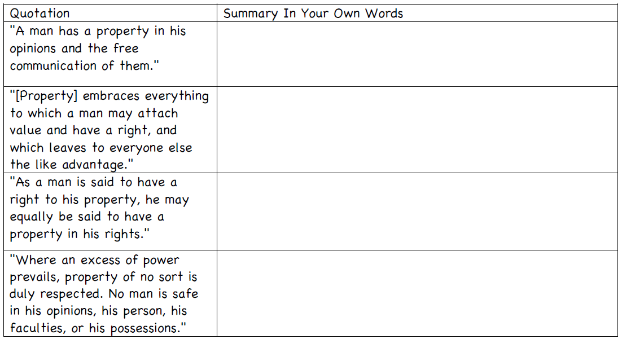
A man owns his opinions and has freedom in sharing them.
Everyone has the right to own property.
People have a right to property and personal freedom.
When there is tyranny (abuse of power), rights are infringed upon (taken away).

Slide 15
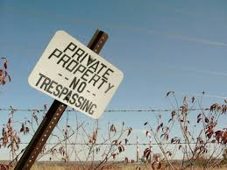
Gov’t was formed to protect the rights of people & property.

Slide 16
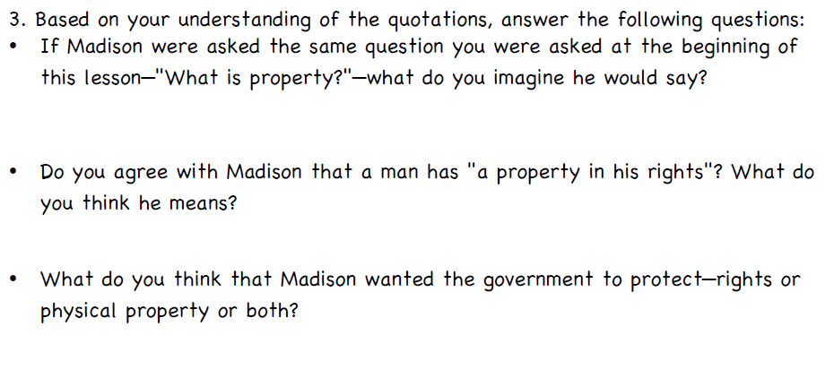
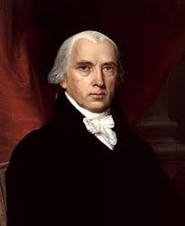
Property is man’s opinions & whatever else he values.
Madison is saying that a man owns his rights.
Both

Slide 17
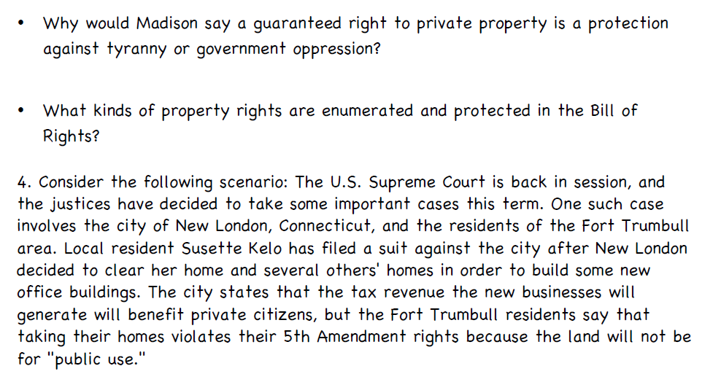
By protecting the right to private property, gov is respects individual rights
5th Amendment protections – due process & eminent domain

Slide 18
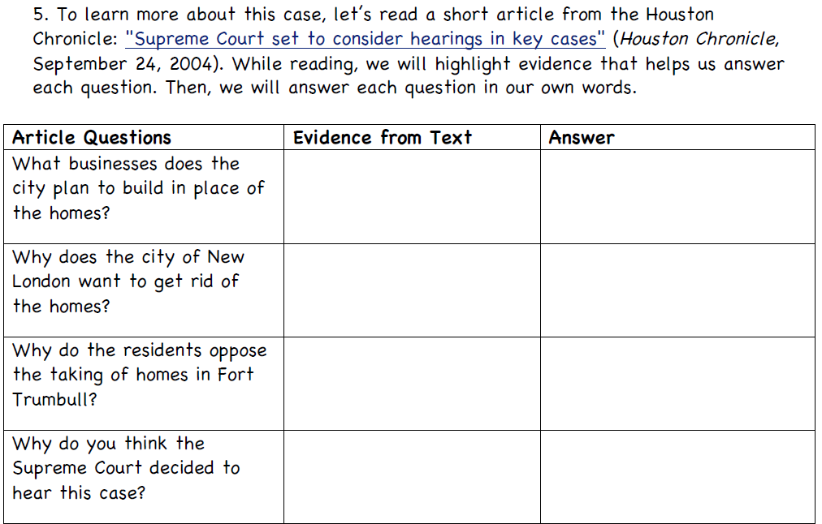
…changing the neighborhood into trendy condos…
city can take land b/c they promise to pay more taxes & create jobs
People are upset at the idea that the gov’t is too powerful
the term “public use” is in question

Slide 19
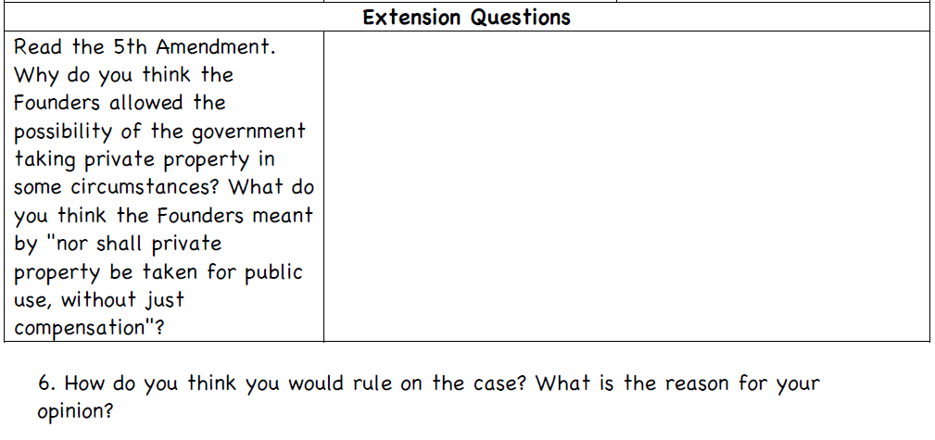
The needs of the public may change & this gives the gov flexibility. To take private property, they must provide fair payment (just compensation).

Slide 20
The court ruled in favor of New London b/c of the city’s economic development plan (not just for the benefit of a small group).

Slide 21
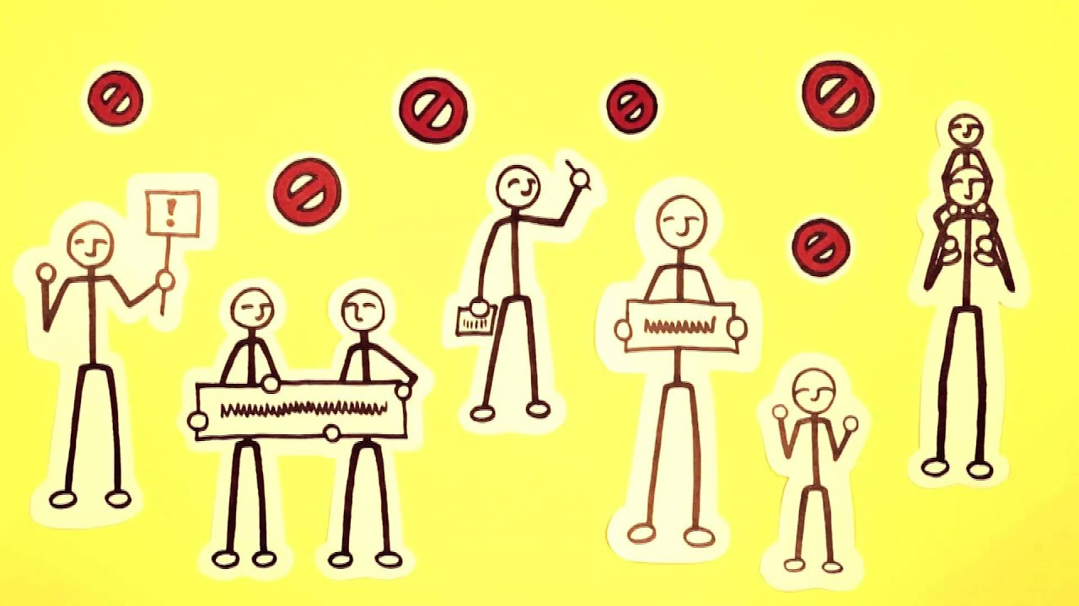

Slide 22
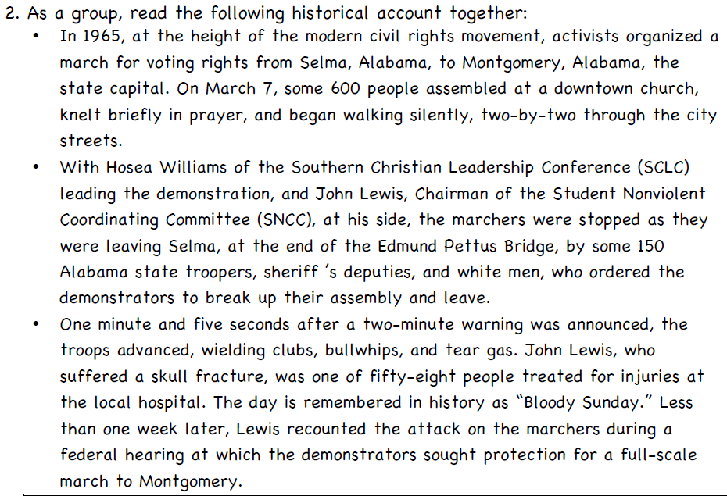
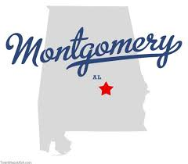
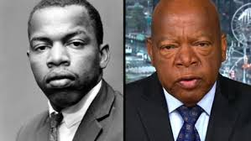

Slide 23
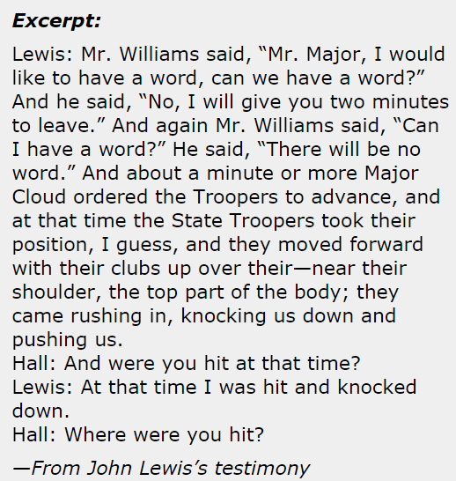
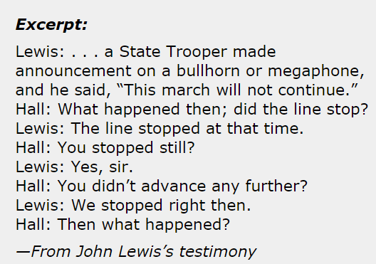
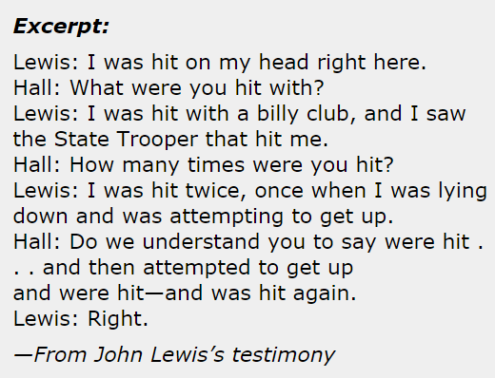
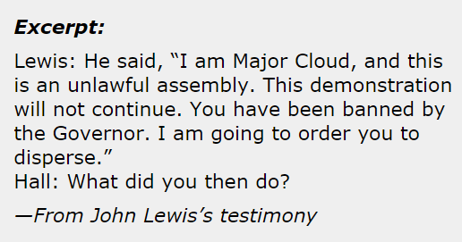
http://www.archives.gov/exhibits/eyewitness/html.php?section=2

Slide 24
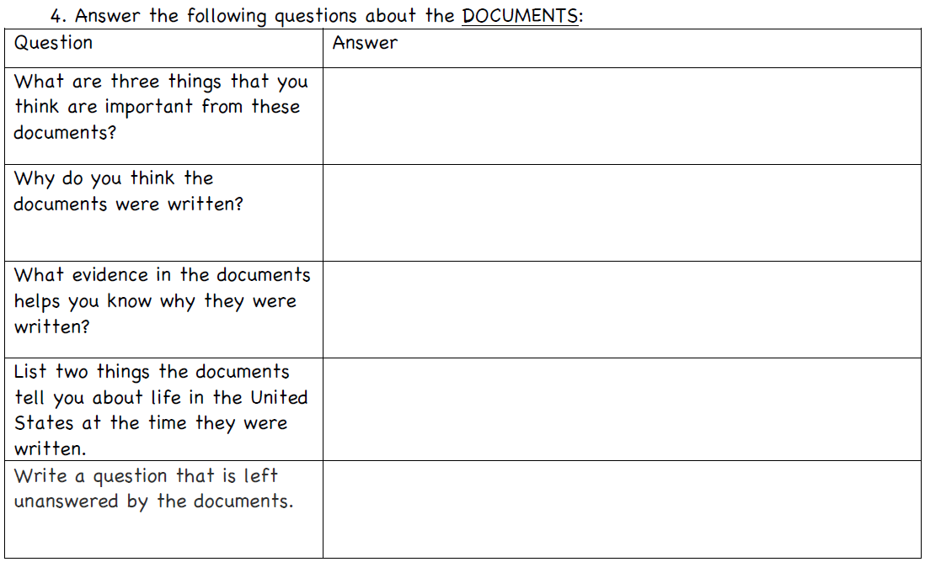

Slide 25
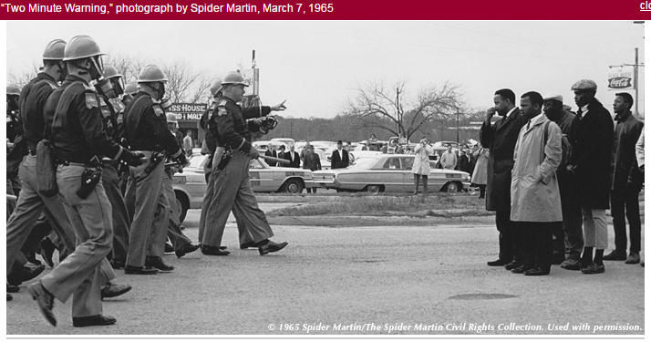

Slide 26
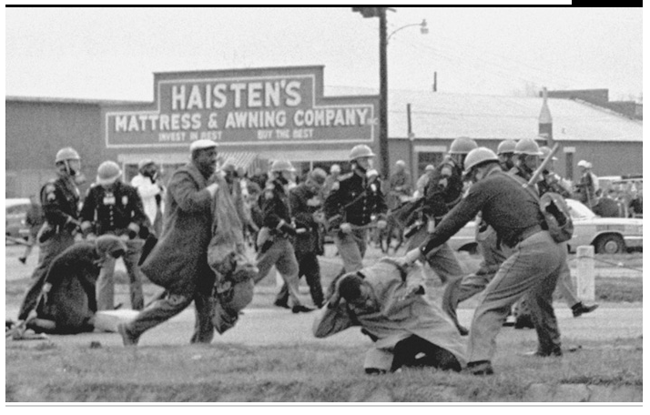

Slide 27
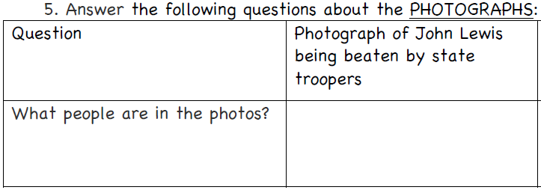
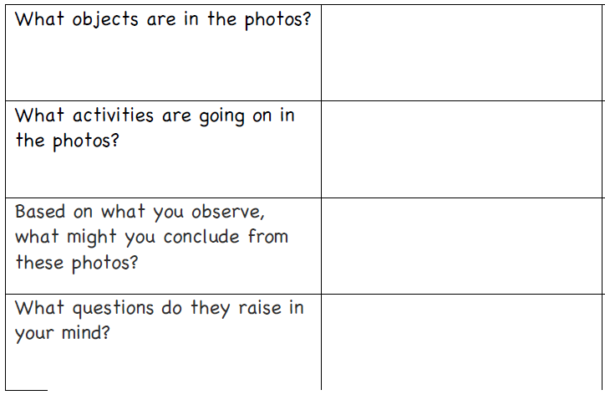

Slide 28
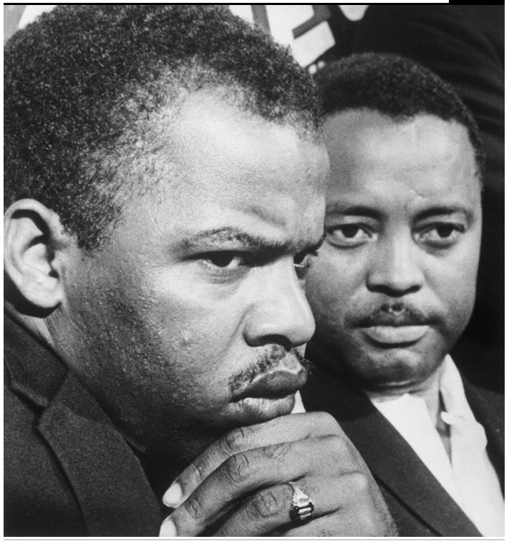
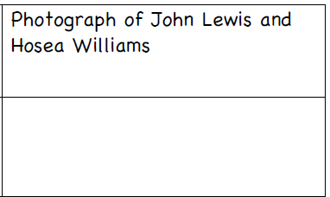

Slide 29
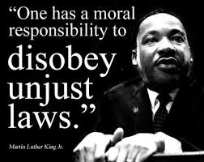
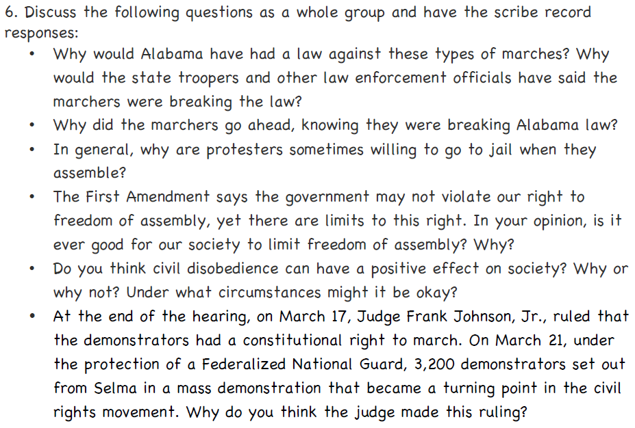

Slide 31
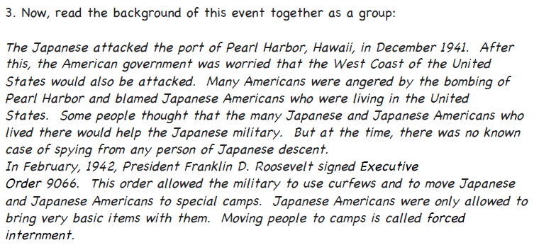
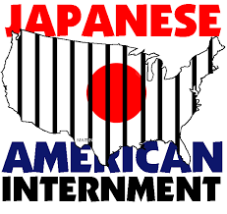

Slide 32
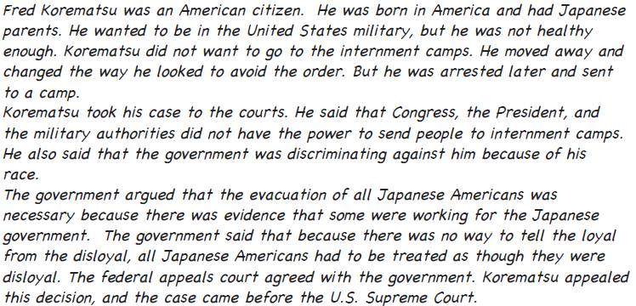
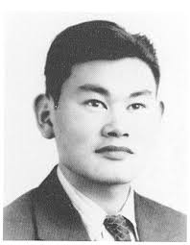
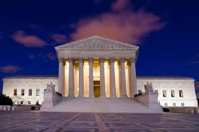

Slide 33
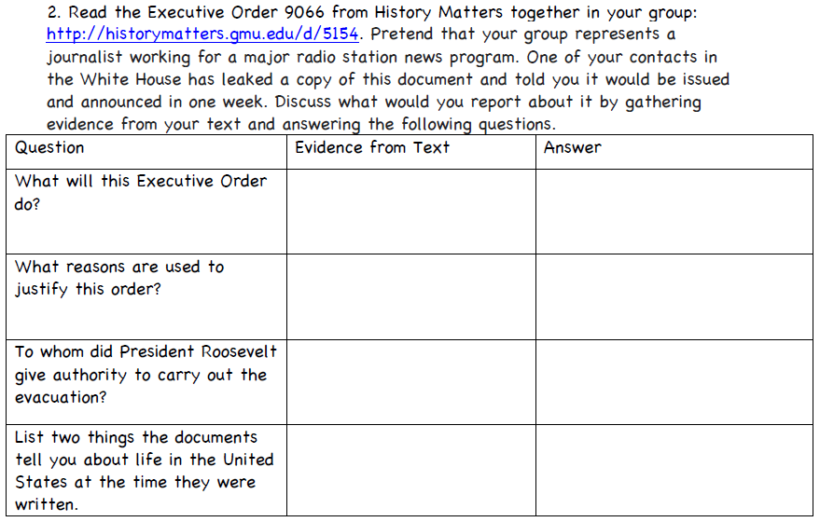
Pres gives permission to create of military areas for those suspected of spying
Pres hoped to win WWII
Sec. of War, Military Commanders, Executive Dept, & Fed Agencies
*ANSWERS MAY VARY*

Slide 34
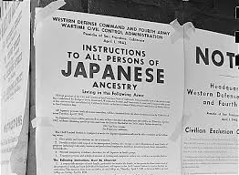
Sec. of War can create military areas & provide for those areas

Slide 35
Japanese attacked Pearl Harbor; US worried about West Coast; Many citizens blamed Japanese Americans.
Article I, Section 8 – Congress can declare war, control funding, support military
Article II, Section 2 – Pres is commander in chief

Slide 36
Possibly because Japan attacked a US base in Hawaii (Germany & Italy did not attack the US).

Slide 37
K
B

Slide 38
US

Slide 39
K
US
K
K
US
K
N

Slide 40
Court ruled in favor of gov, “emergency” situation made need to protect against spies
NOPE! ☺

Slide 41
EXAM PRACTICE #2
We believe individual rights are essential to freedom.
We believe the United States should avoid alliances and use the military only for our direct defense.
------------
In which political party platform are these ideas most likely to be found?
Communist
Socialist
Libertarian
Republican

