Slide 1
Exam Prep Section 1 Part 3: Articles of Confederation

Slide 2
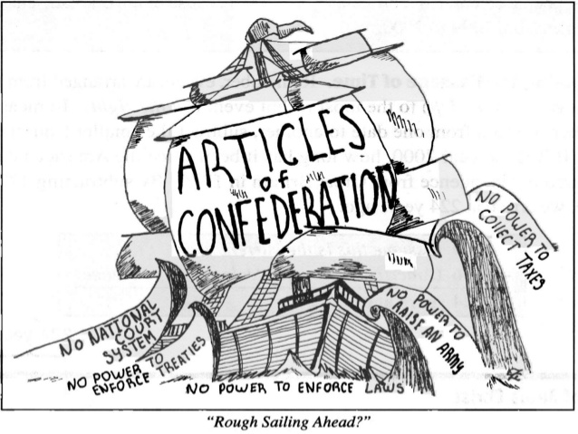
Articles of Confederation had lots of Problems!
Articles of Confederation was the First Constitution of the United States. It could not do a few things:
Most power went to the states
1 Tax the states
2 Build a military to defend the nation
3 Could not regulate trade with other nations or between individual states within the United States.

Slide 3
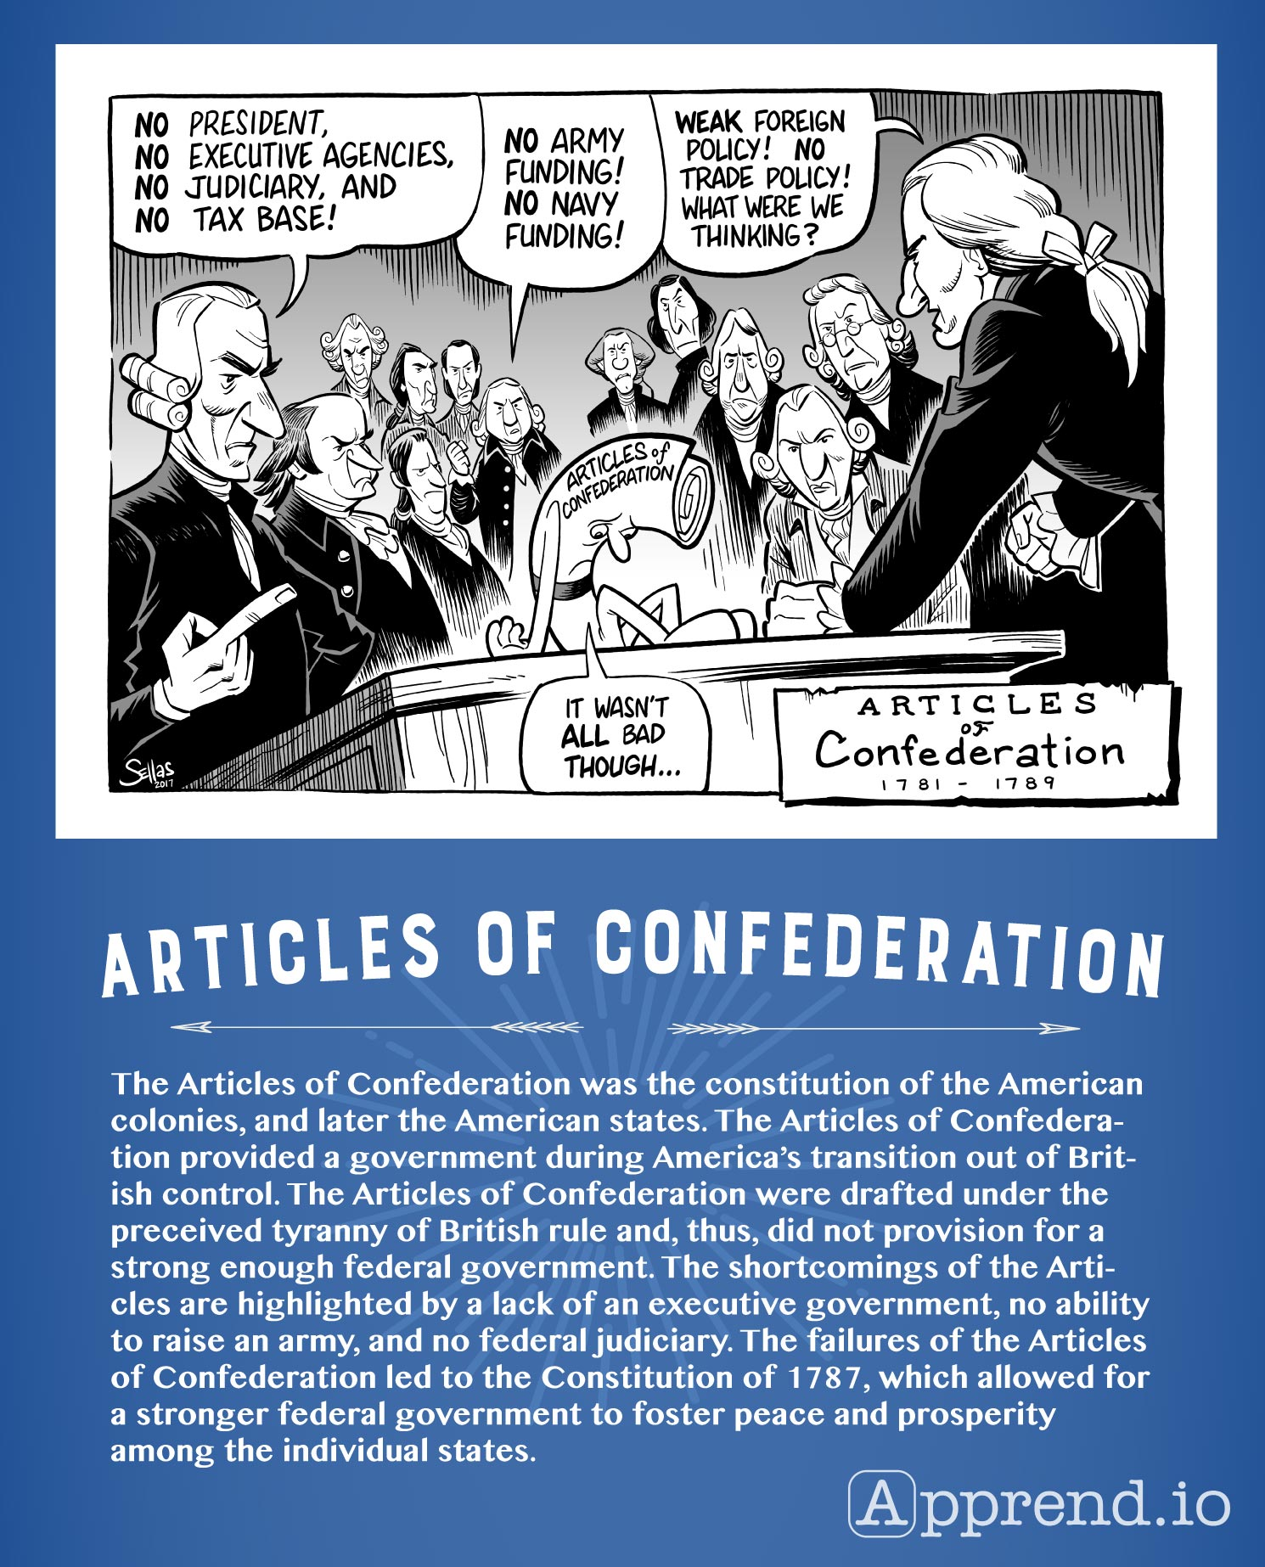
No Executive or Judicial Branches
The Articles of Confederation had no executive branch to ensure that the laws were enforced by the states. Congress also had no way to have its laws enforced.
No court system to decide problems that happen between the states or disputes with the laws passed by Congress.
All states had to agree to amend the Constitution. This was virtually impossible because it is difficult to get every person to agree with everything. So, nothing can get done or be changed.

Slide 4
The Shay's Rebellion
After the Revolution, the economy was struggling. The US still had lots of dept. States looked for ways to pay the dept. Farmers were asked to pay taxes that they were told they would not have to pay.
People revolted against the Massachusetts State government, which was put down by the state militia. This made it clear that the new nation needed to have a military and we had to make changes to the national government because it was too weak to protect people.

Slide 5
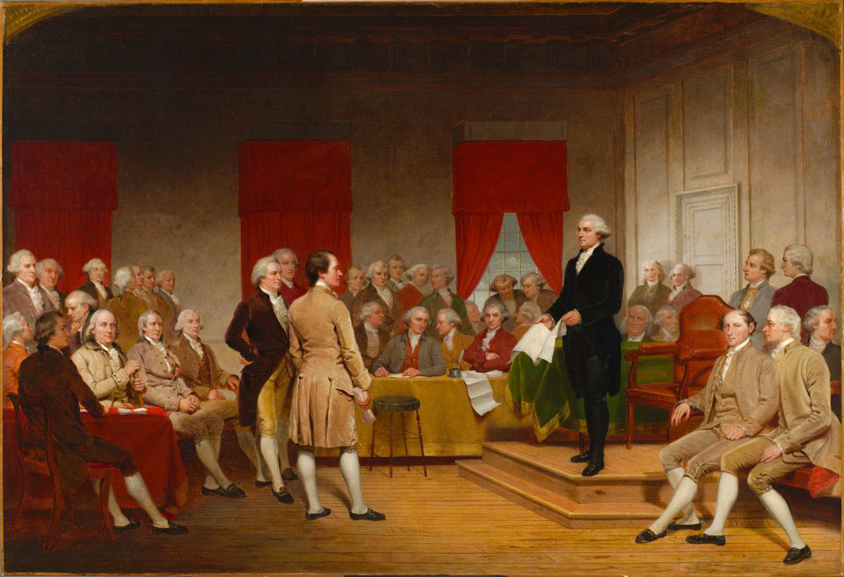
National Leaders Meet to Decide What to do!
Representatives Meet in Philadelphia in 1787 to talk about the Constitution. Leaders talked about how to make changes so that the needs of the country could be dealt with. This created the US Constitution that we use today!

