Slide 1
Exam Prep Part 1 Origins and Purpose of Government

Slide 2
Beginnings of the United States.
Started out as 13 colonies under British rule and part of the British Empire. Settlement began around 1620 with independence from Britain declared in 1776.
Over a period of time, people began to question the rule of “kings”. Happened in Europe but eventually made its way to America. This period is called the Enlightenment. Important people like Hobbes, Locke and Montesquieu believed that government should be fair and provide for people’s protection and or rights. If government doesn’t do these things, it should be replaced!

Slide 3
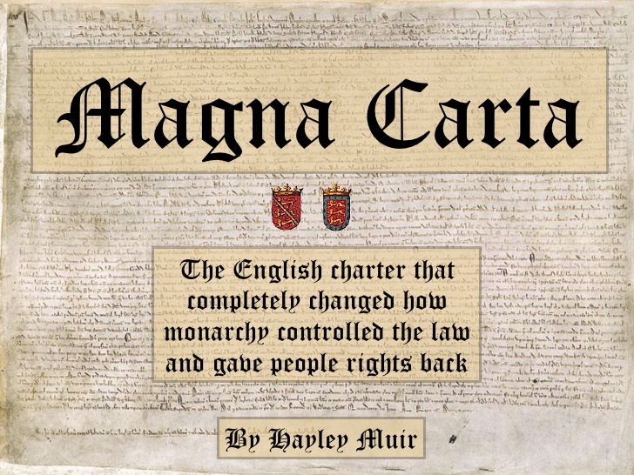
Important Documents that helped pave the way for the American Revolution
Manga Carta- an Important English document that ended fighting between an unpopular English King in the 13th century and his people. In it, for the first time, a European king accepted the idea that people had rights, such as the right not to be in prison without a reason. This establishes the idea that the government had a responsibility to the people.
The English Bill of Rights- Inspired the US Bill of Rights and was the result of a conflict between the English Parliament (the people) and the King. The King thought he had absolute power, the people disagreed. A four year war began with the people winning. After this, the people had the ultimate right to rule and the king would have to follow the law of parliament. (It is believed that John Locke’s ideas inspired the English Bill of Rights.

Slide 4
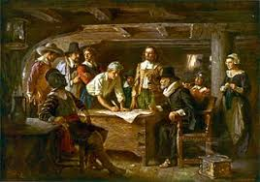
“Mayflower Compact” set up by American settlers in 1620
Mayflower Compact: First set up by the colonists in Massachusetts in 1620. The colonists believed that people had the right to set up a government that was responsible to them. They wanted a government where laws applied equally to all and where the government was in power only at the consent of the people. If the government did not do what the people wanted, the government could be replaced- Social Contract!

Slide 5
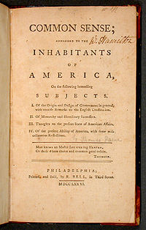
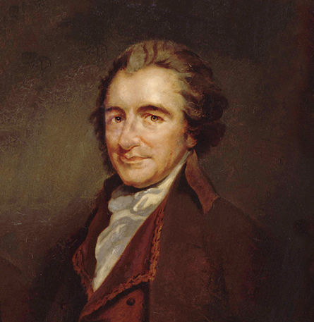
Thomas Pane’s “Common Sense”
Common Sense-it was an important book written in 1776. It encouraged American colonists to seek independence since the English King treated them unfairly. He accused King George of being a tyrant- absolute ruler and challenged his right to rule over the colonies. He believed that the new government needed a written constitution that would apply equally to everyone.

Slide 6
Summary: These documents and events encouraged people to create a new kind of government and a new country.
New ideas about how life should be: Hobbes, Locke, Montesquieu, and Pane all had different ideas about how life “could be”. We did not have to live under a king anymore! We could have more control over our lives. This was called the “Enlightenment”.
World Events Lead People to Change their Minds! Both in Europe and in America, life was difficult. People could not live their lives without a king interfering or taking away their freedoms for no good reason. It was happening in Europe and people were getting sick of it. It was also happening in the colonies. If the monarchies of the world were fair, maybe the colonies would not have revolted. But fairness was NOT a part of how the world was at that time. Thomas Hobbes would have agreed! Remember, he said life was nasty, brutish and short for most people, AND that people were selfish. So to him, it was not a surprise that government wasn’t fair, but did it have to be this way???

