Slide 1
SS.7.C.3.13
QUESTION:
How many constitutions do you think are in the United States? (Answer in a complete sentence)
Notes:
Have students offer their own definition of what a constitution is. Definition provided on the following slide.
1

Slide 2
SS.7.C.3.13
How many constitutions do you think are in the United States?
ANSWER: There is one for the federal government and one for each state.
Notes:
Have students offer their own definition of what a constitution is. Definition provided on the following slide.
2

Slide 3
COMPARING THE U.S. AND FLORIDA CONSTITUTIONS
SS.7.C.3.13 Compare the constitutions of the United States and Florida.

Slide 4
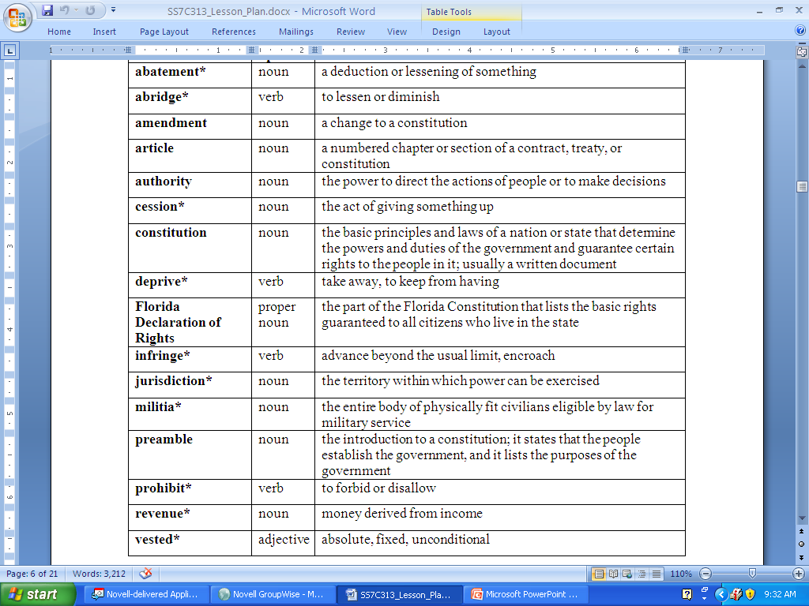

Slide 5
In general, a constitution is a document that organizes a government.
Think of a constitution as a rule book for government…
Rule Book
Notes:
The following slide will elaborate on the definition as applied to the U.S. Constitution. Ask students if they know of anything else a constitution does (lists the rights of the people, says what government can and cannot do, etc)

Slide 6

The United States Constitution does the following:
Sets up the government
Defines power and limits of the government
Lays out some of the rights of the people
Notes:
Ask students what “social contract” means (review of Locke PowerPoint) – the agreement between the people and the government: the people agree to live under and obey the government, the people give the power to make and enforce laws, and the government gives protection to the people in return.

Slide 7
The Constitution creates limits and guidelines for the government in order to protect the people from an abuse of power.
Constitution
The Constitution protects the rights of the people from the government.
The constitution is a social contract between We the People and the government.
In a constitutional government, it all starts with the people…
The people must consent to give the power to make and enforce laws to the government.
Government
The government is structured to offer protection for the people through public safety measures and the justice system.
The People
The People
Notes:
This slide will look at CONSTITUTIONAL GOVERNMENTS
Distribute student handout “What is a Constitution?”
Students will complete their handout as the PowerPoint progresses. Remind students to check and see if they are on the correct section – Constitutional Government.
The first step in a “constitutional government” is the establishment of a social contract between the people and the government.
The result of that social contract is a constitution that will outline the limits and guidelines placed on government and the rights of the people to be protected from the government.

Slide 8
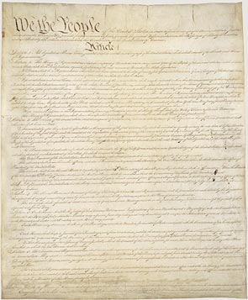
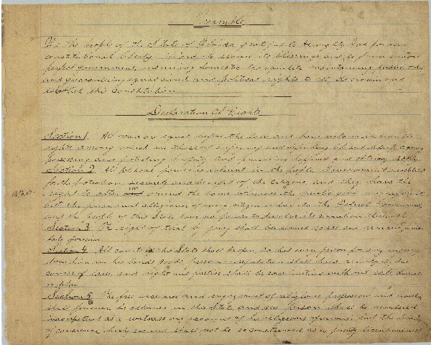
IDENTIFY THE DOCUMENTS
Notes:
Have students offer their own definition of what a constitution is. Definition provided on the following slide.
8

Slide 9
U.S. CONSTITUTION
How Do they Compare?
FLORIDA CONSTITUTION
Notes:
9

Slide 10
Look at the U.S. Constitution on page 54 in your textbook.
Look at the Florida Constitution handout.

Slide 11

What are the First three words of the U.S. Constitution?
We the People…

Slide 12
What are the First three words of the FLORIDA Constitution?
We the People…
Notes:
Ask students if they knew Florida had a Constitution. Ask if any of them have ever read the document.

Slide 13
How Do they Compare?
Both begin with a preamble and their basic structures are similar.
Notes:
13

Slide 14
In your pairs take a few minutes to make a list of the shared structural features between both
documents.
LET’S SHARE!
Notes:
Have students offer their own definition of what a constitution is. Definition provided on the following slide.

Slide 15
Similarities
Both documents have
      a preamble
      Articles
      amendments
Notes:
Have students offer their own definition of what a constitution is. Definition provided on the following slide.
15

Slide 16
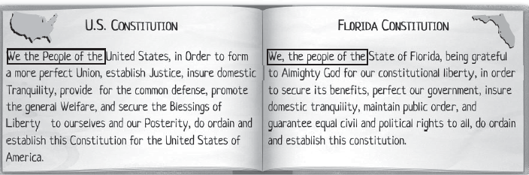
COMPARATIVE CONSTITUTIONS
Read the first paragraph and the activity directions.
Notes:
Have students work in small groups. Discuss responses upon completion using a “round-robin” method. Each group will share a fact about the Florida Constitution, a fact about the U.S. Constitution, and something the two documents have in common. Then, move to the next group. Continue around the classroom until students run out of answers. Students should not repeat responses given by other groups.

Slide 17
Volunteer?
Read the preamble to the U.S. Constitution

Slide 18
Key Points of The Preamble
Introduction to the U.S. Constitution
Outlines general goals of the framers
    Just government
    Ensure peace
    Adequate national defense
    Healthy, free nation
“We the People” – nation ruled by the people

Slide 19
Volunteer?
Read the Preamble to the Florida Constitution.

Slide 20
KEY POINTS OF BOTH
Both are introductions
Outline general goals of the writers
Emphasize the role of the people
Notes:
Have students offer their own definition of what a constitution is. Definition provided on the following slide.
20

Slide 21
Read “Government Rules!” paragraph and directions
Notes:
Have students offer their own definition of what a constitution is. Definition provided on the following slide.
21

Slide 22
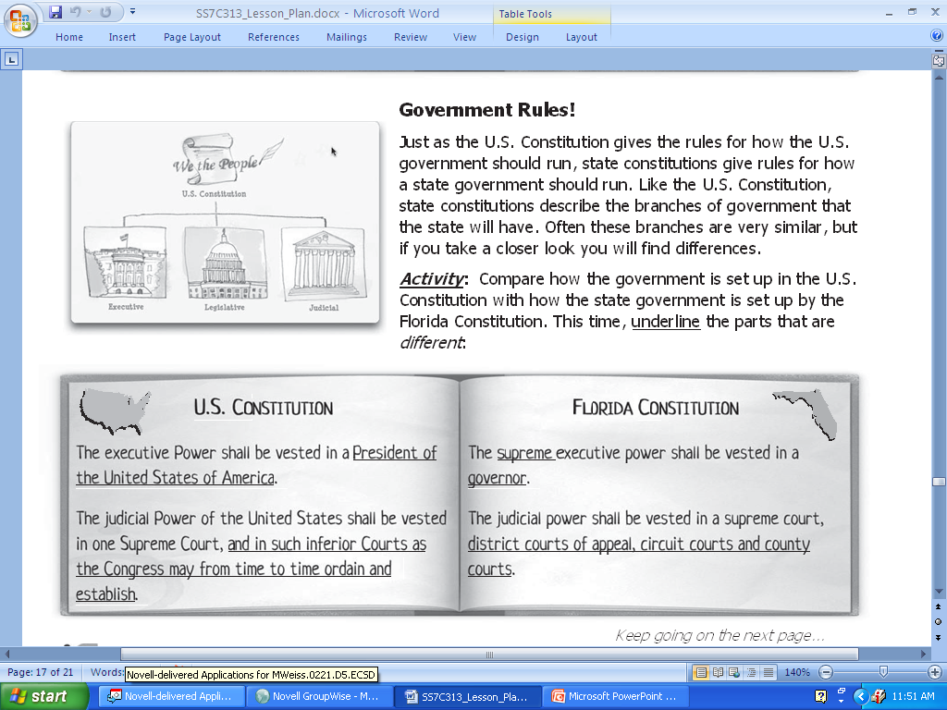

Slide 23
Read and review the first completed example in the chart (bottom of page 9a)
Read next passages and underline differences
Read and complete page 9b.
Notes:
Have students offer their own definition of what a constitution is. Definition provided on the following slide.
23

Slide 24
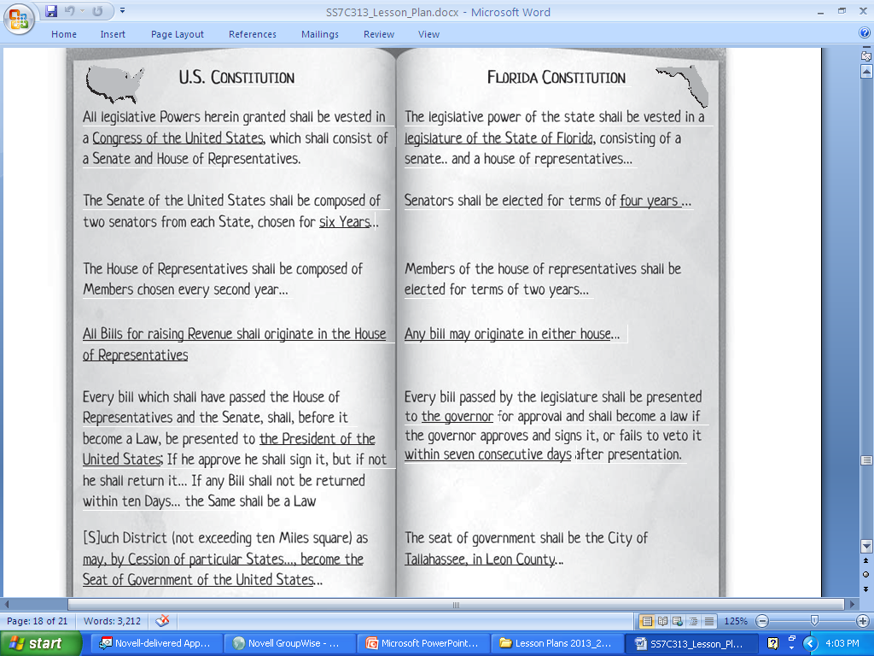

Slide 25
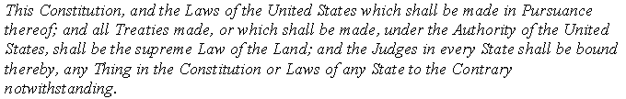
ARTICLE IV OF THE U.S. CONSTITUTION
Notes:
Have students offer their own definition of what a constitution is. Definition provided on the following slide.
25

Slide 26
What does this excerpt say?
What evidence from the excerpt did you use to create this summary?
What is important about this excerpt?
Supremacy Clause
Notes:
Have students offer their own definition of what a constitution is. Definition provided on the following slide.
26

Slide 27
ACTIVITY
Read “Everybody’s Got Rights.”
Read directions at top of page 12
Complete first example together
Complete second example and review
Read and complete the rest of the activity on pages 12 and 13.
Notes:
Have students offer their own definition of what a constitution is. Definition provided on the following slide.
27

Slide 28
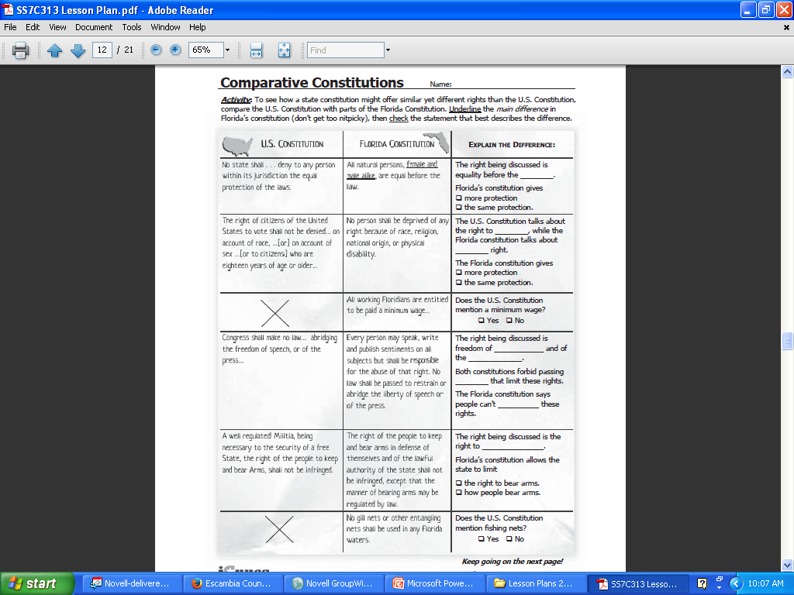

Slide 29
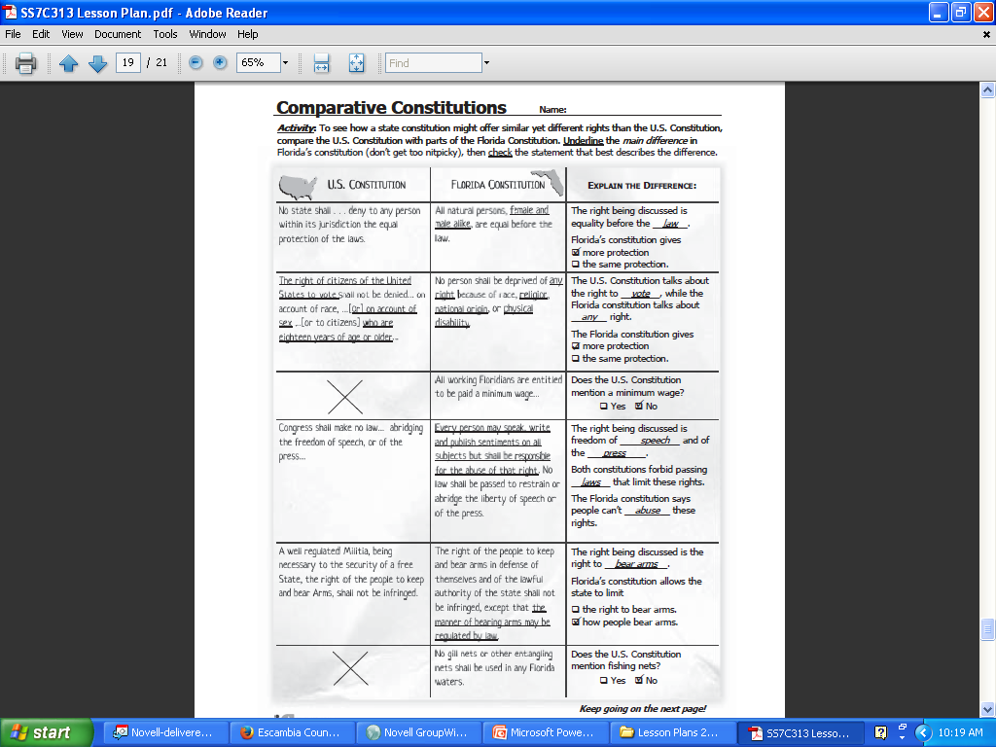

Slide 30
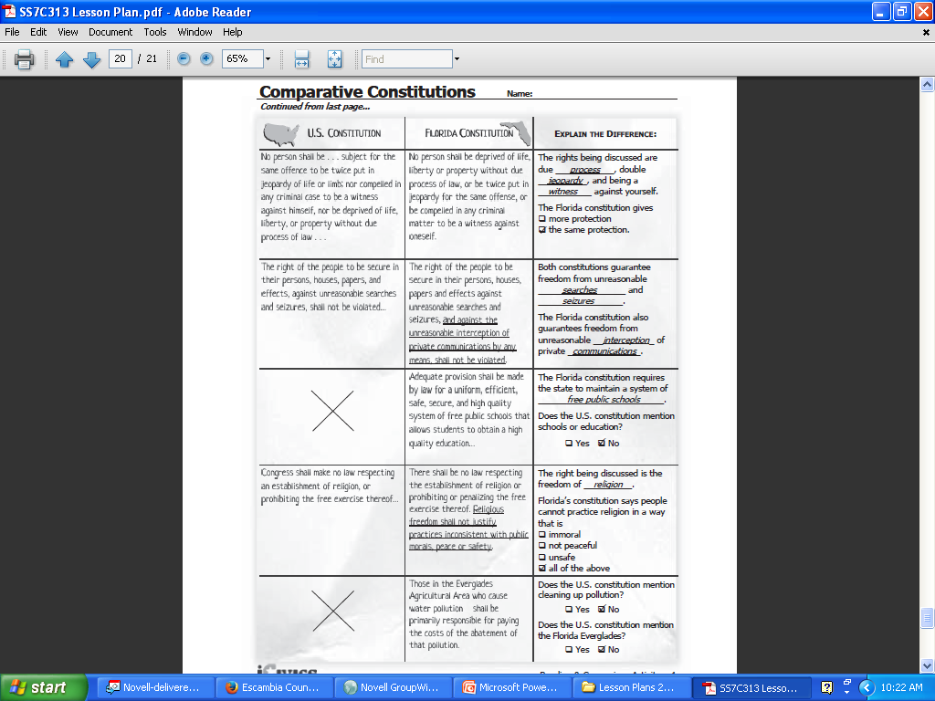

Slide 31
DISCUSSION
Based on what you have read, what do you think are the purposes of constitutions?
What clues are in the activities that helped you determine the purposes?”
Notes:
Have students offer their own definition of what a constitution is. Definition provided on the following slide.
31

Slide 32
DISCUSSION
The purposes of a constitution (for the whole country or for one state) are the same:
To provide a framework for the government, limit government authority, and protect the rights of the people
Notes:
Have students offer their own definition of what a constitution is. Definition provided on the following slide.
32

Slide 33
DISCUSSION
What are changes to constitutions called?
Do you think the process is the same for the U.S. and Florida constitutions?”
Notes:
Have students offer their own definition of what a constitution is. Definition provided on the following slide.
33

Slide 34
AMENDING THE U.S. CONSTITUTION
Read and review the handout “Amending the Constitution”
We will be looking at the methods of Amending the U.S. Constitution.
Notes:
Have students offer their own definition of what a constitution is. Definition provided on the following slide.
34

Slide 35
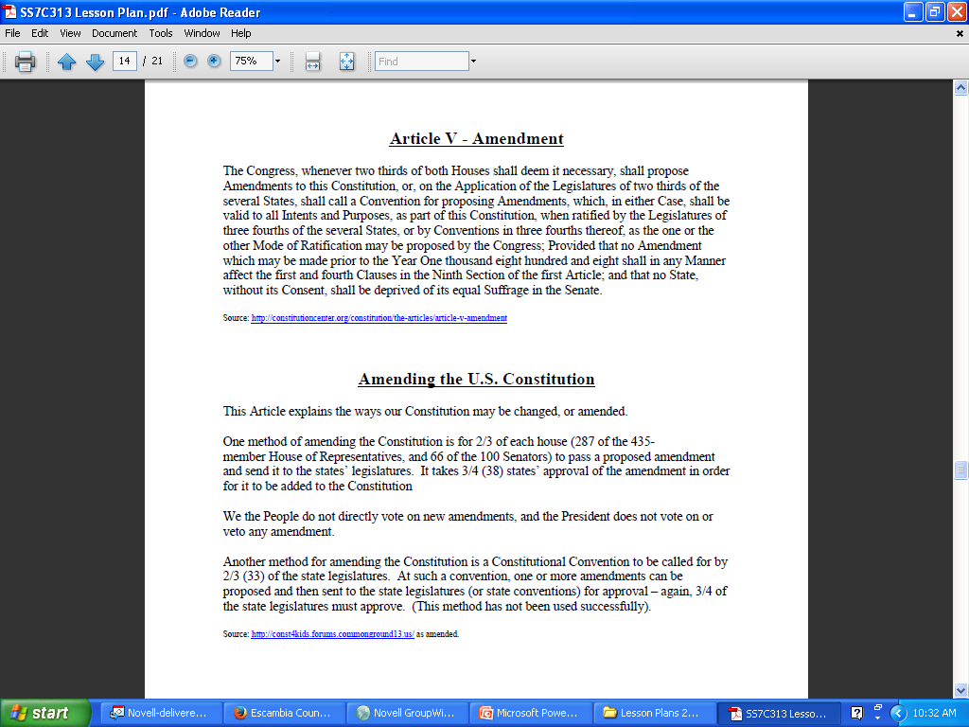

Slide 36
AMENDING THE FLORIDA CONSTITUTION
Student activity sheet “Amending the Florida Constitution.” #10 in folder
Notes:
Have students offer their own definition of what a constitution is. Definition provided on the following slide.
36

Slide 37

AMENDING THE FLORIDA CONSTITUTION
60% voter approval needed
Five different methods used
National level – only elected state and federal legislators may vote.
Florida – all registered voters
Process for U.S. Constitution has never changed, the process for Florida has had many changes
Notes:
Have students offer their own definition of what a constitution is. Definition provided on the following slide.
37

Slide 38

BALLOT INITIATIVE PROCESS
According to Article XI, Section 3 of the Florida Constitution, a committee must register with the Secretary of State. The committee must collect a number of signatures equal to 8% of the votes cast in the most recent presidential election from at least one-half of the congressional districts in the state. Based on presidential voting in 2008, 676,811 signatures were required for amendments to be placed on the 2012 ballot secured from voters residing in at least 14 congressional districts.
Notes:
Click on the picture to link to the answer slide.

Slide 39

Amending the Florida Constitution
What does it take to amend the Florida Constitution?
In the spaces below, write a brief summary of each method, and draw an illustration that symbolizes each method.
Method
Illustration
Description
(Summarize)
Article XI, Section 3: committee must register with the Secretary of State, committee collects signatures equal to 8% of votes cast in most recent presidential election from at least ½ of the congressional districts in the state.
Ballot Initiative Process

Slide 40
DIRECTIONS
Complete the next 4 methods on the worksheet. Don’t forget to draw an illustration that symbolizes each method.

Slide 41
CONSTITUTIONAL CONVENTION
Florida voters may call a constitutional convention by collecting a number equal to 15% of those voting for president in the last presidential election in Florida. At the next general election, provided that it takes place at least 90 days later, Florida voters must approve, with a majority, “Shall a constitutional convention be held?" in order to proceed with a constitutional convention.
Notes:
Click on the picture to link to the answer slide.
41

Slide 42
Constitutional Revision Commission
Composed of 37 members, this commission meets every
20 years to examine the state constitution and propose
the amendments deemed necessary. The commission
last met in 1997-1998 and will next meet in 2017.
Members of the Constitutional Revision Commission include:
The Attorney General
2. 15 members chosen by the Governor
3. 9 members chosen by the Speaker of the House
4. 9 members chosen by the Senate President
5. 3 members chosen by the Chief Justice of the Florida Supreme Court
Notes:
Click on the picture to link to the answer slide.
42

Slide 43
Legislative Joint Resolution
The Florida Legislature can pass a joint resolution supported by three-fifths (60%) of the membership of each house of the legislature. The proposed amendment will appear on the next general election ballot provided that the next general election is at least 90 days later.
Notes:
Click on the picture to link to the answer slide.
43

Slide 44
Taxation and Budget Reform Commission
This is a 22-member Commission that last met in 2007 and will meet every 20th year thereafter.
Members of the Taxation and Budget Reform Commission include:
1. 11 members chosen by the Governor
2. 7 members chosen by the Speaker of the House
3. 7 members chosen by the Senate President
(Note: No voting member of the Taxation and Budget Reform Commission may be a member of the state legislature at the time of appointment)
4. 4 non-voting ex officio members who are members of the legislature at the time of appointment two of which are chosen by the Speaker of the House and two of which are chosen by the Senate President. One of the Speaker’s and one of the Senate President’s selections must be a member of the minority party in their chamber.
Notes:
Click on the picture to link to the answer slide.
44

Slide 45
So, how do they stack?
United States Constitution
The United States Constitution is the highest law in the land. This is stated in Article VI of the Constitution: “The Constitution…shall be the supreme Law of the Land…”
Florida Constitution
The Florida Constitution sets up the government of Florida and defines the rights of Florida’s citizens. The Florida Constitution is placed above state laws.
Federal law
Federal law applies to all those who live in the United States. It is created by the United States Congress and can overrule pieces of a state’s Constitution.
Federal law
State law
State laws are the next layer. These impact all individuals living within the state.
Florida Constitution
State law
Local ordinances
Local ordinances impact us on a local level. An example might be a noise ordinance after 10 p.m.
School rules
School rules are a kind of law. They are the lowest level because they impact you on a super local level.
Local ordinances
School rules

Slide 46
FORMATIVE ASSESSMENT 1
Compare and contrast the U. S. and Florida constitutions, using two elements of each document (e.g., how the government is organized, what rights citizens are guaranteed, how each can be amended, what powers each branch has, what the preambles say, etc.). Cite specific examples to support your statements.

Slide 47
FORMATIVE ASSESSMENT 2
The purpose of a constitution is to provide a framework for government, to limit government authority, and to protect the rights of the people. Using evidence from the “Comparative Constitutions” packet, find specific examples for each purpose and from each constitution. Summarize your findings in two paragraphs, one for each constitution.

Slide 48
FORMATIVE ASSESSMENT 3
Compare the processes for amending the U.S. and Florida constitutions by writing a well-crafted paragraph responding to the following prompt: Which method, when elected officials amend the constitution (U.S.) or when citizens amend the constitution (Florida), best serves the people? Use evidence from the lesson activities to explain your answer.

