Slide 1
“Checking” the Power of Government

Slide 2
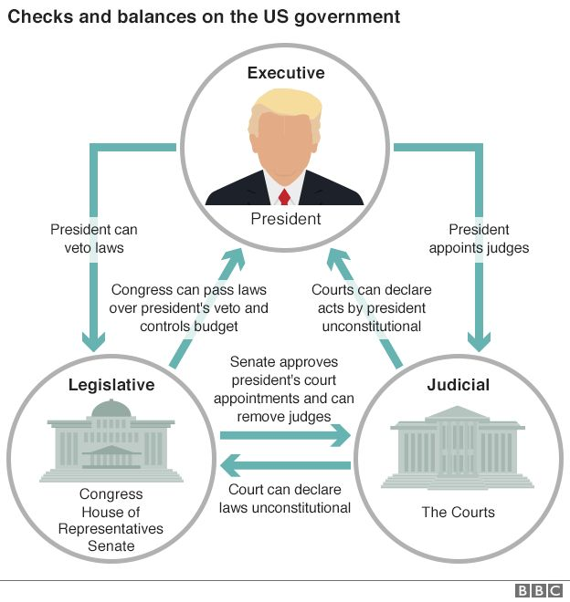
No one branch of the US government is all powerful!
The US Constitution was designed with the idea that no one branch of the government would have too much power, and that it would be possible to check the power of government by putting in “safeguards” that would protect individual freedoms and keep the country going.
When the Constitution was created, the world was full of governments with leaders that were “ALL POWERFUL”. This resulted in people not having the freedom to live their lives! The US Constitution would serve as a model to the world of how a government could be “fair” and at the same time protect freedoms.

Slide 3
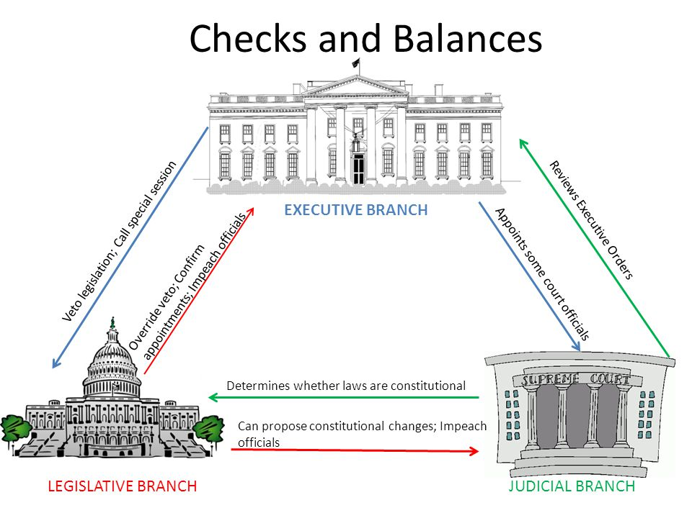
Examples of Checks in the US System

