Slide 1
Beginnings of the American Government

Slide 2
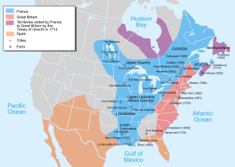
Empire Building in North America: 1750-1775
Empire Building- By 1750- European countries were setting up overseas colonies for the purpose of taking the natural resources they found there. These resources were turned into goods which were then sold for money. As the armies of Britain, France and Spain moved into North American, they would clash with each other over territory. However fighting costs money. So, Britain had to think of new ways to make sure they could protect their territorial possessions.

Slide 3
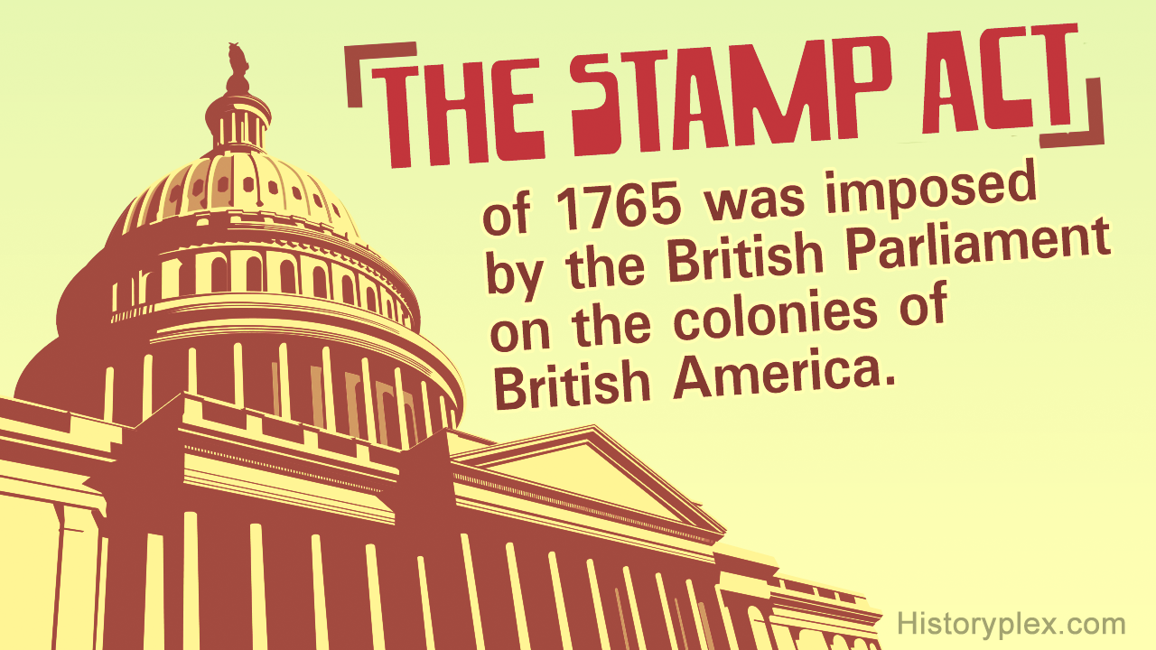
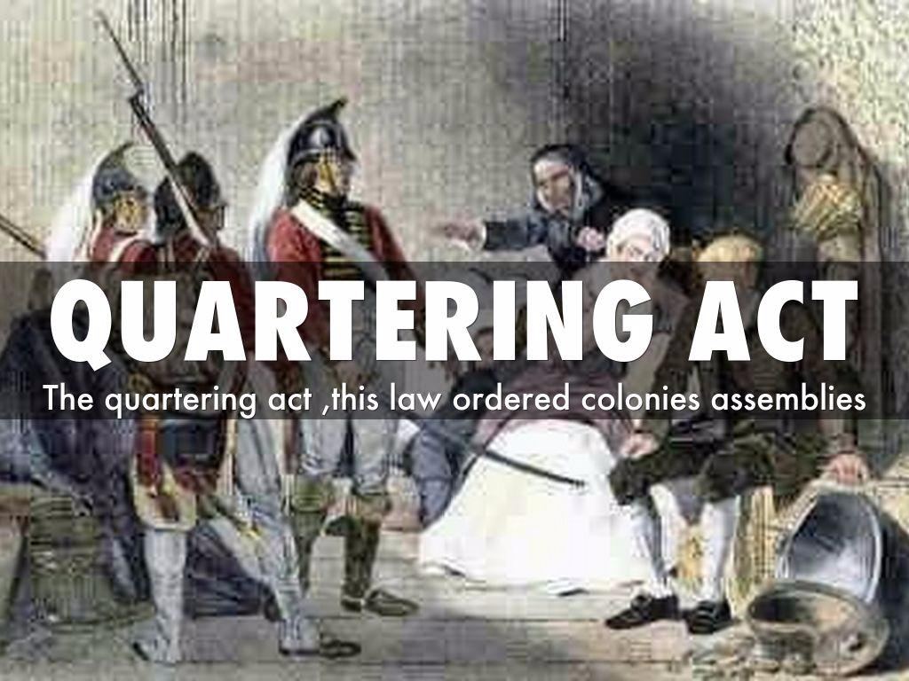
Stamp, Sugar and Quartering Acts- The Intolerable Acts hit the American Colonies!
Between 1760 and 1770, Britain tried to tax the colonists to try and pay for these expensive wars. It didn’t work and in fact it raised the anger of the colonists who believed that they wanted a say in what taxes they should pay. Also, since the British people did not want a large standing army at home, they sent the army to the colonies. The army was kept there to defend the colonies from foreign attack.

Slide 4
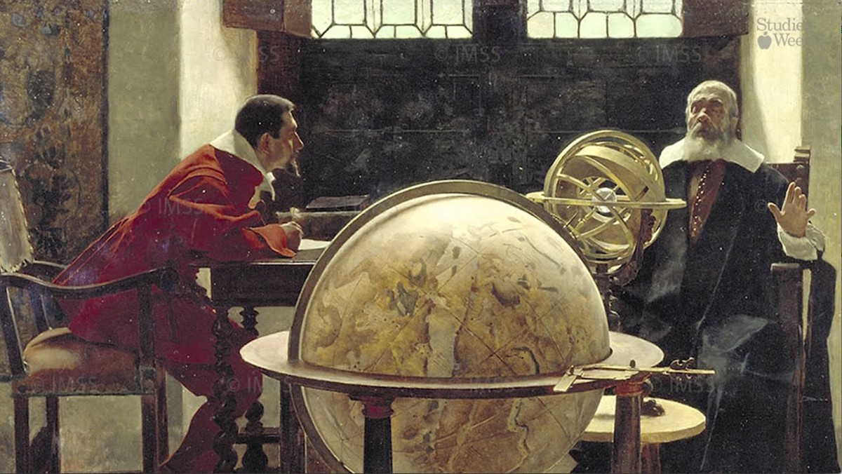
The Enlightenment: New ideas began to spread throughout Europe!
New ideas about how society and people were to be governed began to spread throughout Europe in the 1700’s. People like Thomas Hobbes, John Locke, and Baron de Montesquieu believed that life could be different. We didn’t have to live with a monarch…if we didn’t want too. We could have a new type of government with rights, freedoms and private property.

Slide 5
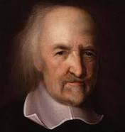
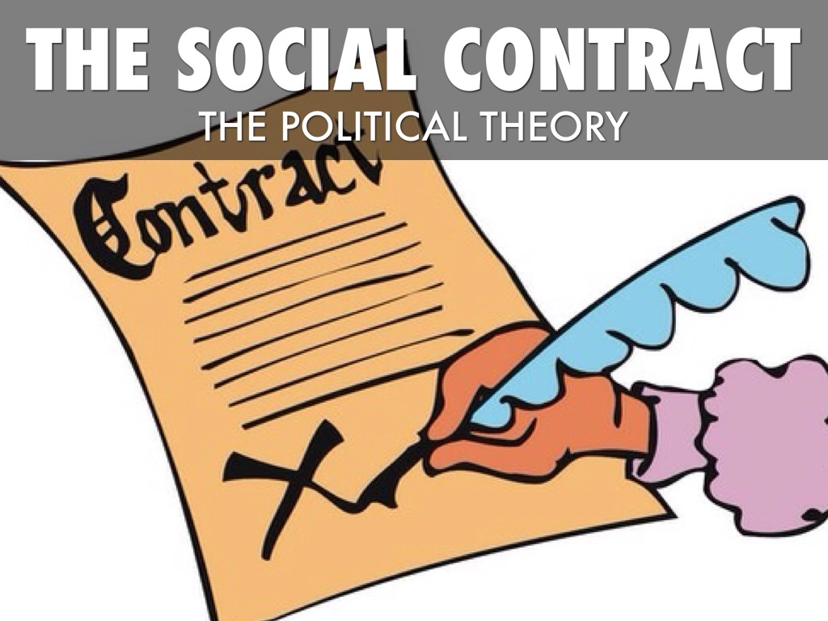
Thomas Hobbes: Life is nasty, brutish and short!
Thomas Hobbes (1588-1679) He believed that life was nasty, brutish and short! He believed that the natural state of man was to do whatever he needed to do to get what he needed. Man was very selfish. Government, under a monarch, only existed to give people protection from others. So long as the monarch gave people protection, people agreed to give up there rights/freedoms. This is called the social contract! This was type of society Hobbes lived in at the time in England.

Slide 6
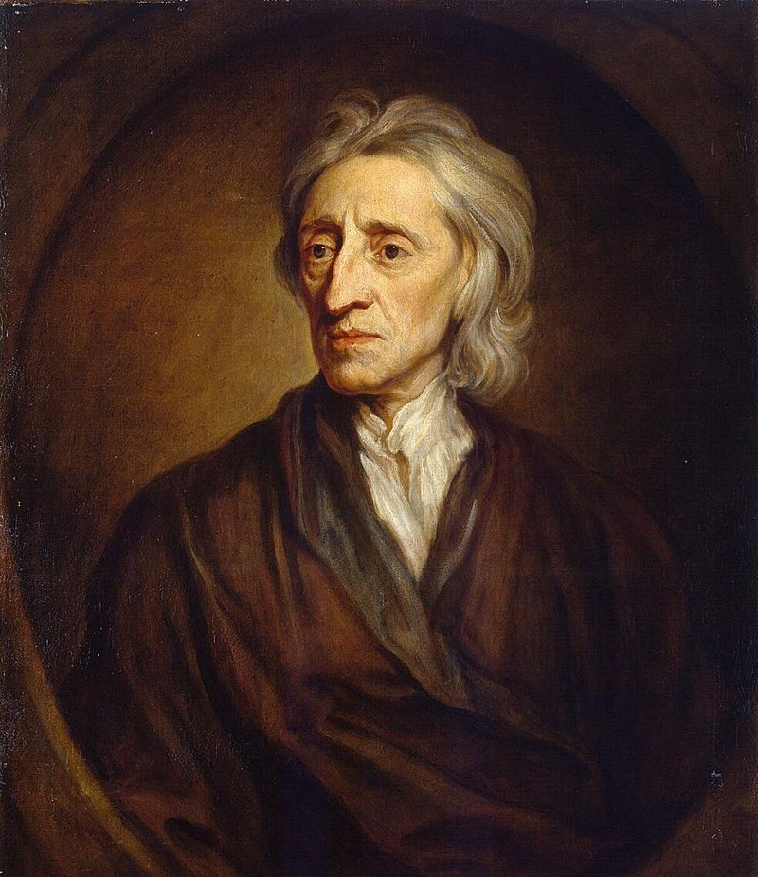
John Locke: Government and Private Property
John Locke (1632-1704)- He believed that all men had natural rights that derived from God and that could not be taken away by government. He believed everyone was equal and that government existed only to help protect people from harming others and to help protect private property. He also believed in the idea of a social contract. He felt that that as long as the government did these things, then they would have the right to govern. If government didn’t uphold its end of the bargain, people could replace it!

Slide 7
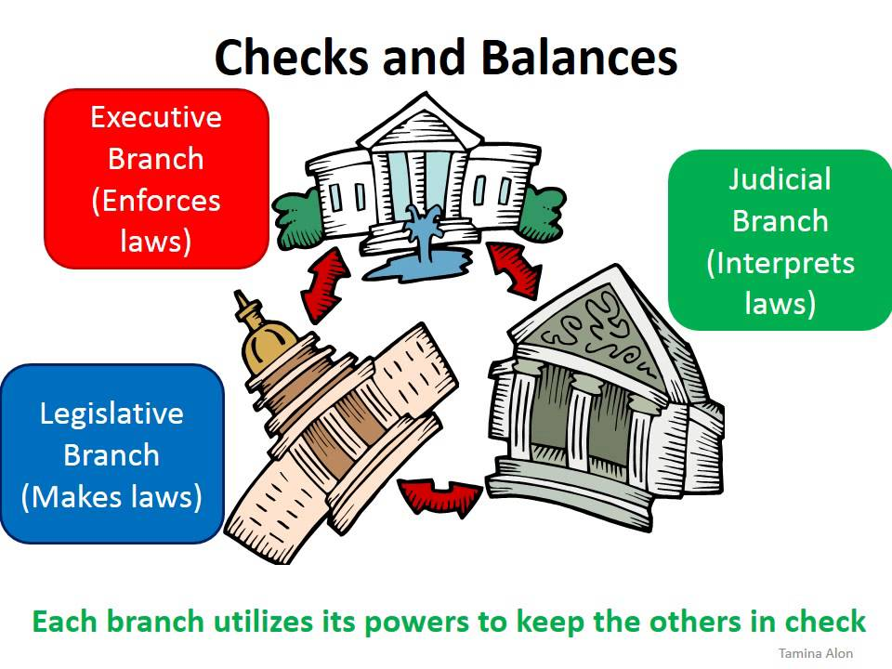
Baron de Montesquieu: The Father of Separation of Powers!
Baron de Montesquieu (1659-1755) Montesquieu argued that government should be created to accommodate separate branches of government with equal but different powers. This way, power would not be concentrated with one individual or group of individuals. Liberty was threatened if power became concentrated in one place; thus, no branch of government could threaten the freedom of the people.

