Slide 1
Civics: What is it?
Civics Benchmarks: 2.1, 2.2 and 1.11. Covers benchmark topics: What does it mean to be a US citizen, Duties and Responsibilities of Citizens, and the importance of the Rule of law.

Slide 2
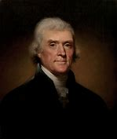
2.1: Civics: It is your duty!
Civics is the “study” of the rights and responsibilities of citizens. Basically, while we have “rights” or important things that are given to us simply because we are “human” and because we live in a democracy, we also have responsibilities.
It is both your right and your duty to be “informed”. One of our founding fathers, Thomas Jefferson said it best, “whenever people are well in-formed, they can be trusted with their own government.” The important word here is “informed”. You have a responsibility to get all the facts, no matter what the topic is about and then make a choice that is right for you. This is what civics is all about.

Slide 3
Roots of Citizenship 2.1 and 1.11.
The idea of citizenship goes back a few thousand years, to the first ever republic in ancient Greece and Rome. At that time, a new idea, a government of the people for the people, was born. People in this new style of government would no longer be “told” what the laws were, they would have an opportunity to make them. However, many centuries would pass before having a democratic government, would become the norm.

Slide 4
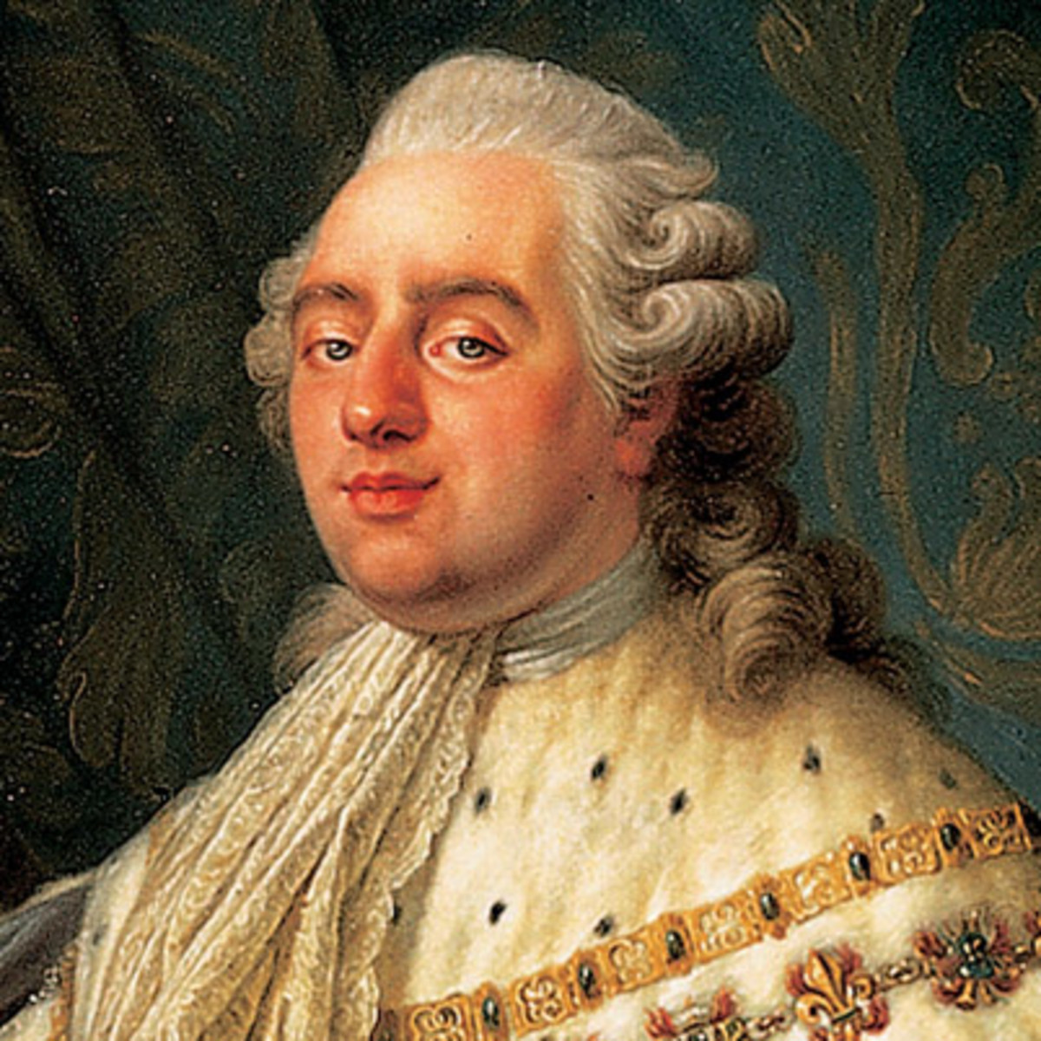
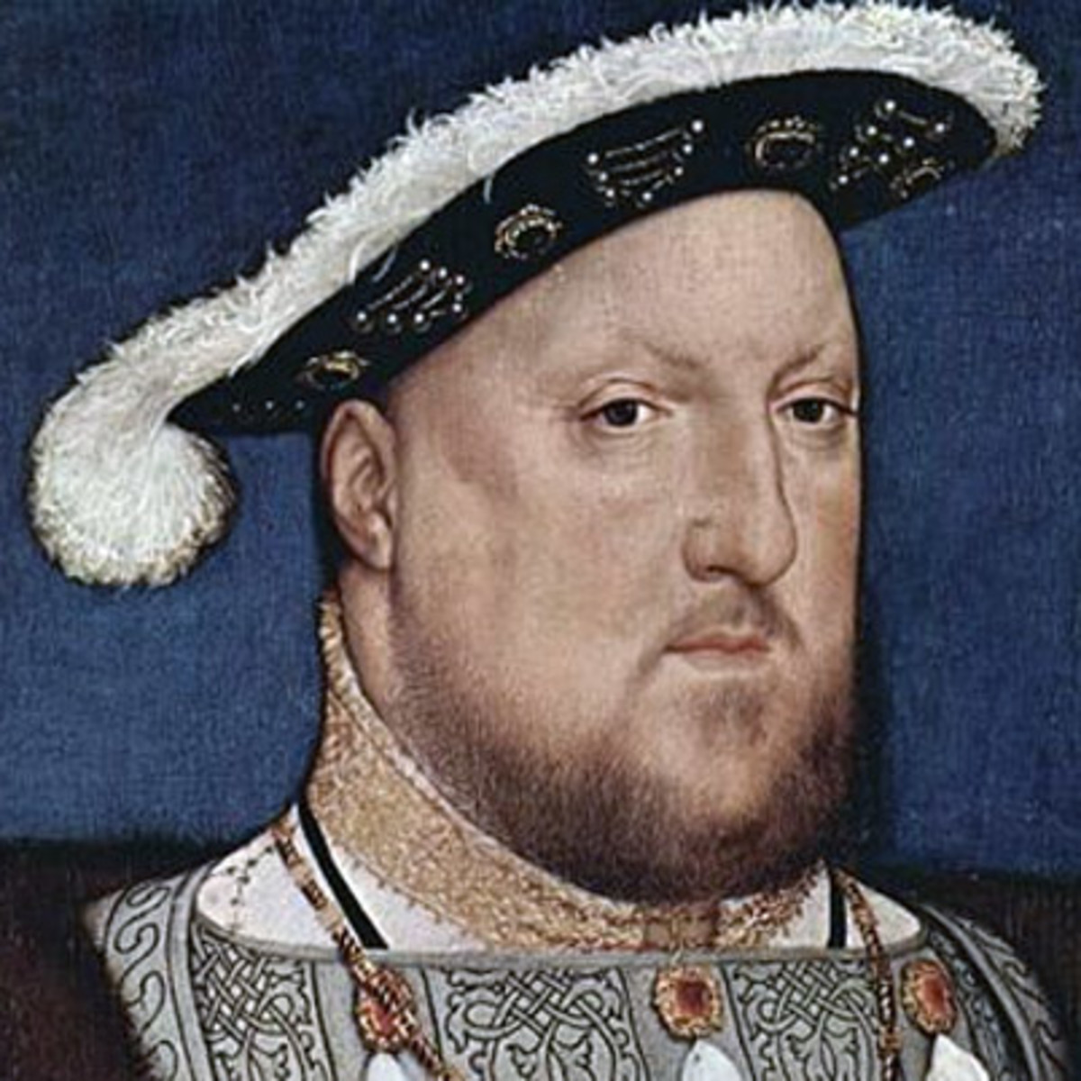
Monarchies rule the World
After the fall of Rome, many places around the world would soon be ruled by powerful kings and queens. These kings and queens were called “monarchies” or rule by one powerful person. Many countries around the world had them. However, for our purposes here, the two most important monarchies that influenced the creation of the United States, were England and France.

Slide 5
Monarchies have all the power; they are not democracies!
Key difference between monarchies or any government where a single person is in charge is that “they” not the people, have the power.
American colonists decided to create the United States because they were tired of Kings and Queens telling them what to do. American colonists believed that they had the right to be involved in all decisions that impacted them, and if they needed to fight for that right, then so be it! Having a say, and electing the people who make decisions for you, is an important part of American democracy.

Slide 6
Ways to obtain citizenship in the United States: 2.1
Law of Soil: You are born in the United States. Most countries indicate that if you are a citizen of their country, being born on the land of the country will automatically grant that person citizenship. This includes American territories like Porto Rico and any US military base.
Law of Blood: US citizenship by right of birth parent. In the United States, you can become a citizen if one of your parents was born in the USA and if they have lived in the United States.
Citizenship by naturalization. People who wish to become US citizens who were not born in the US and whom did not have at least one US parent, can become citizens of the United States. They must apply to US citizenship and Immigration so that they can start the process of becoming a citizen.

Slide 7
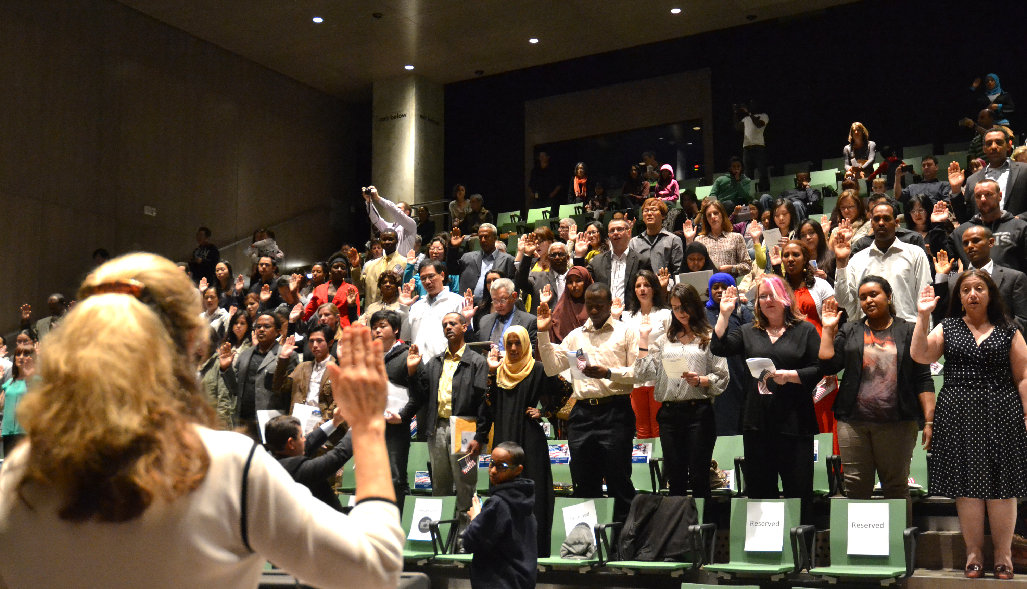
Becoming a US citizen if not born in the US.
To become a US citizen, foreign citizens of other countries, also called foreign nationals, may become a citizen by completing the following requirements:
1. They have lived in the United States for a least 5 years.
2. They have lived in the United States as a legal permanent resident.
3. They must be of good moral character and have lived lawfully in the United States prior to becoming a citizen.
They must be able to speak, read, write English.
Have an understanding of US civics.
Take an oath indicating that they will be faithful to the United States of America.
Once a person completes these steps, they will become US citizens.

Slide 8
Loosing citizenship
A person may lose their citizenship in three ways:
They become a citizen of another country. By doing so, according to American law, you are expatriated and therefore are no longer a citizen of the United States.
Naturalized (foreign born) citizens are found to have lied on their citizenship application and will therefore lose their citizenship. These people could be deported and sent to another country.
Being convicted of high crimes against the United States. Committing actions of treason, terrorism and rebellion against the US government can result in loss of citizenship.
Only the federal government can deny citizenship. The states may remove partial rights such as the right to vote but they cannot remove a person’s citizenship.

Slide 9
Foreign Born Residents of the United States
Permanent Residents: Not everyone who lives in the United States is a citizen. These people are citizens of another country, like me, your teacher! These people are considered foreign nationals or “aliens” by the United States. Those people who have been granted the right to live and work in the United States are called Legal Aliens. Permanent residents can stay in the country as long as they wish! A non-resident is someone who stays in the country for a short period of time, like vacationers from other countries, but they must return within a specified period of time.
Refugees. These people are a special class of legal resident. In these cases, these people have been granted permission to stay and live in the United States because their homeland is too dangerous for them to return. In order to become a refugee, you need to prove that your life is in danger should you return to the country in which you are from.

