Slide 1
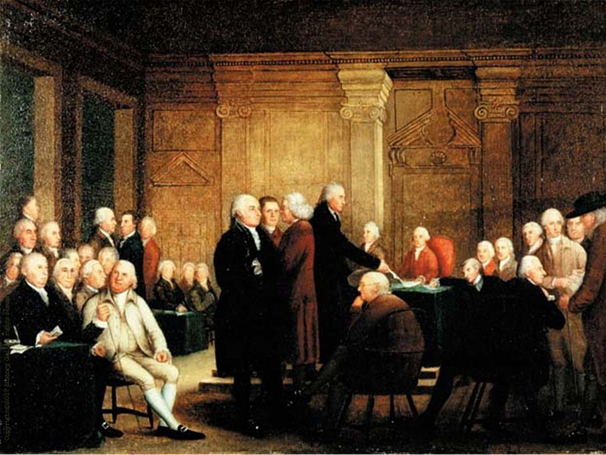
ISSUES

Slide 2
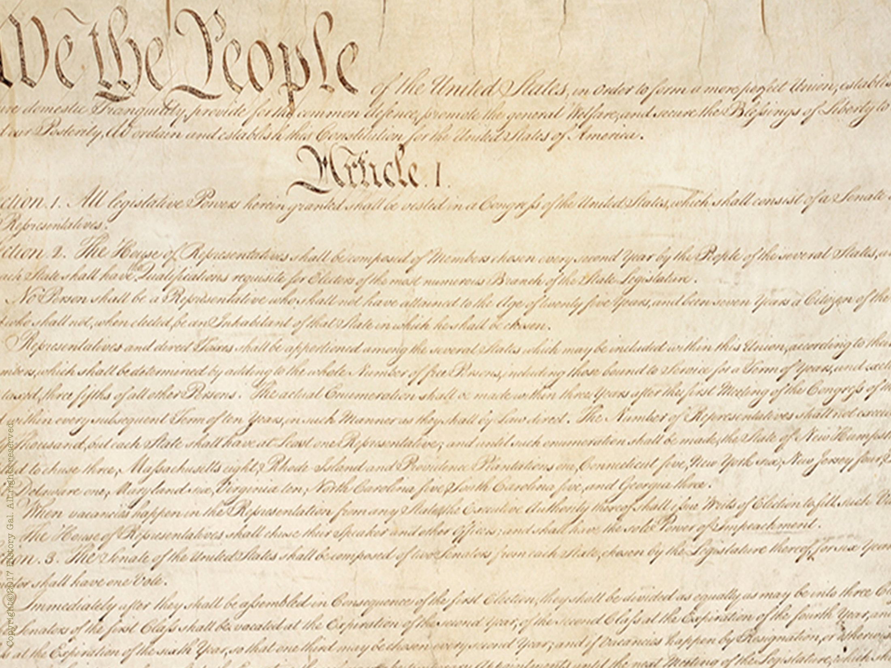
SHOULD THEY MAKE CHANGES TO THE ARTICLES OR CREATE A NEW DOCUMENT?
They decide to create a new document and worked in secret for 4 months at Independence Hall to create a new government.

Slide 3
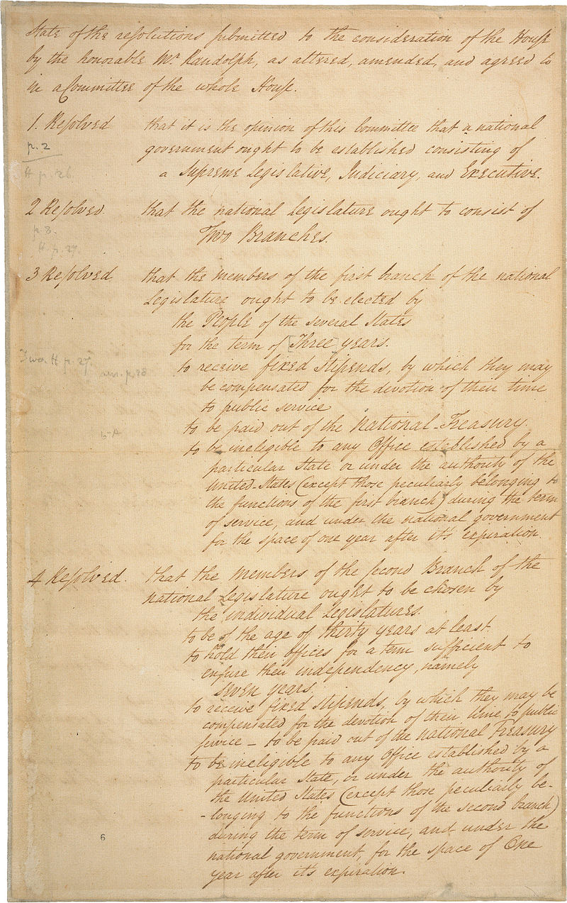
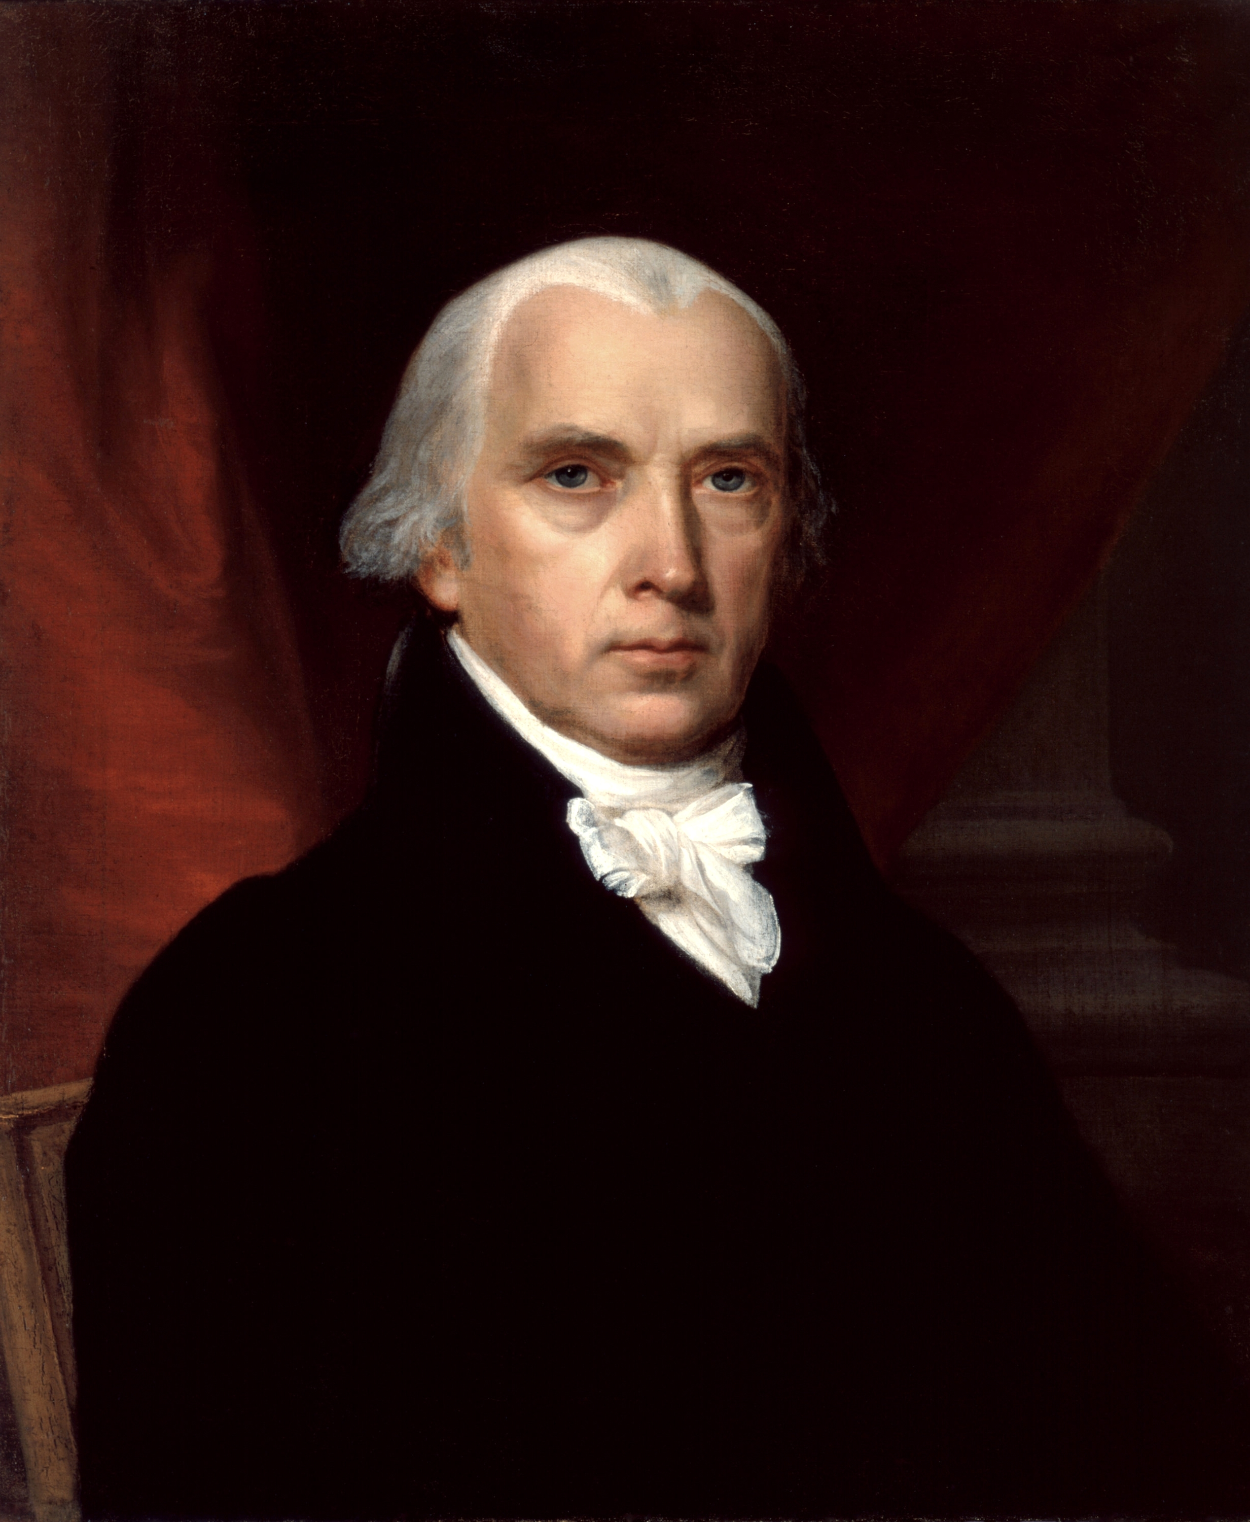
SHOULD STATES HAVE EQUAL REPRESENTATION OR SHOULD IT BE BASED ON POPULATION?
Option #1: VIRGINIA PLAN by James Madison called for 3 branches of government with a BICAMERAL (two house) legislature based on population
James Madison

Slide 4
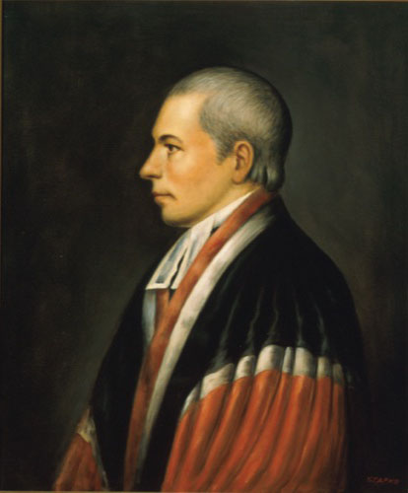
William Patterson
Option #2: NEW JERSEY PLAN by William Patterson called for a unicameral
legislature based on equal representation

Slide 5
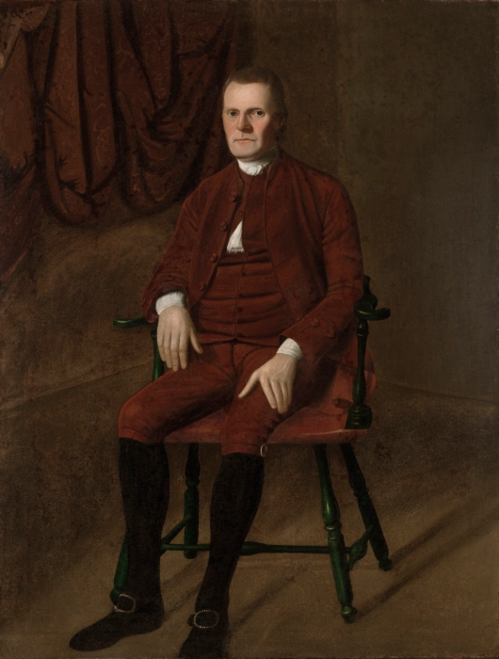
Option #3: “GREAT COMPROMISE” or CONNECTICUT COMPROMISE by Roger Sherman of CT – bicameral legislature
with the Senate based on equal representation and the House of Representatives based on population
Roger Sherman

Slide 6
The Decision?
Option #3: The Great Compromise

Slide 7
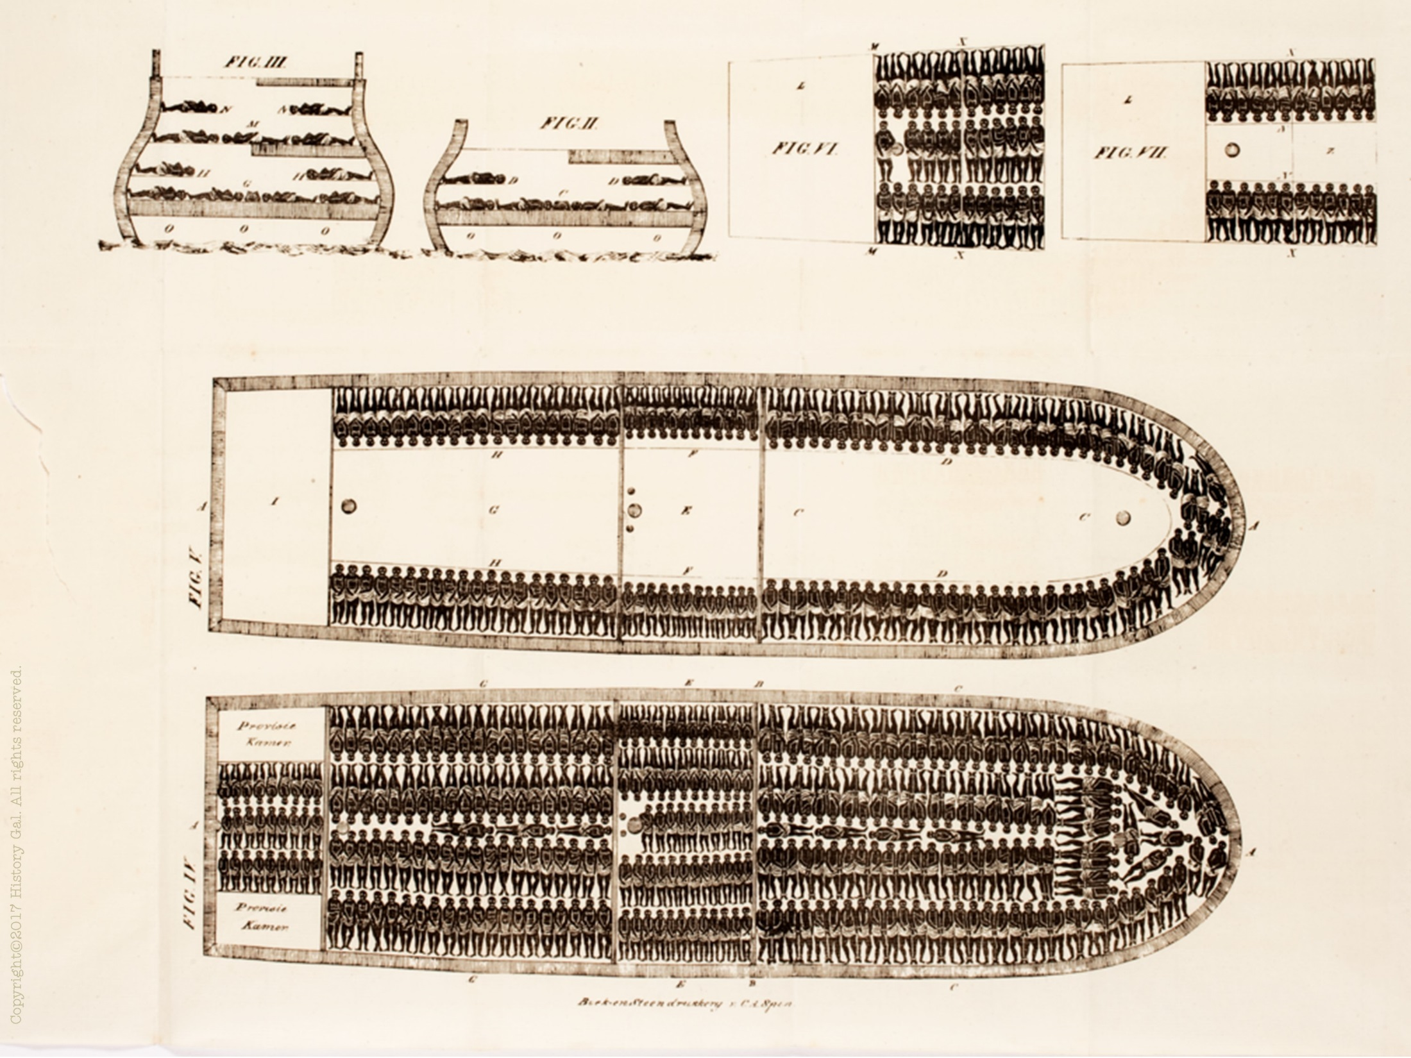
SLAVERY QUESTIONS
1. Would slaves count for population based representation?
3/5 COMPROMISE – slaves would count as 3/5 a person for the House of Representatives and for tax purposes

Slide 8
2. Would slavery be outlawed?
COMMERCE AND SLAVE TRADE COMPROMISE – Congress would not tax state exports and the slave trade would end in 1808
FUGITIVE SLAVE CLAUSE – “a person held to service or labour” who fled to another state would be returned to their owner

Slide 9
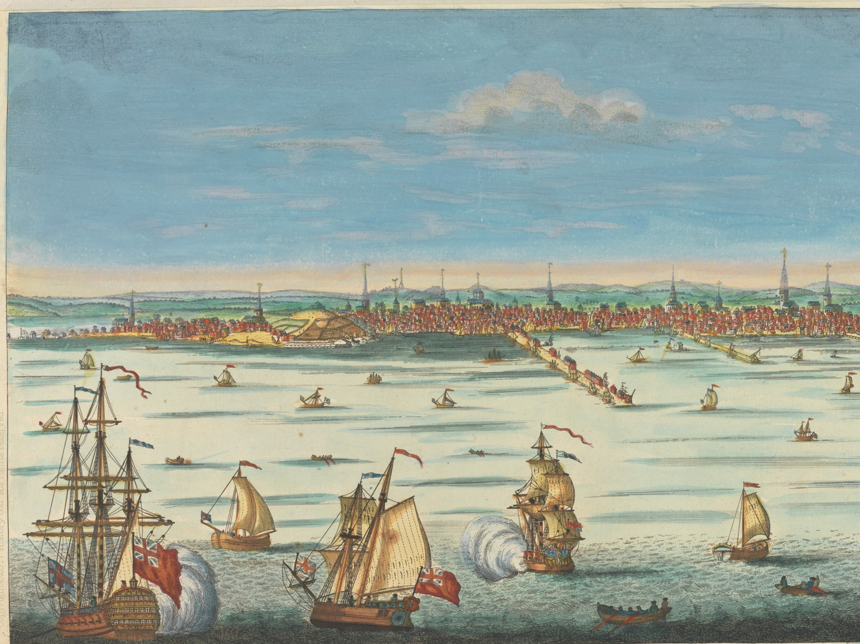
WHO WOULD BE IN CONTROL OF TRADE – STATES OR NATIONAL GOVERNMENT?
Congress can regulate interstate and foreign trade, could put tariffs on imports

Slide 10
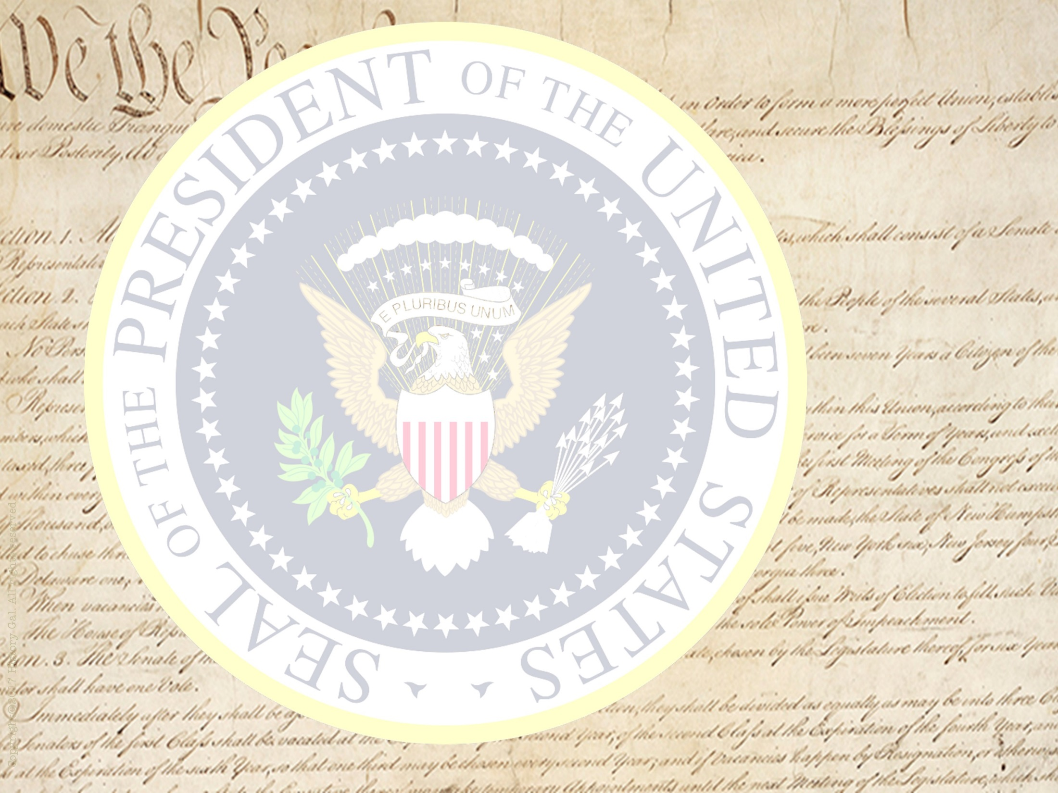
WHO WOULD BE THE LEADER OF THIS NEW GOVERNMENT?
President with power of veto, elected to a 4 year term (no term limit)
elected by the electoral college (voters for President chosen by local elections), winner has most electoral votes, runner up becomes Vice President

Slide 11
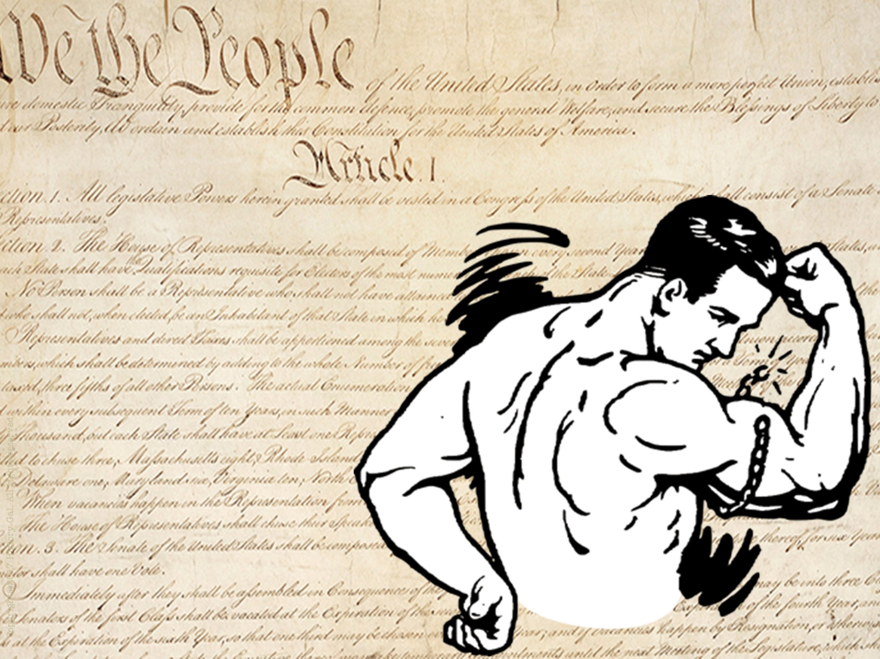
WHO HAS THE SUPREME POWER – STATES OR NATIONAL GOVERNMENT?
SUPREMACY CLAUSE – U.S. Constitution is supreme law of the land
NECESSARY AND PROPER CLAUSE (“elastic clause”) – gives Congress power to carry out the expressed powers listed in the Constitution

Slide 12
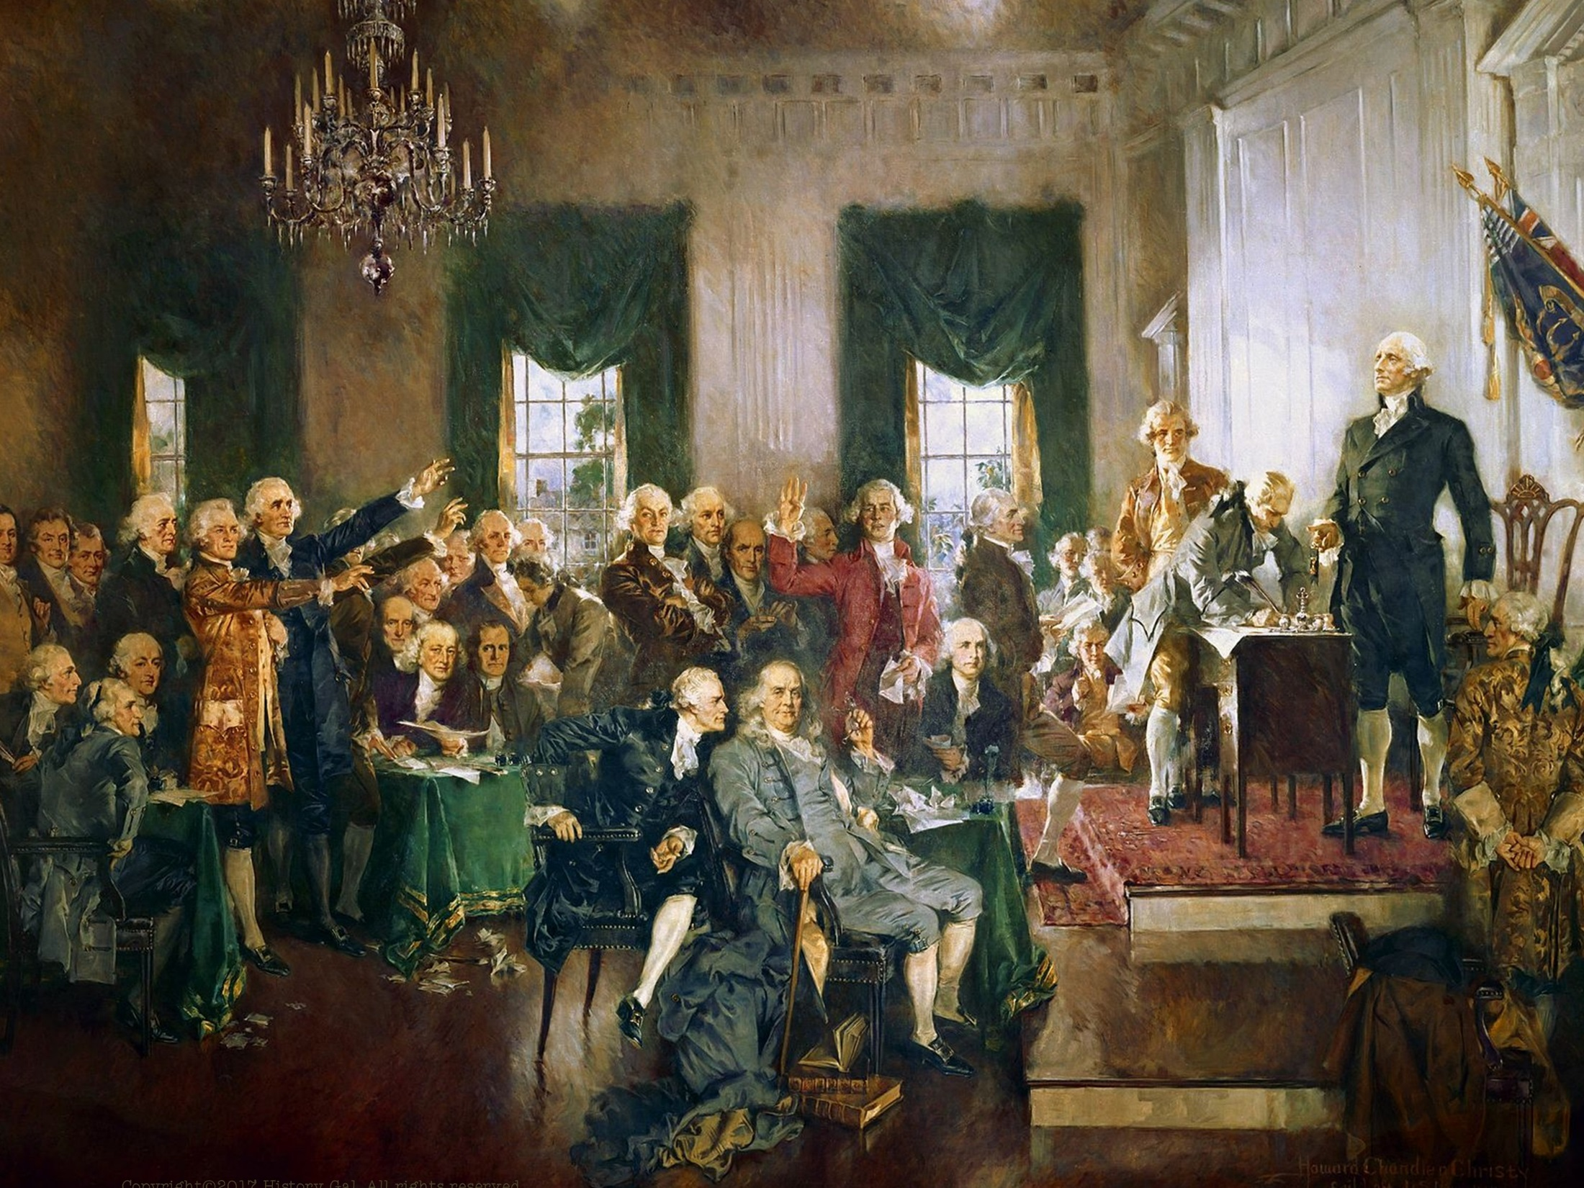
September 17, 1787 – Philadelphia Convention approved a draft of the Constitution to submit to the states for ratification
Constitutional Convention with raps by Alexander Hamilton
Constitutional Convention for Dummies

Slide 13
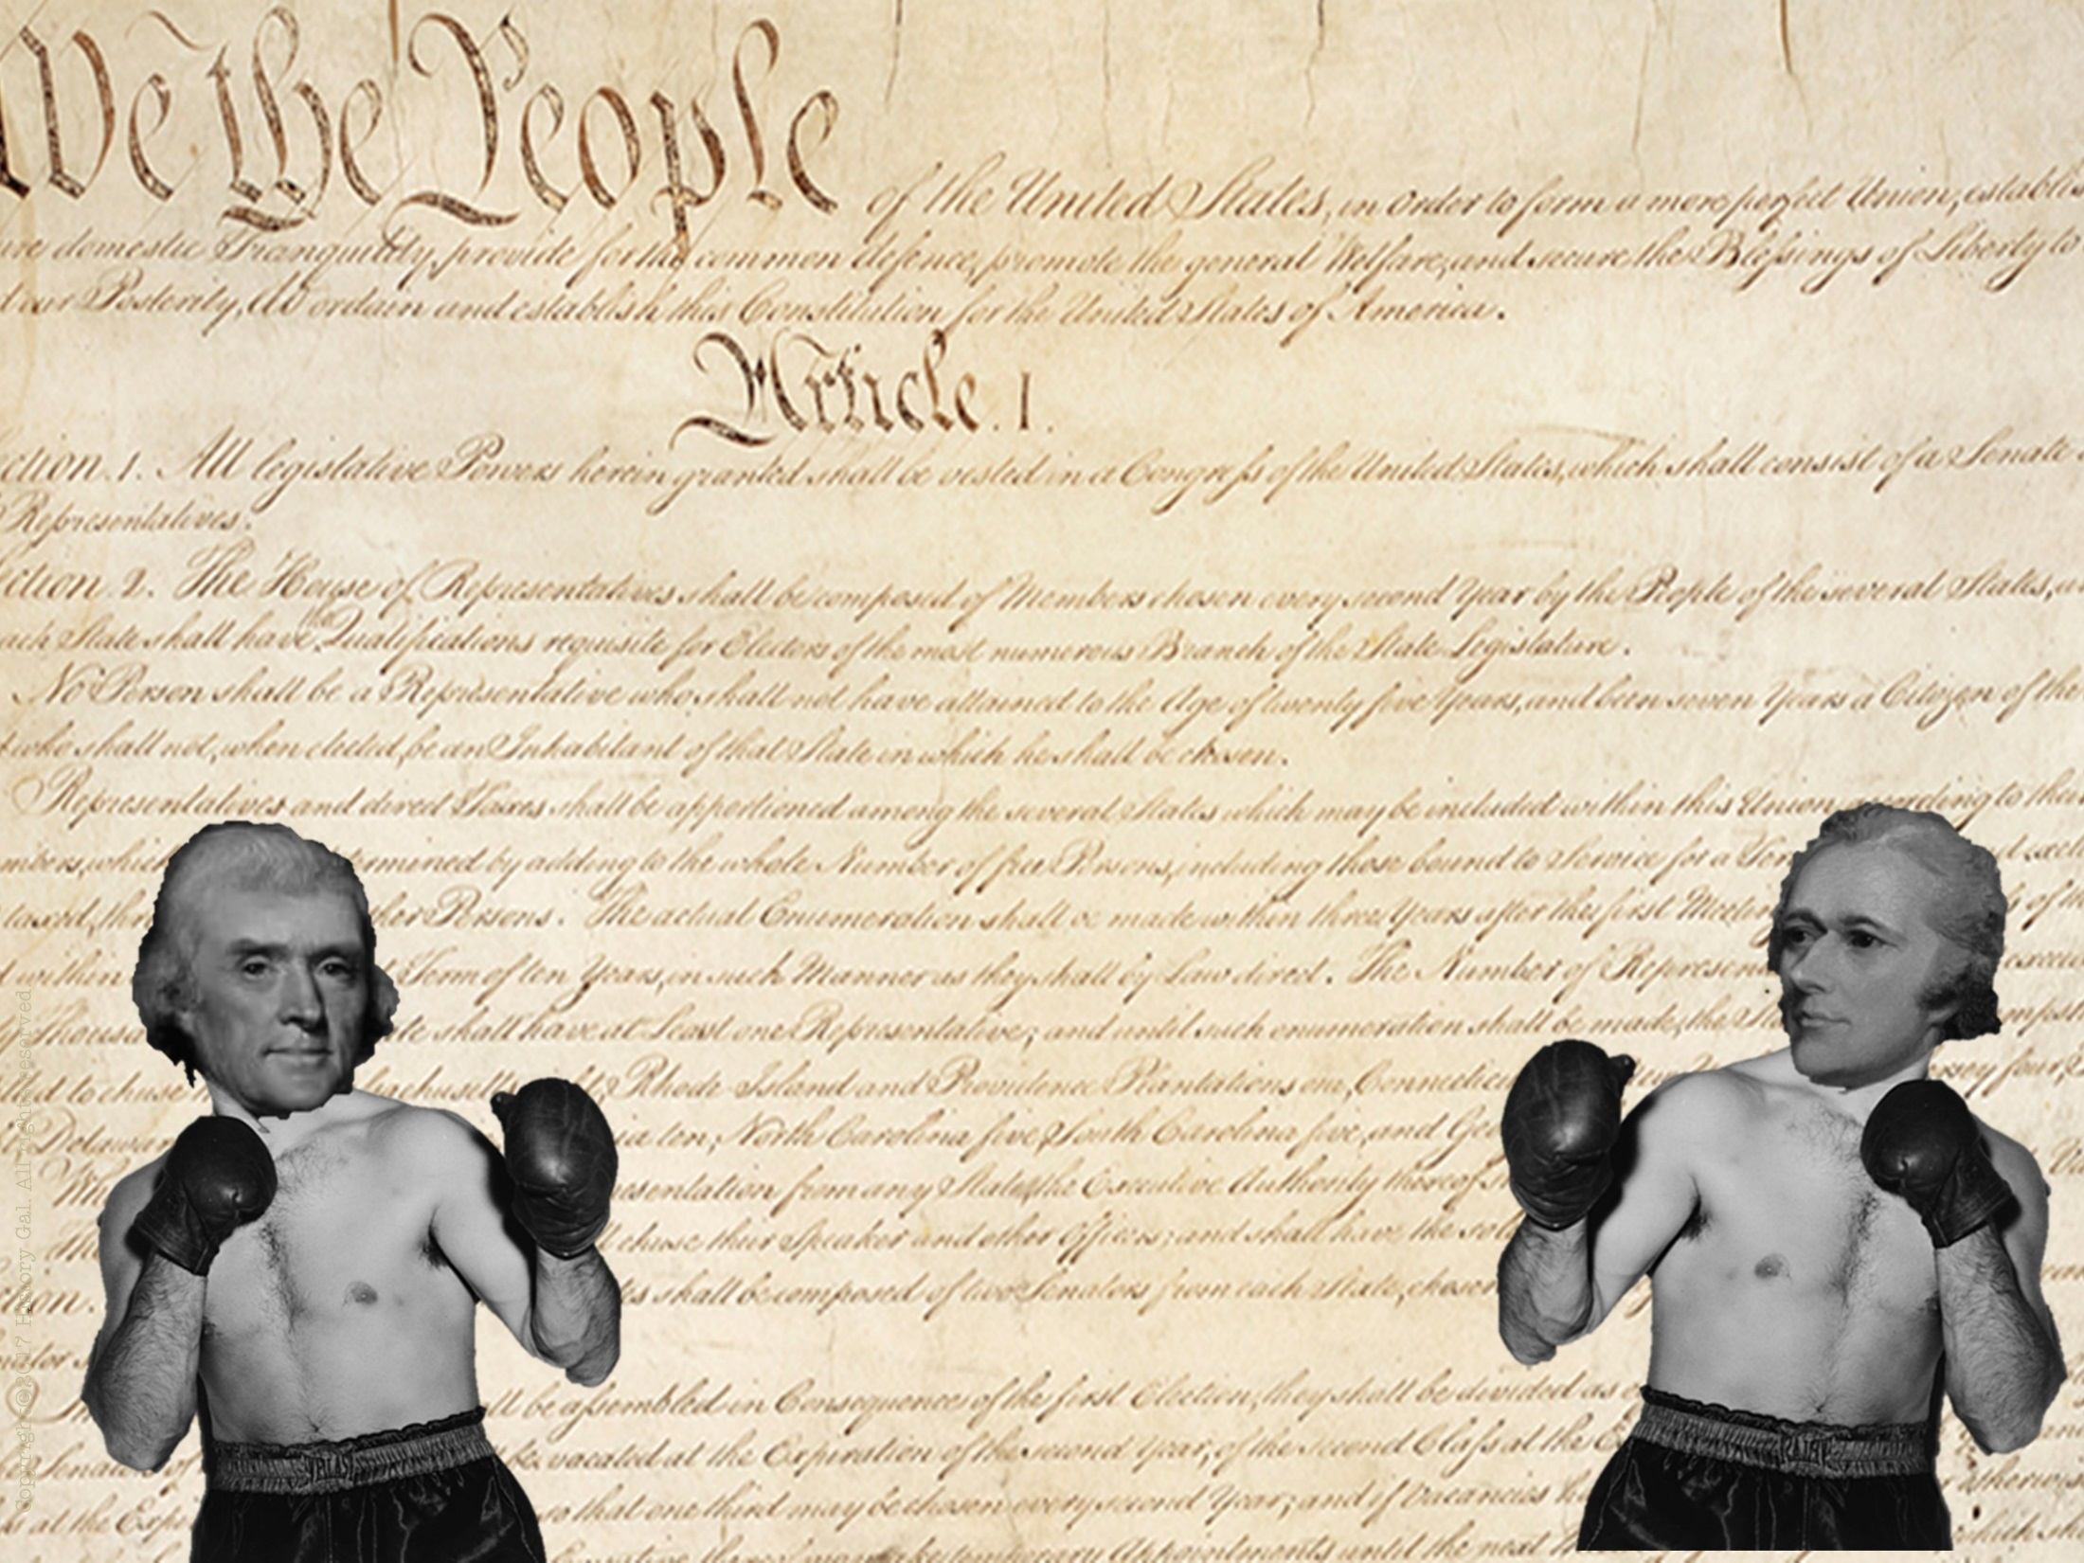
9 out of 13 states had to ratify the Constitution before it could go into effect
Ratification Debate:
FEDERALISTS – supported the Constitution and strong national government
ANTI-FEDERALISTS – opposed a
strong national government
Federalist v. Anti-Federalists
Why wasn’t the Bill of Rights Originally in in the Constitution?

Slide 14
FEDERALISTS
ANTI-FEDERALISTS
George Washington
Ben Franklin
James Madison
Alexander Hamilton
George Mason, Patrick Henry, James Winthrop, John Hancock, George Clinton
LEADERS
A strong national government was needed to maintain order and preserve the Union
A strong central government would destroy the work of the Revolution, limit democracy and limit states’ rights
ARGUMENTS
Emphasized the weaknesses of the Articles of Confederation, showed their opponents as negative with no solutions
Argued that the proposed Constitution contained no protection of individual rights, it gave the central government more power than the British king ever had
STRATEGY
Strong leaders, well organized
Appealed to popular distrust of
government
ADVANTAGES
Poorly organized, slow to respond to Federalist challenge
Constitution was new and
untried, lacked a bill of rights
DISADVANTAGES
Federalists v. Anti-Federalists

Slide 15
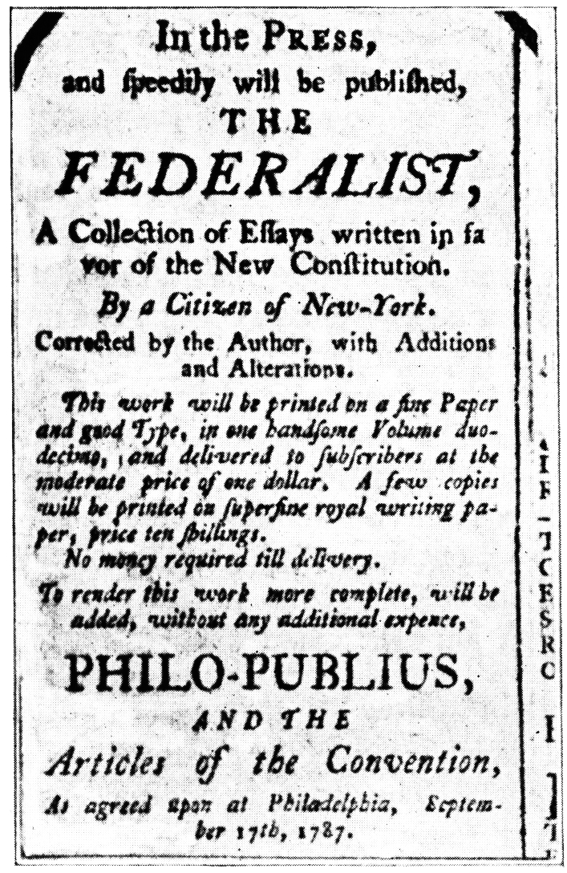
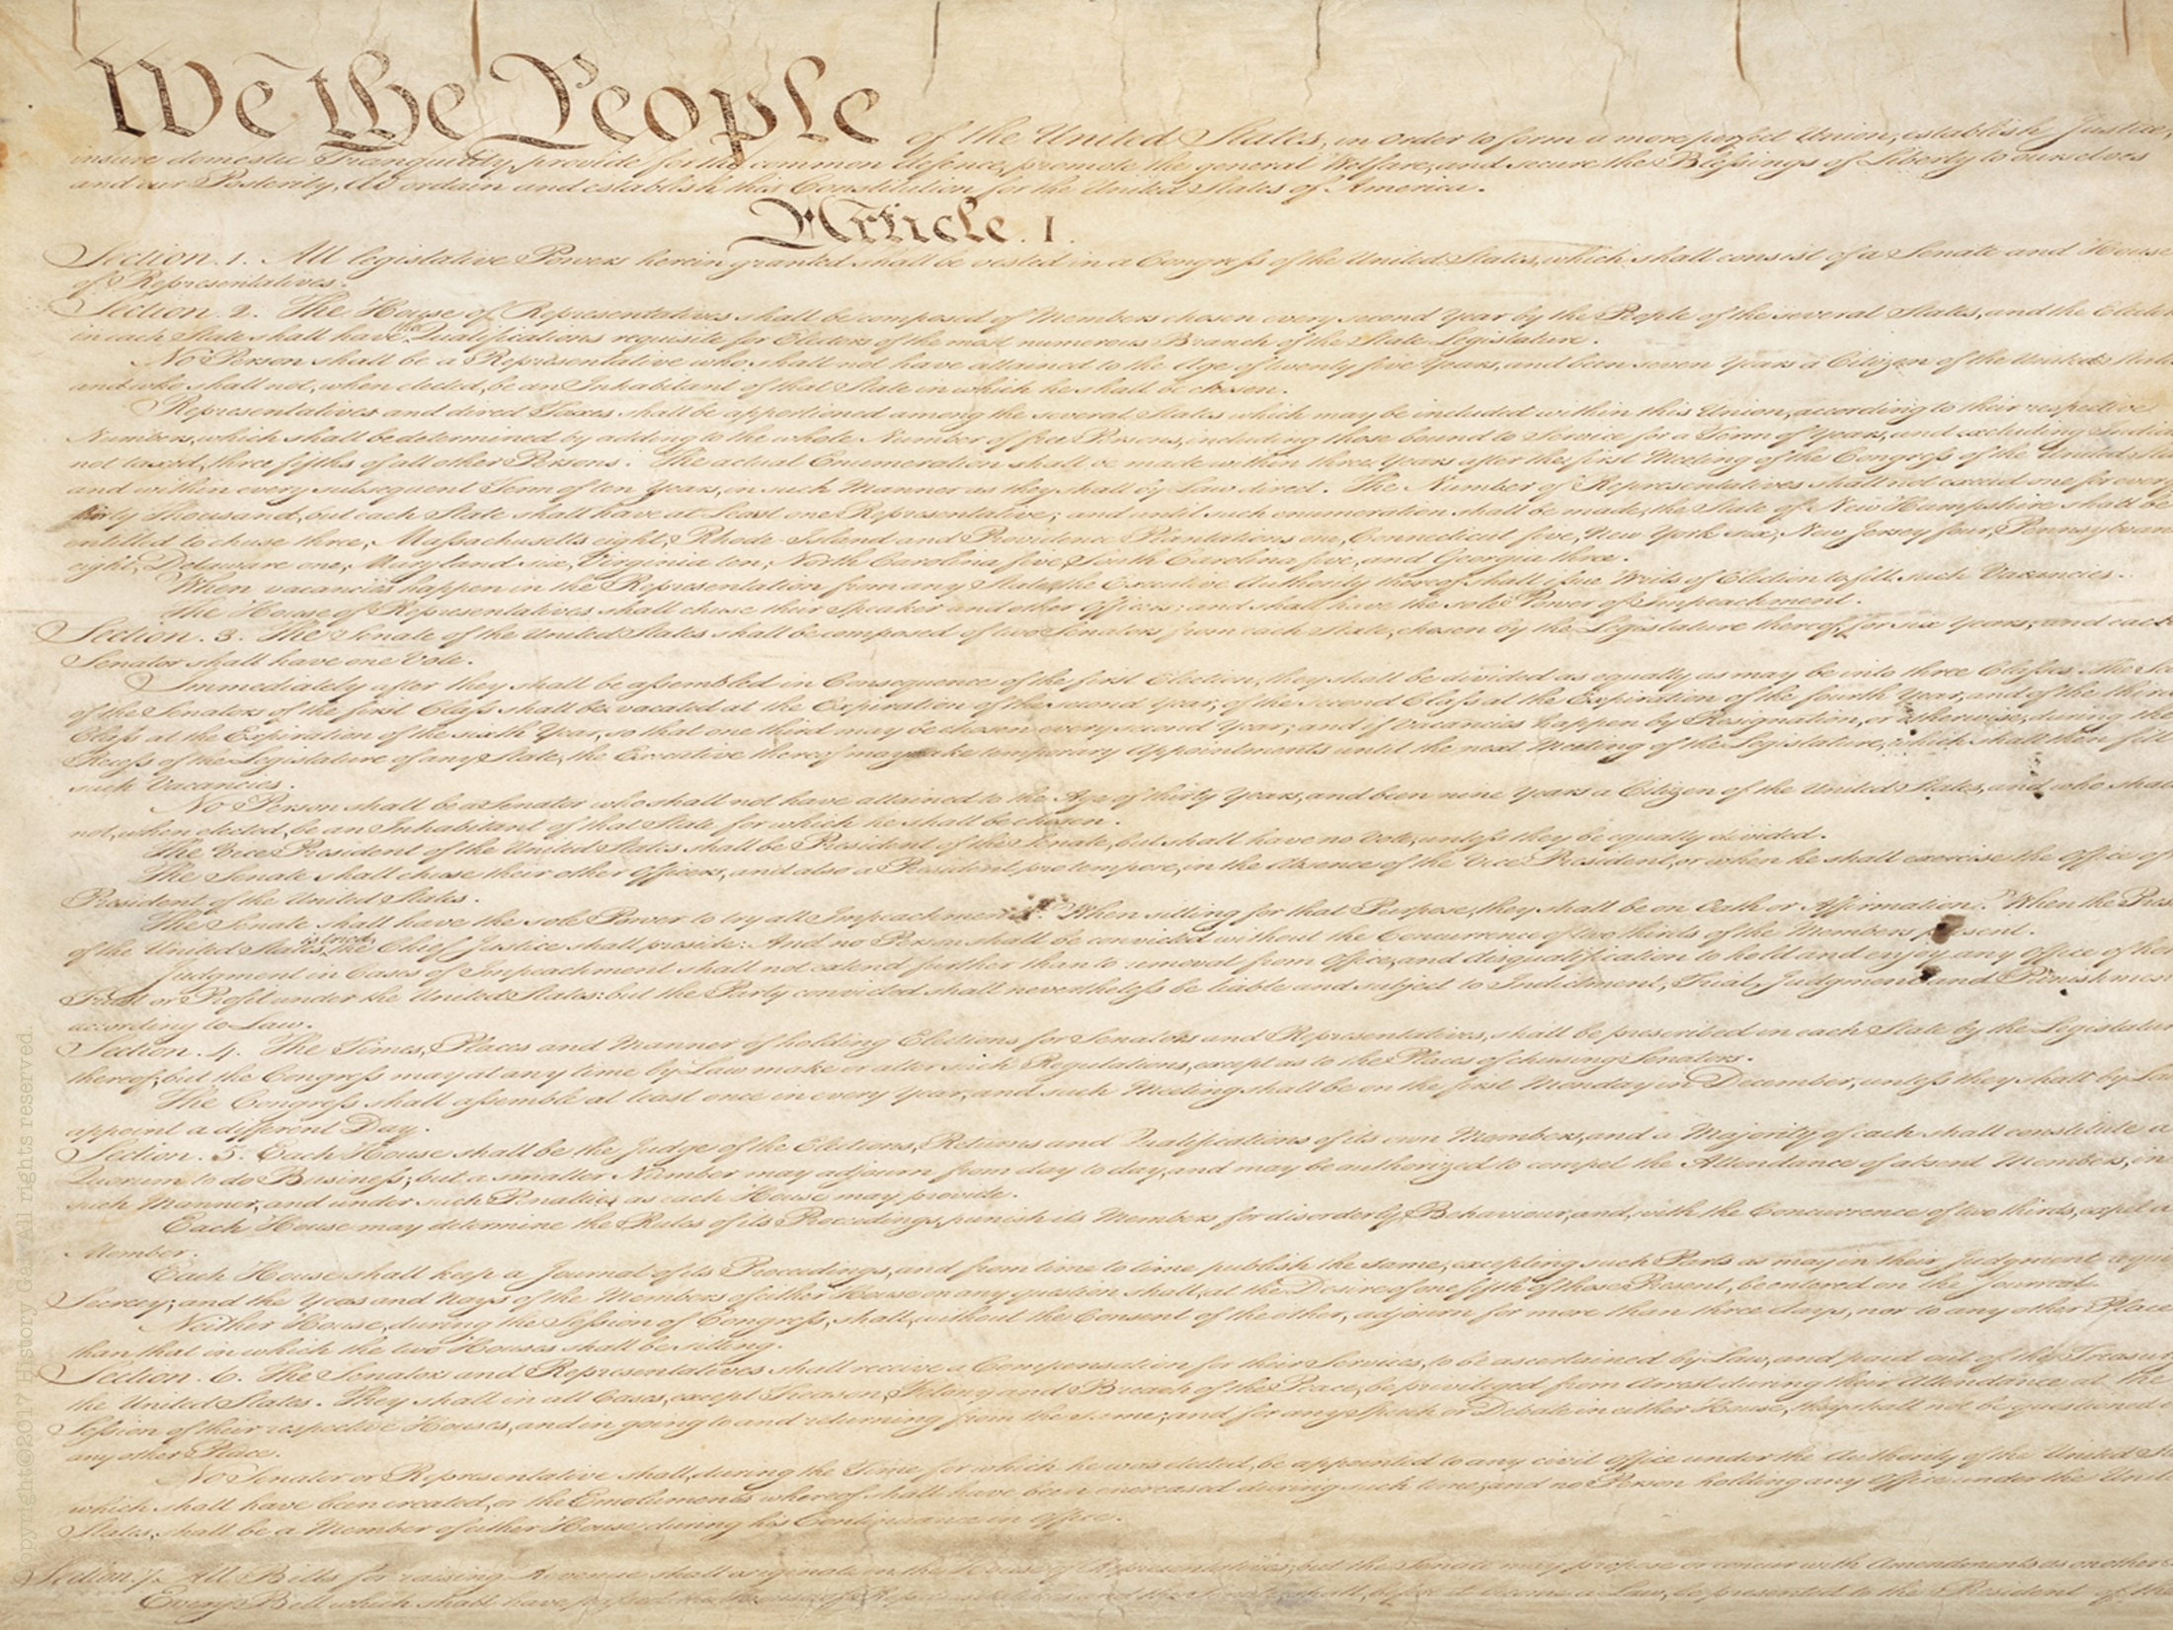
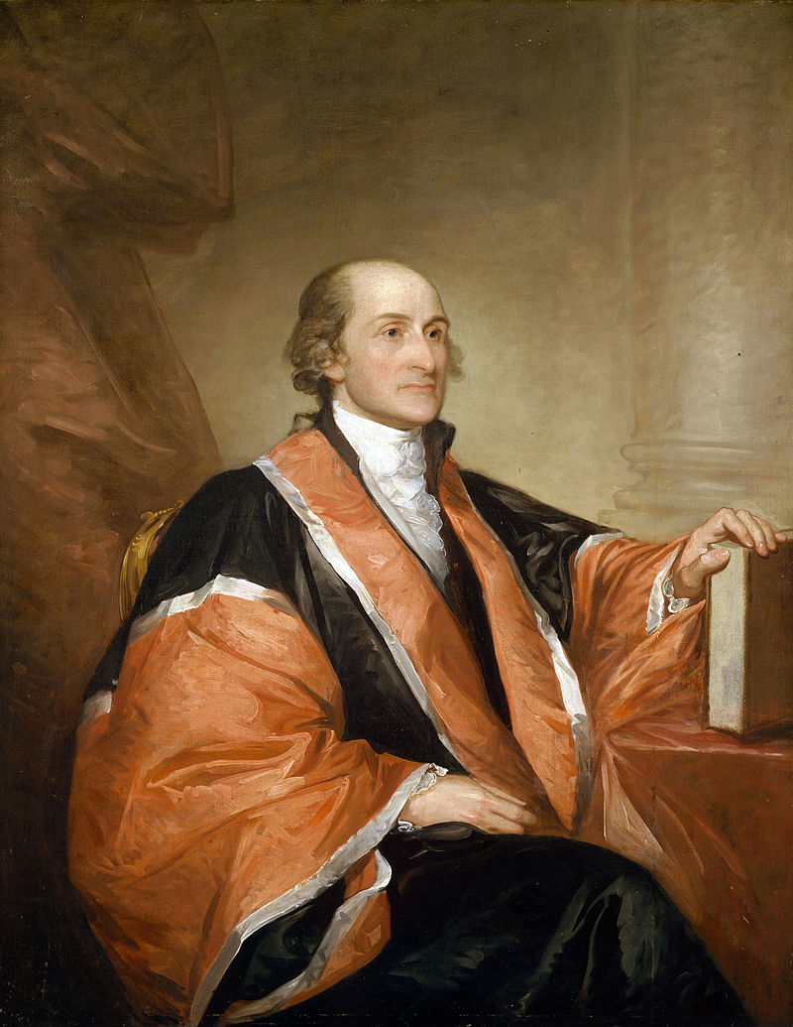
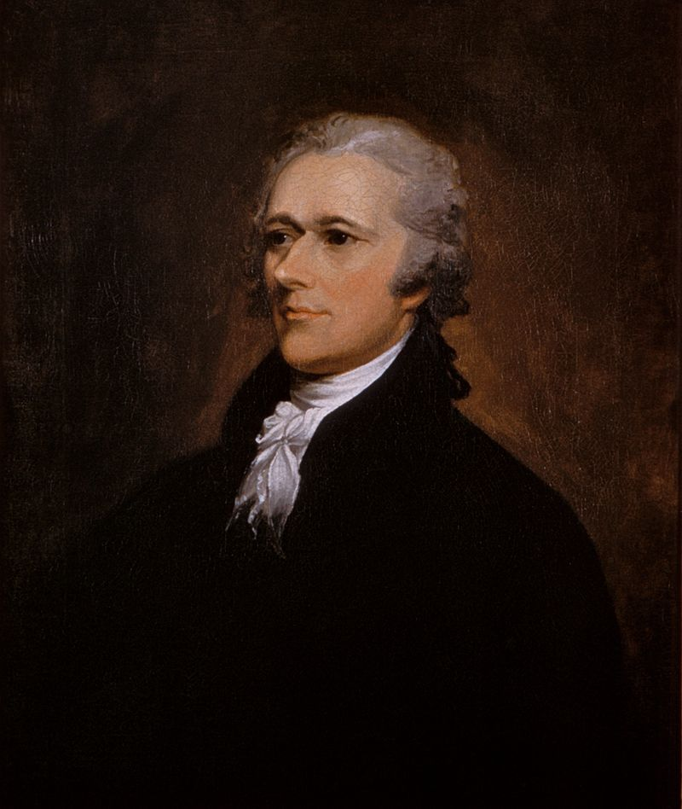
FEDERALISTS PAPERS
To try to convince people to accept the Constitution, James Madison, Alexander Hamilton, John Jay wrote the Federalist Papers (85 essays that gave reasons for ratification)
James Madison
John Jay
Alexander Hamilton

