Slide 1
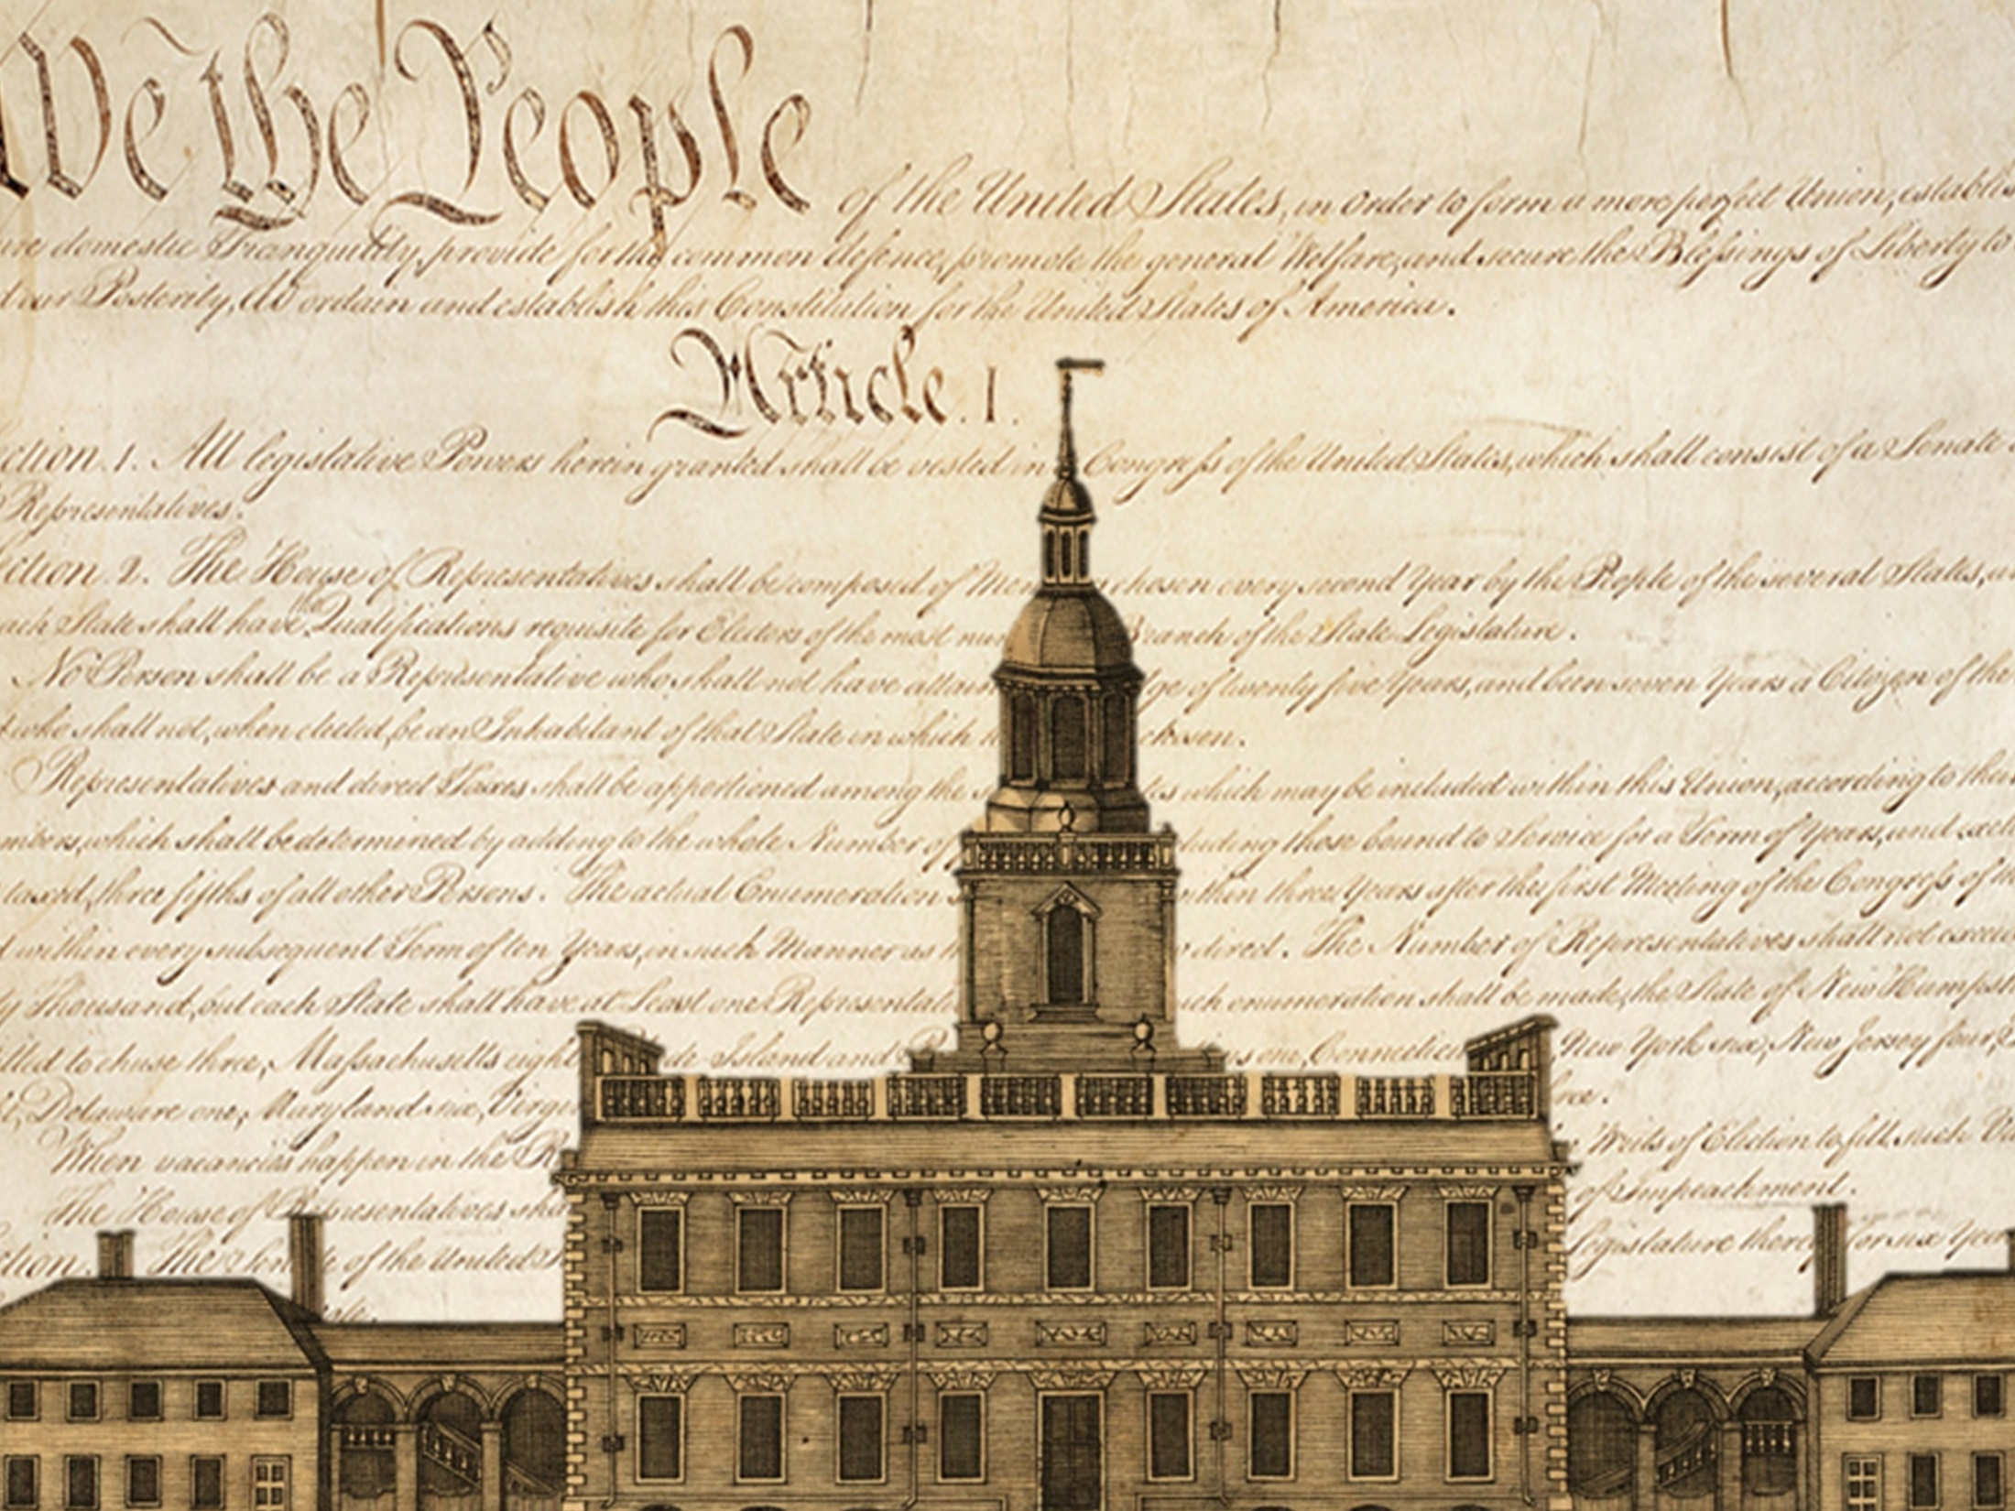
PHILADELPHIA CONVENTION –
All states except
Rhode Island sent
delegates
(total of 55
delegates)
May – Sept. 1787
The Making of the Constitution
History Channel Constitution Convention Video
Introduction to Constitutional Convention Video

Slide 2
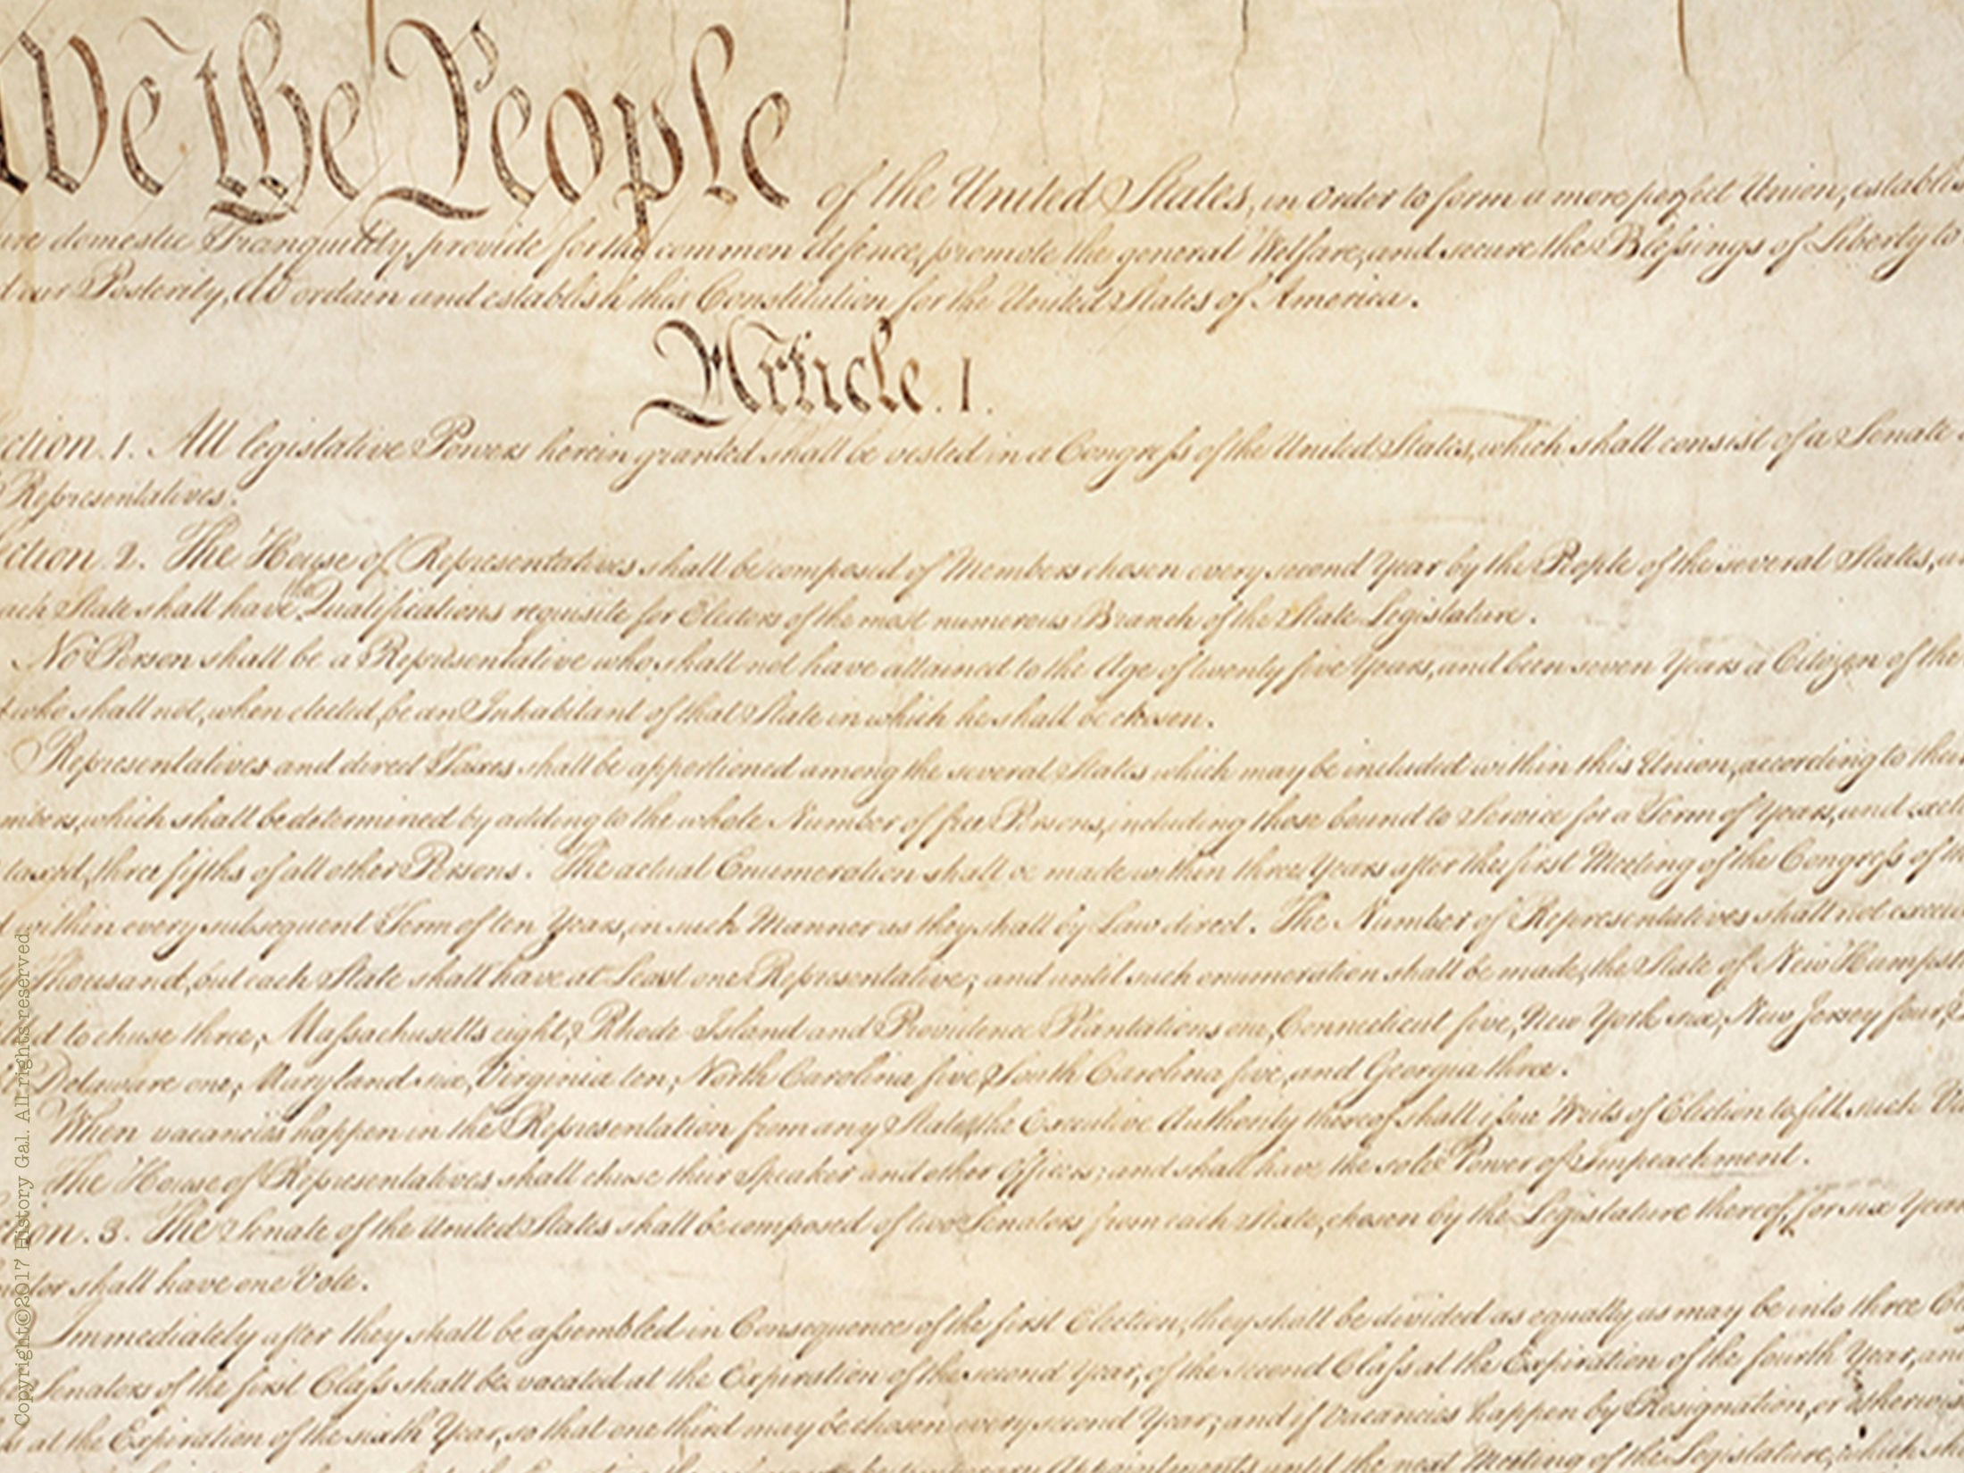
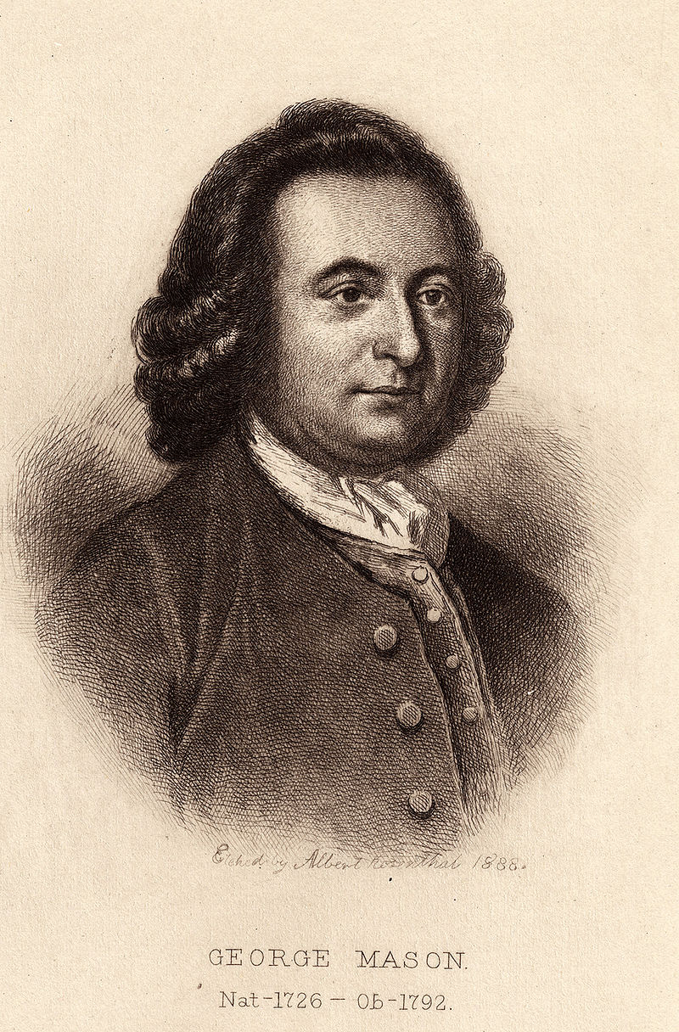
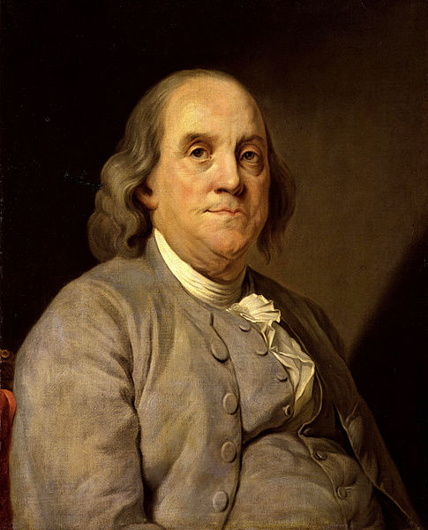
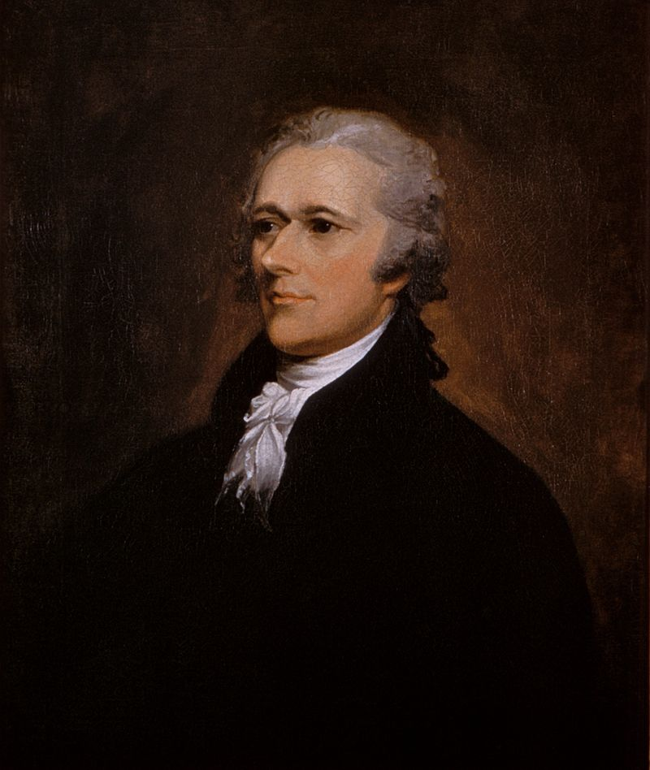
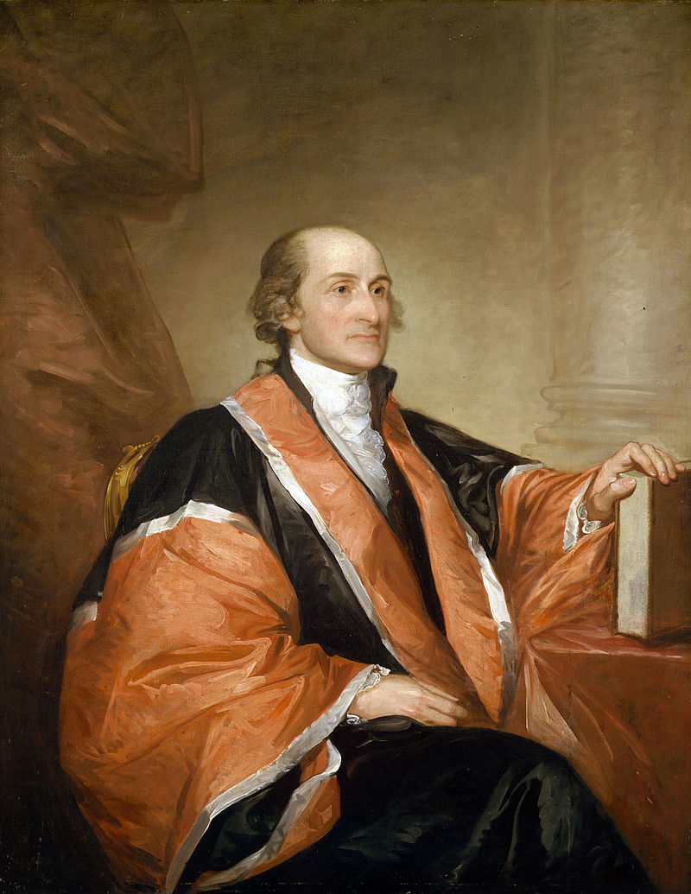
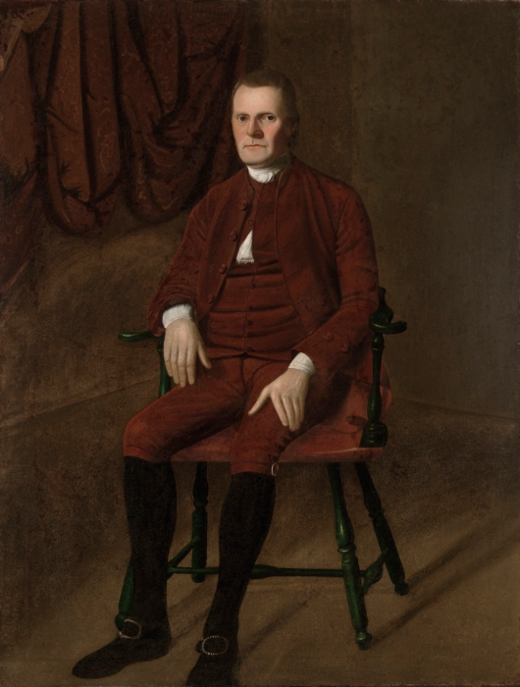
WHO ATTENDED?
George Mason
Benjamin
Franklin
Alexander Hamilton
Roger Sherman
John Jay

Slide 3
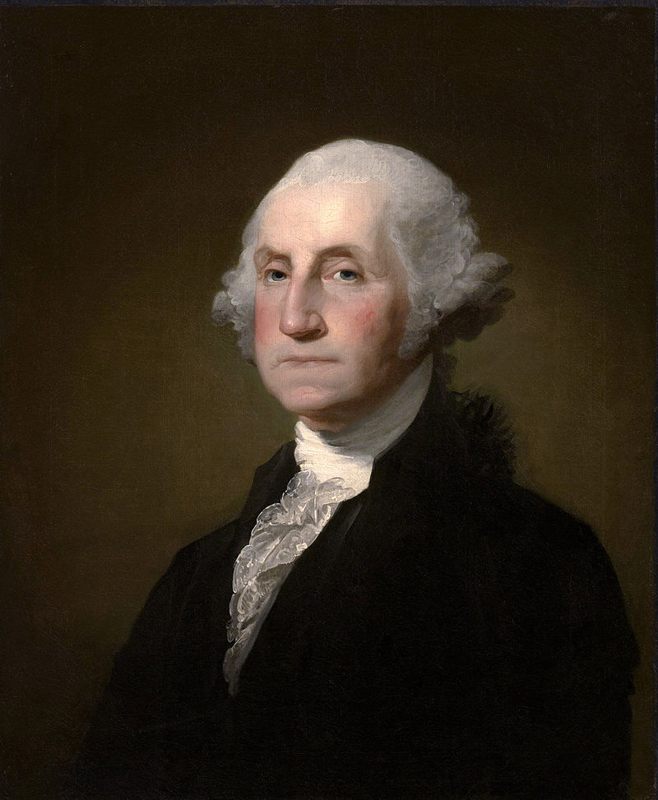
George Washington
Presided over the convention

Slide 4
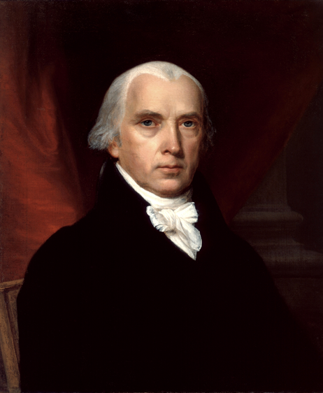
Considered “The Father of the Constitution”
Main author of Constitution
Took diligent notes on every debate and discussion that occurred during the convention (that’s how we know today who said what and the reasoning behind their decisions)
Very well read and educated on democratic philosophies
James Madison

Slide 5
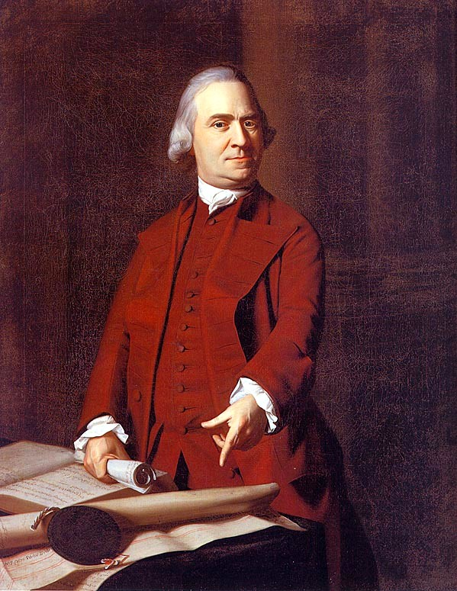
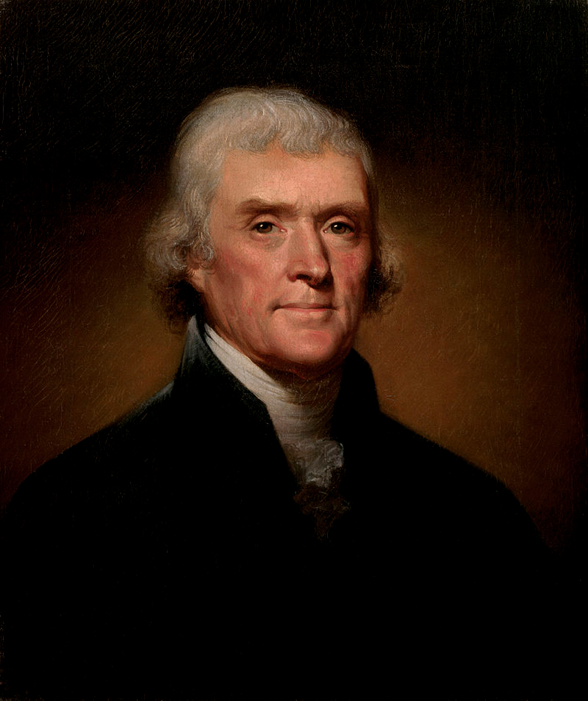
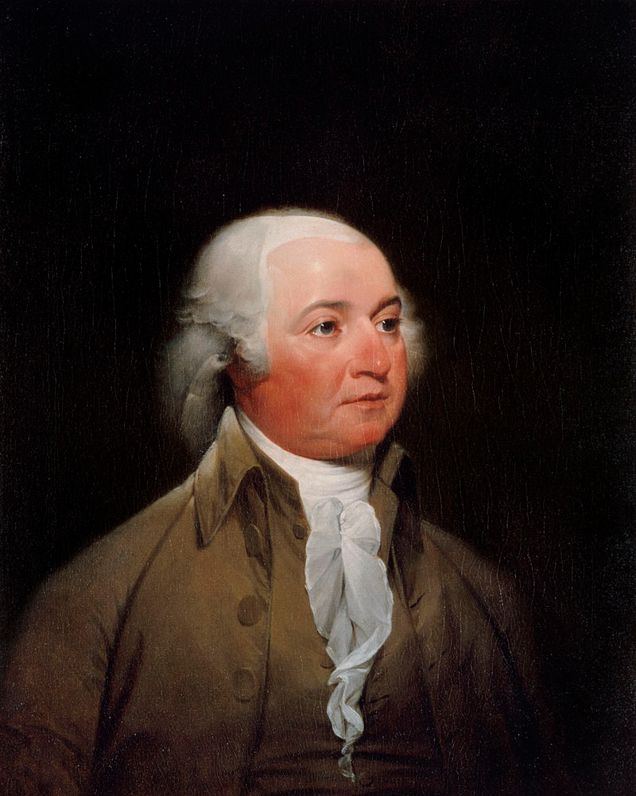
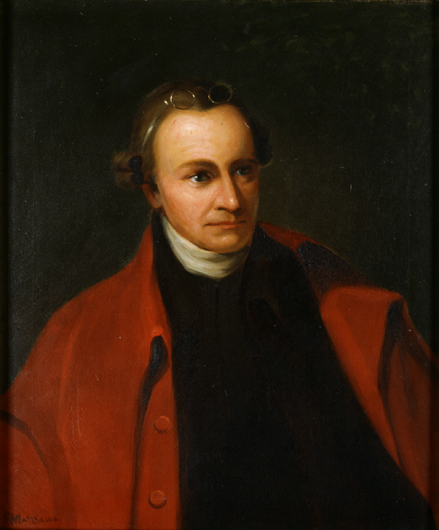
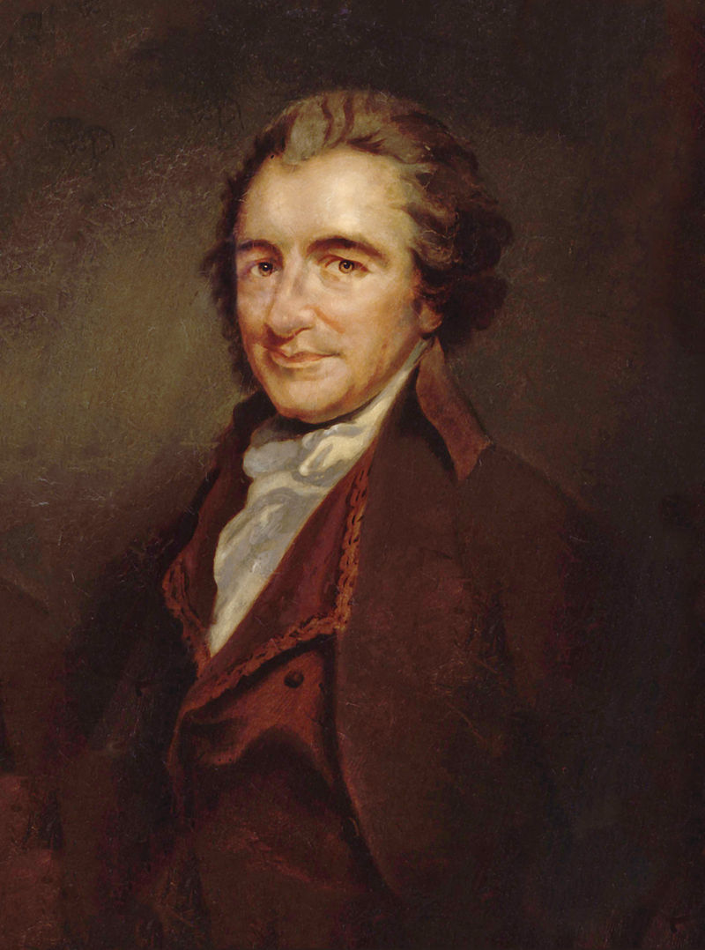
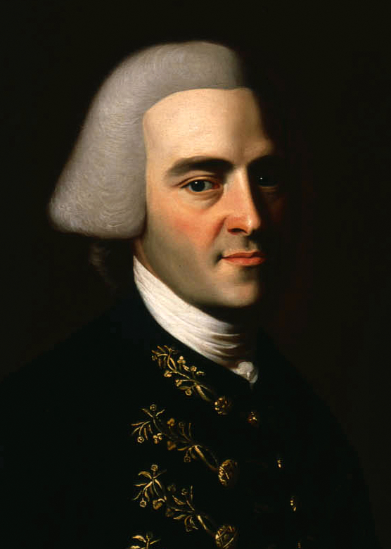
WHO DID NOT ATTEND?
Samuel Adams (declined to go –did not want the central government to have too much power)
Thomas Jefferson (serving as U.S. ambassador in France)
John Adams (serving as U.S. ambassador in Great Britain)
Patrick Henry
(refused to attend saying, he “smelt a rat in Philadelphia, tending toward the monarchy.”)
John Hancock (invited but did not attend possibly due to illness or his responsibilities as governor of Massachusetts)
Thomas Paine (living in Europe)

Slide 6
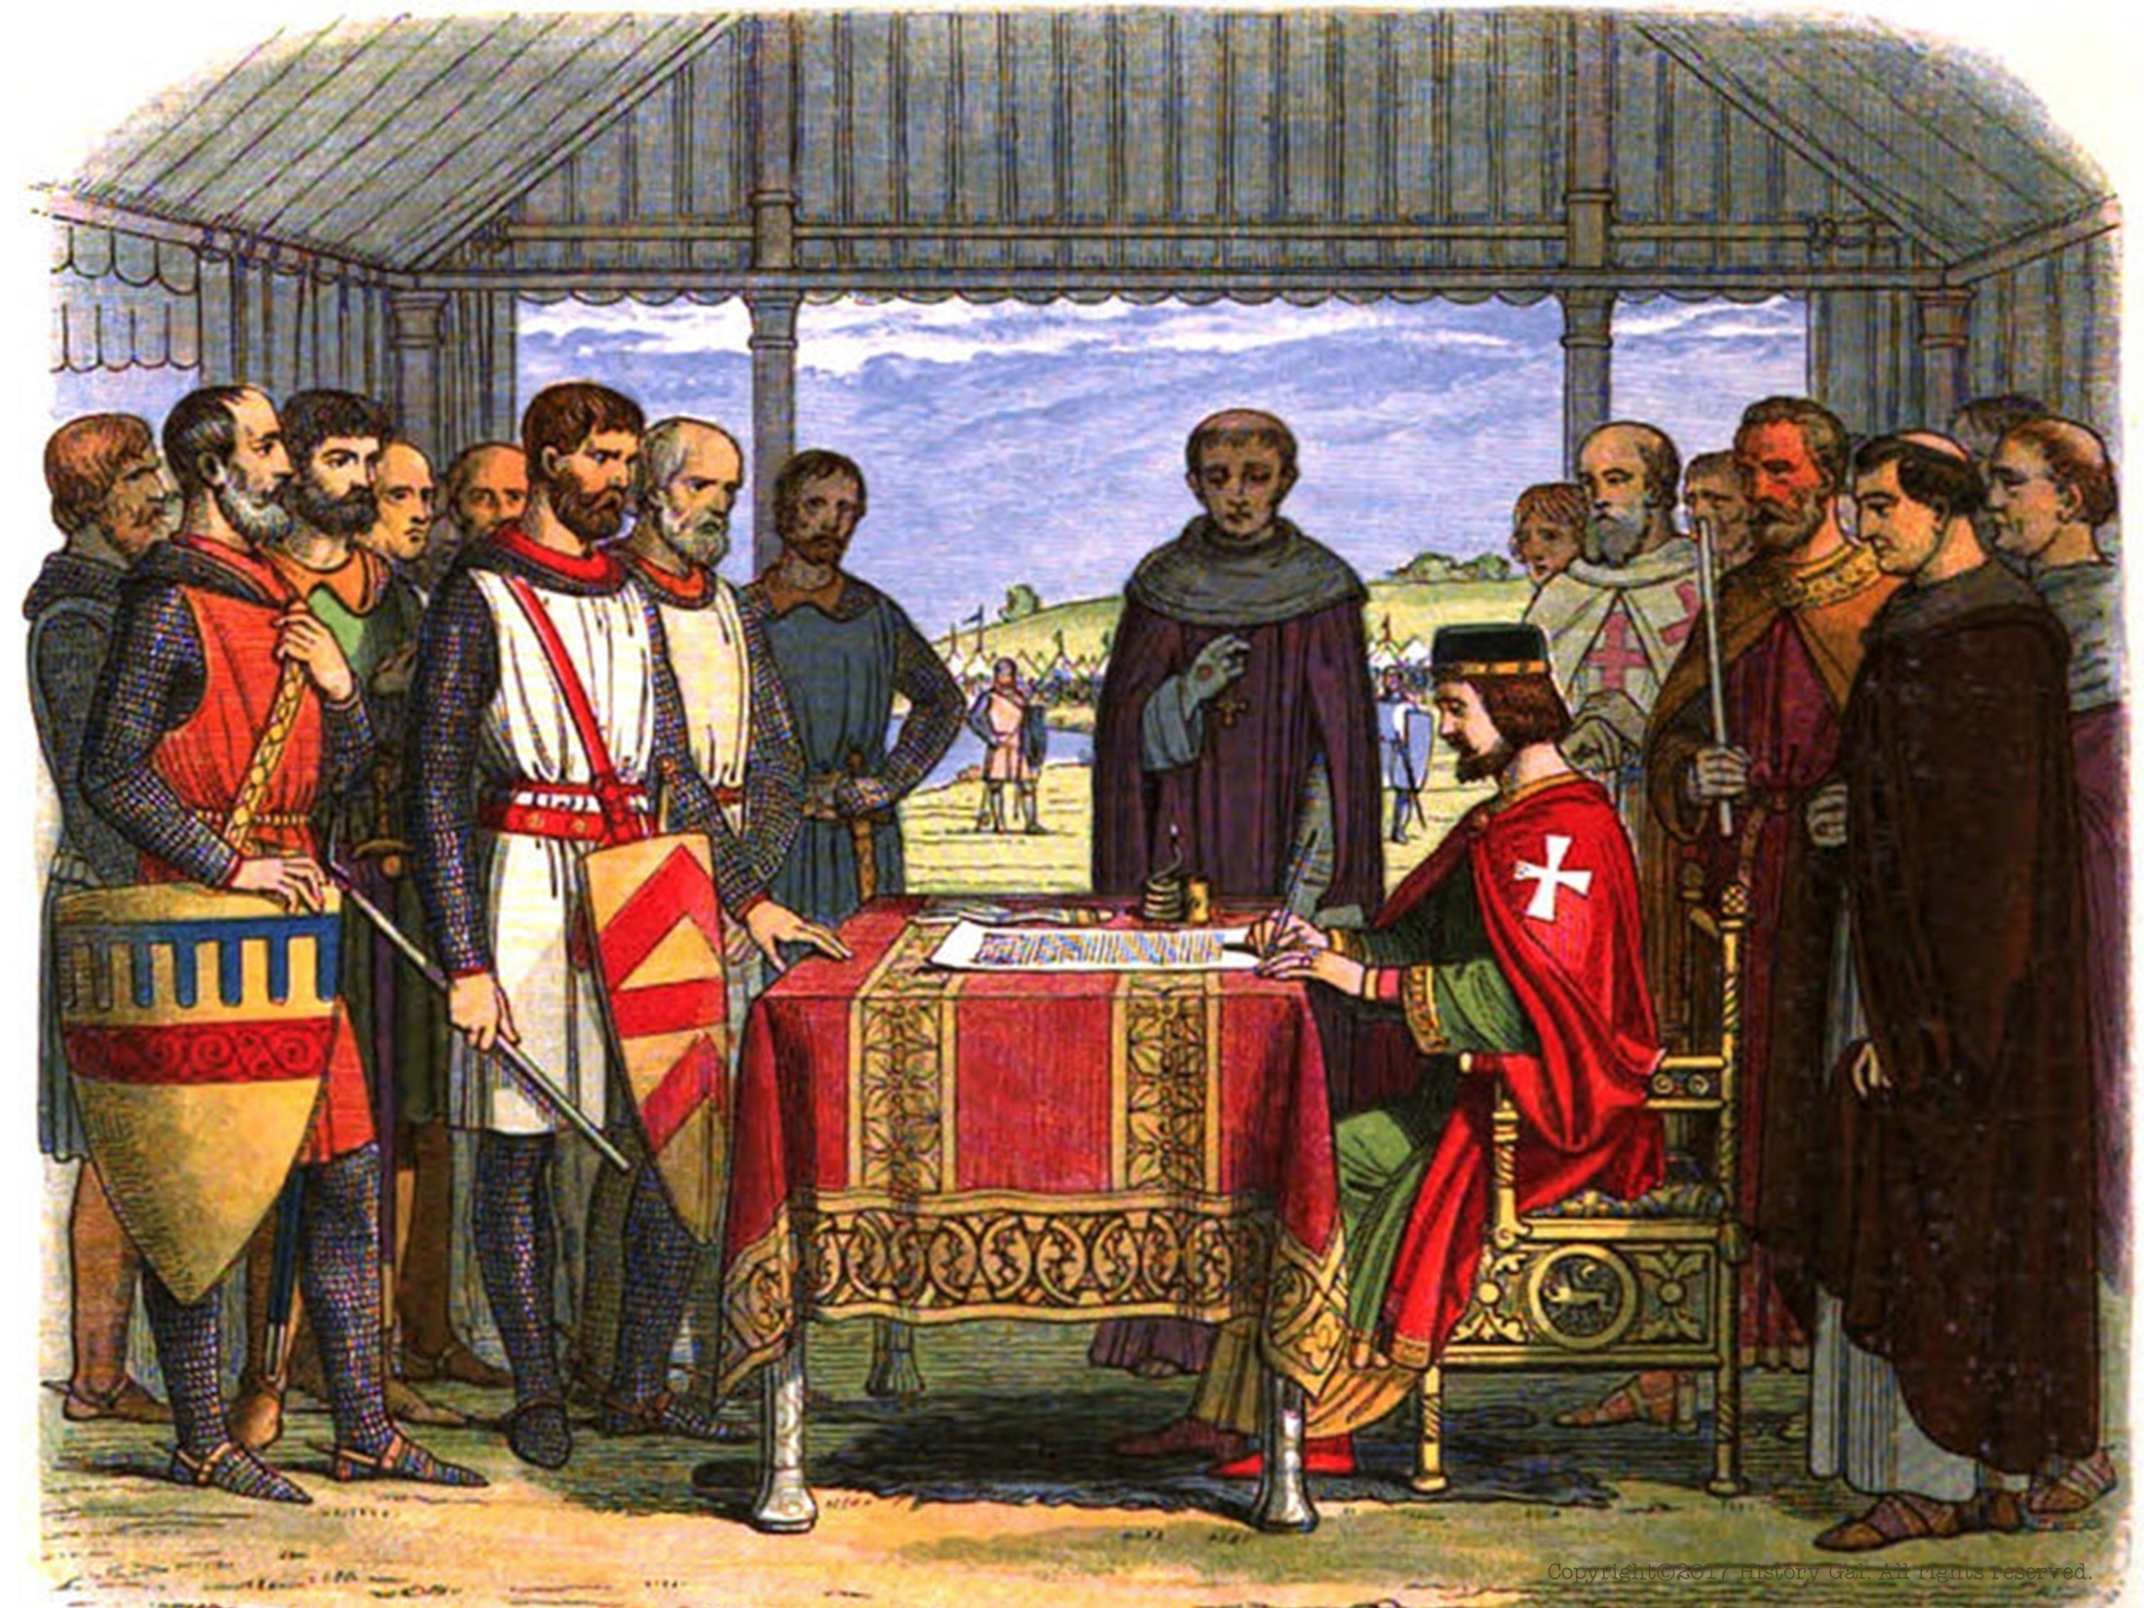
HISTORICAL FOUNDATIONS AND TRADITIONS THAT INFLUENCED THE FOUNDING FATHERS:
From
England
Magna Carta (1215)
John Locke’s “Natural Rights” (1689)
English Bill of Rights (1689)
England’s Parliament – bicameral House of Lord and House of Commons
What Would John Locke Say Song

Slide 7
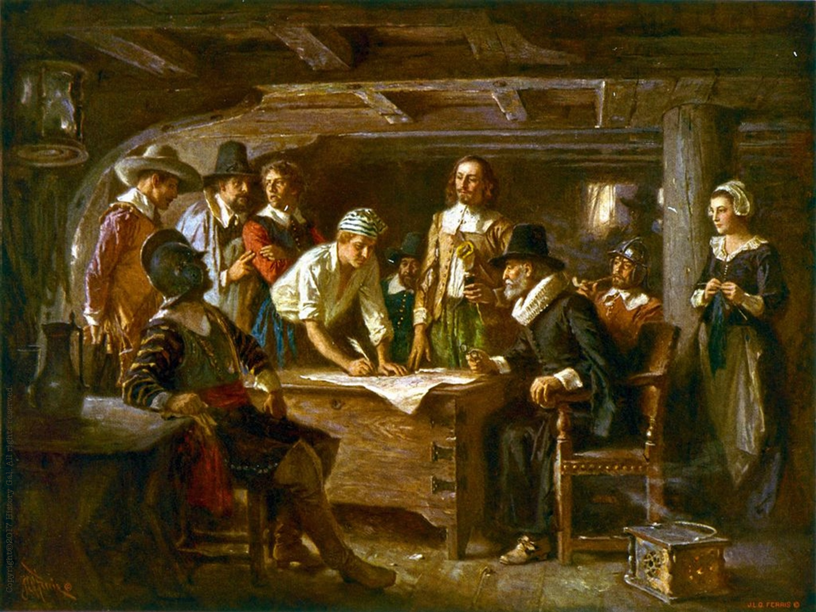
HISTORICAL FOUNDATIONS AND TRADITIONS THAT INFLUENCED THE FOUNDING FATHERS:
From 13 Colonies
Virginia House of Burgesses (1619)
Charter Colonies could elect their own officials vs. Royal and Proprietary Colonies -appointed by the King
Mayflower Compact (1620)
Fundamental Orders of Connecticut (1639)
Maryland Toleration Act (1649)
Peter Zenger Trial (1735)
Peter Zenger Trial Video

Slide 8
BASIC PRINCIPLES CONTAINED
IN THE CONSTITUTION
POPULAR SOVEREIGNTY – power comes from the people
LIMITED GOVERNMENT – government can only do what people give it permission to do
SEPARATION OF POWERS – powers are divided between separate branches of government

Slide 9
CHECKS AND BALANCES – Powers of each branch are checked and balanced by the other branches
FEDERALISM – division of power between a central government and local government
JUDICIAL REVIEW– authority of Supreme Court to declare laws unconstitutional – NOT in the Constitution but will become an important role of the Supreme Court in 1803 with the ruling of Marbury v. Madison

