Slide 1
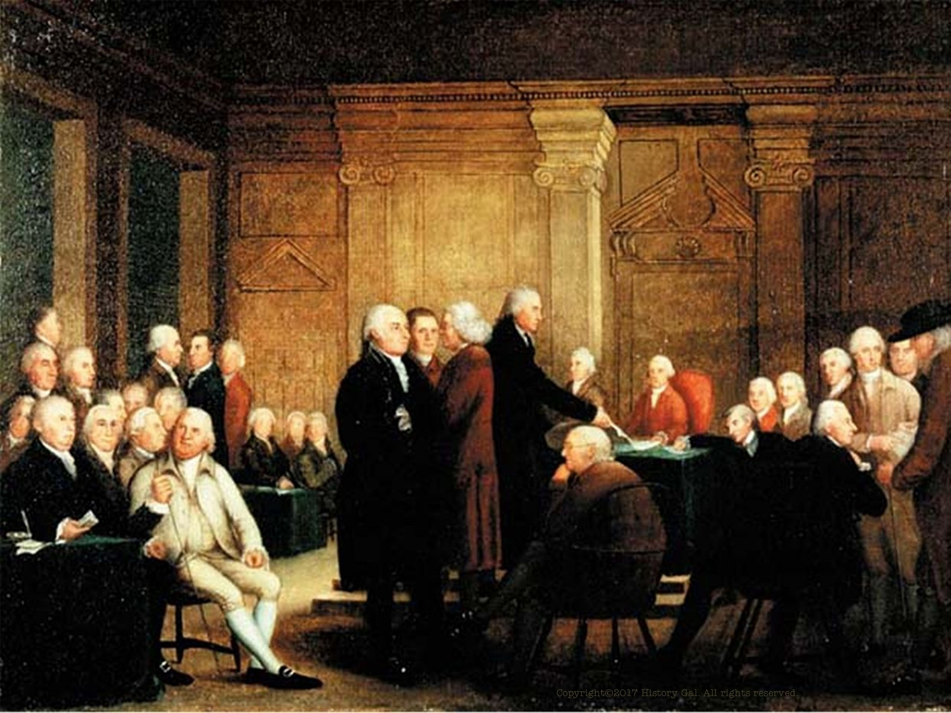
A NEW NATION

Slide 2
The colonies may have won their independence from Great Britain, but they still had to create a government that would keep the colonies together and help the new nation – the United States – prosper.

Slide 3
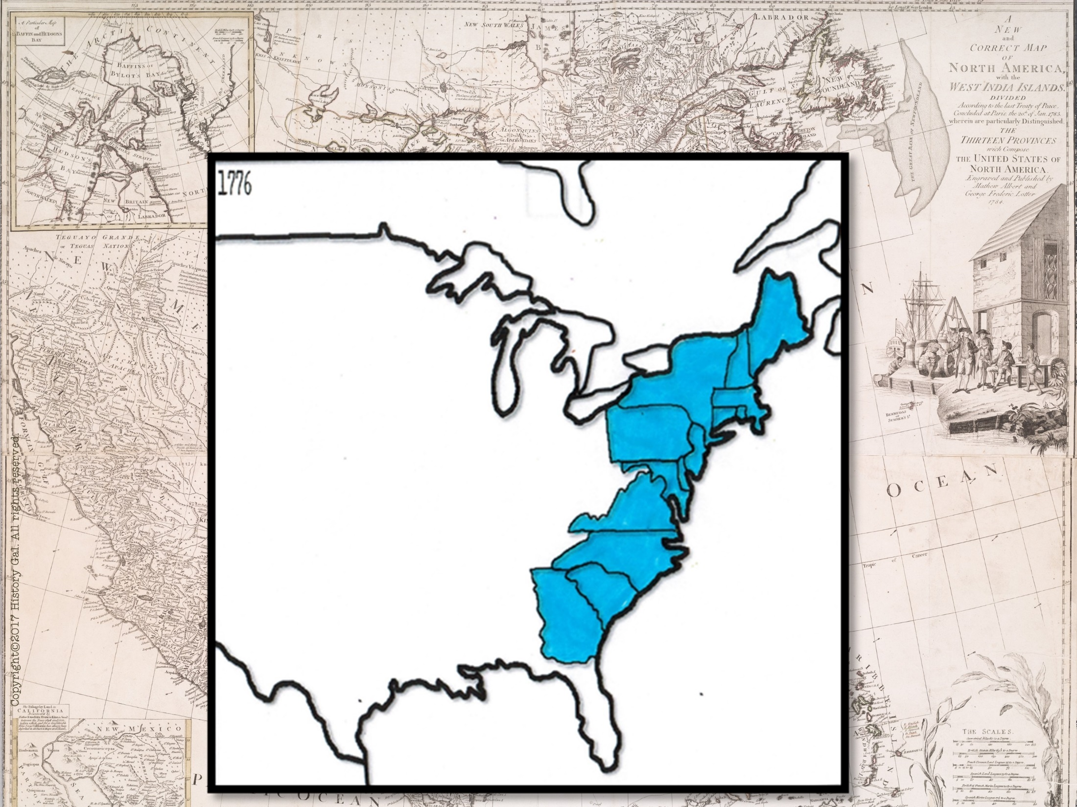
13 COLONIES BEFORE THE AMERICAN REVOLUTION

Slide 4
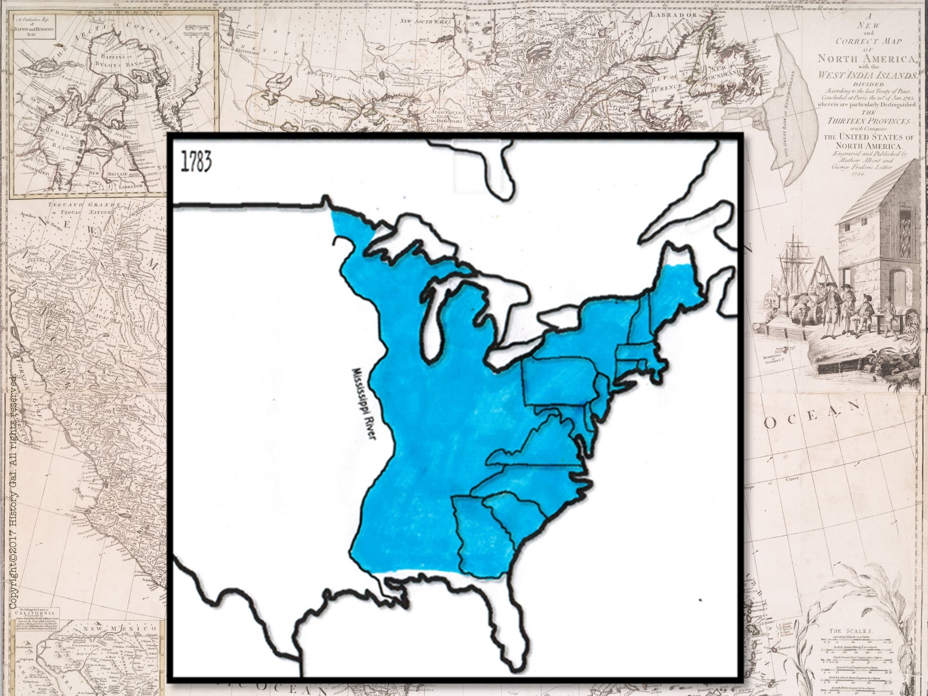
UNITED STATES AFTER THE AMERICAN REVOLUTION

Slide 5
The 1780s were know as the CRITICAL PERIOD - Will the new government/nation be strong enough to survive?

Slide 6
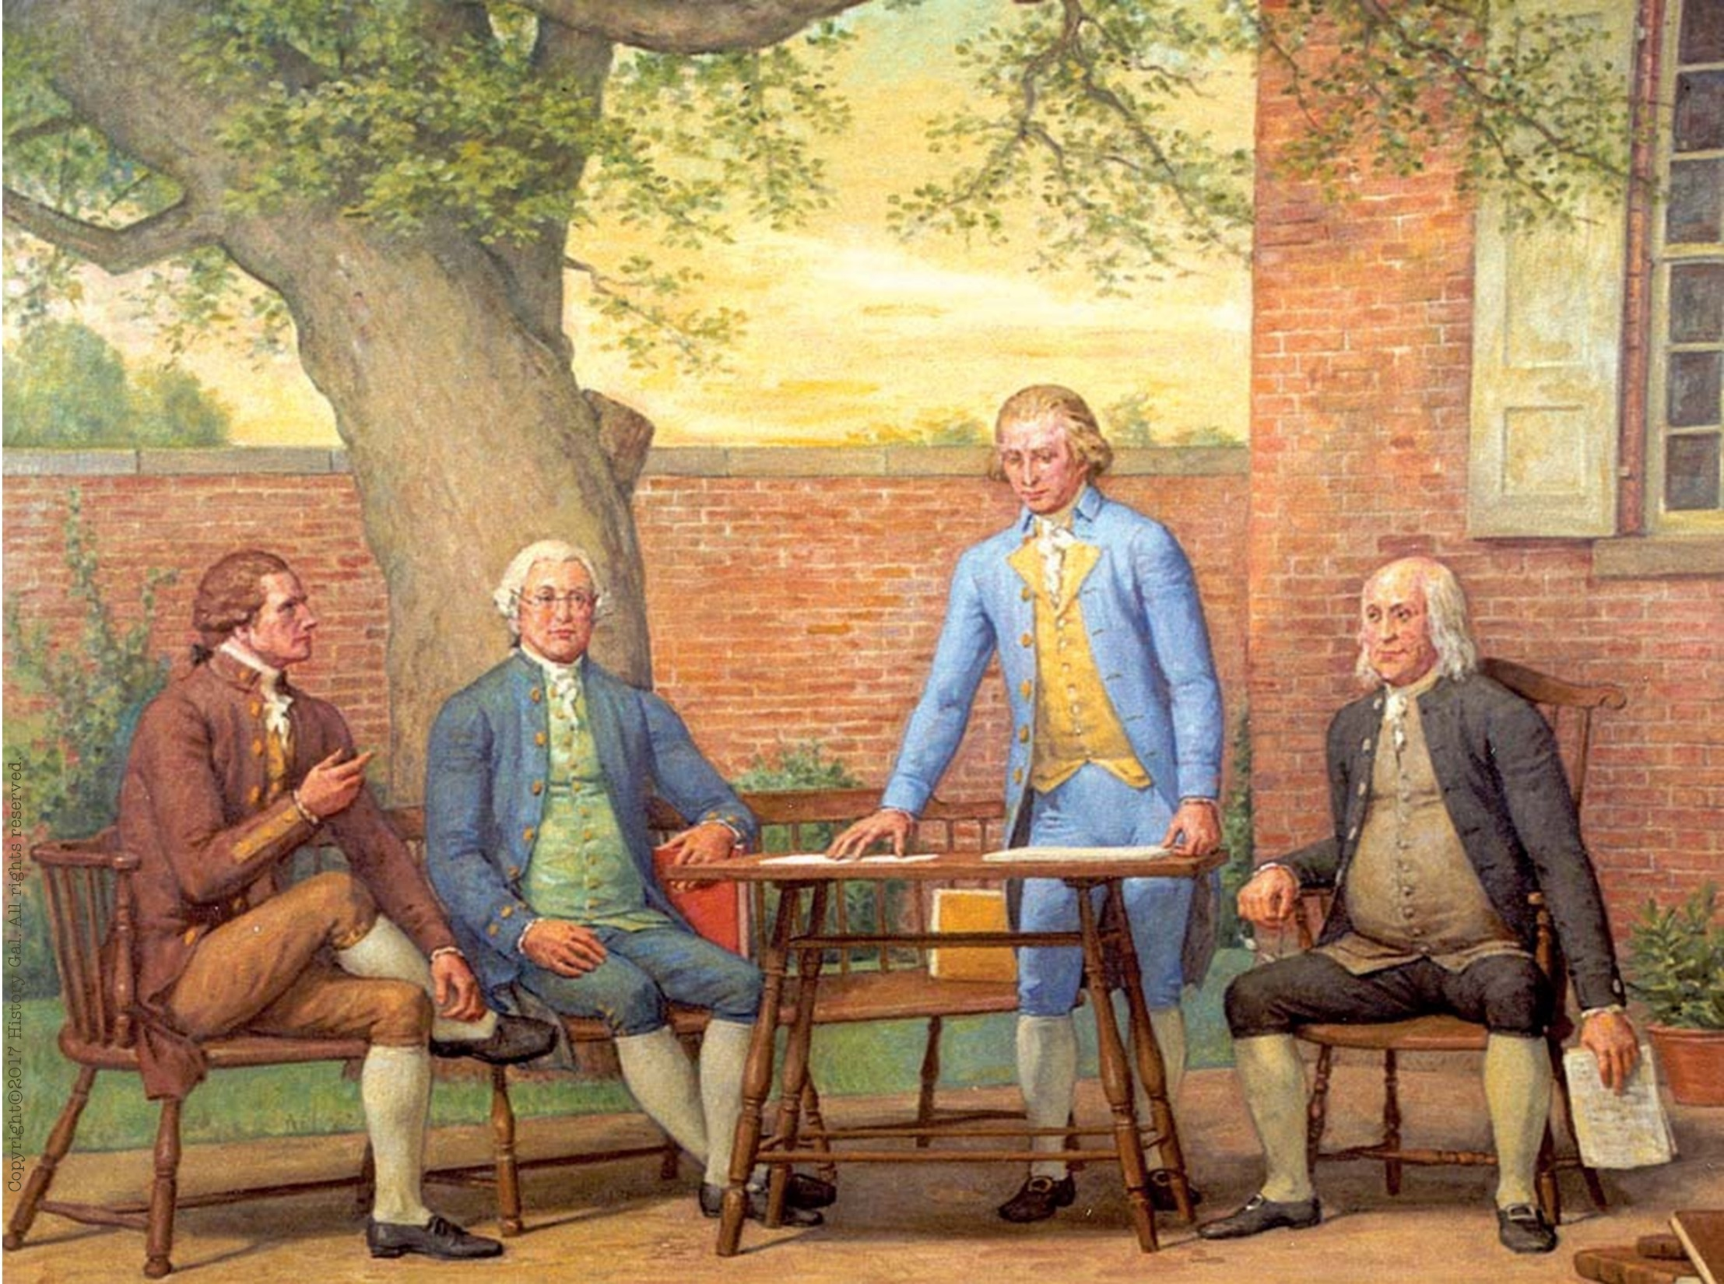
ARTICLES OF CONFEDERATION –
A loose confederation of the states with a weak central government
Articles of Confederation in One Minute

Slide 7
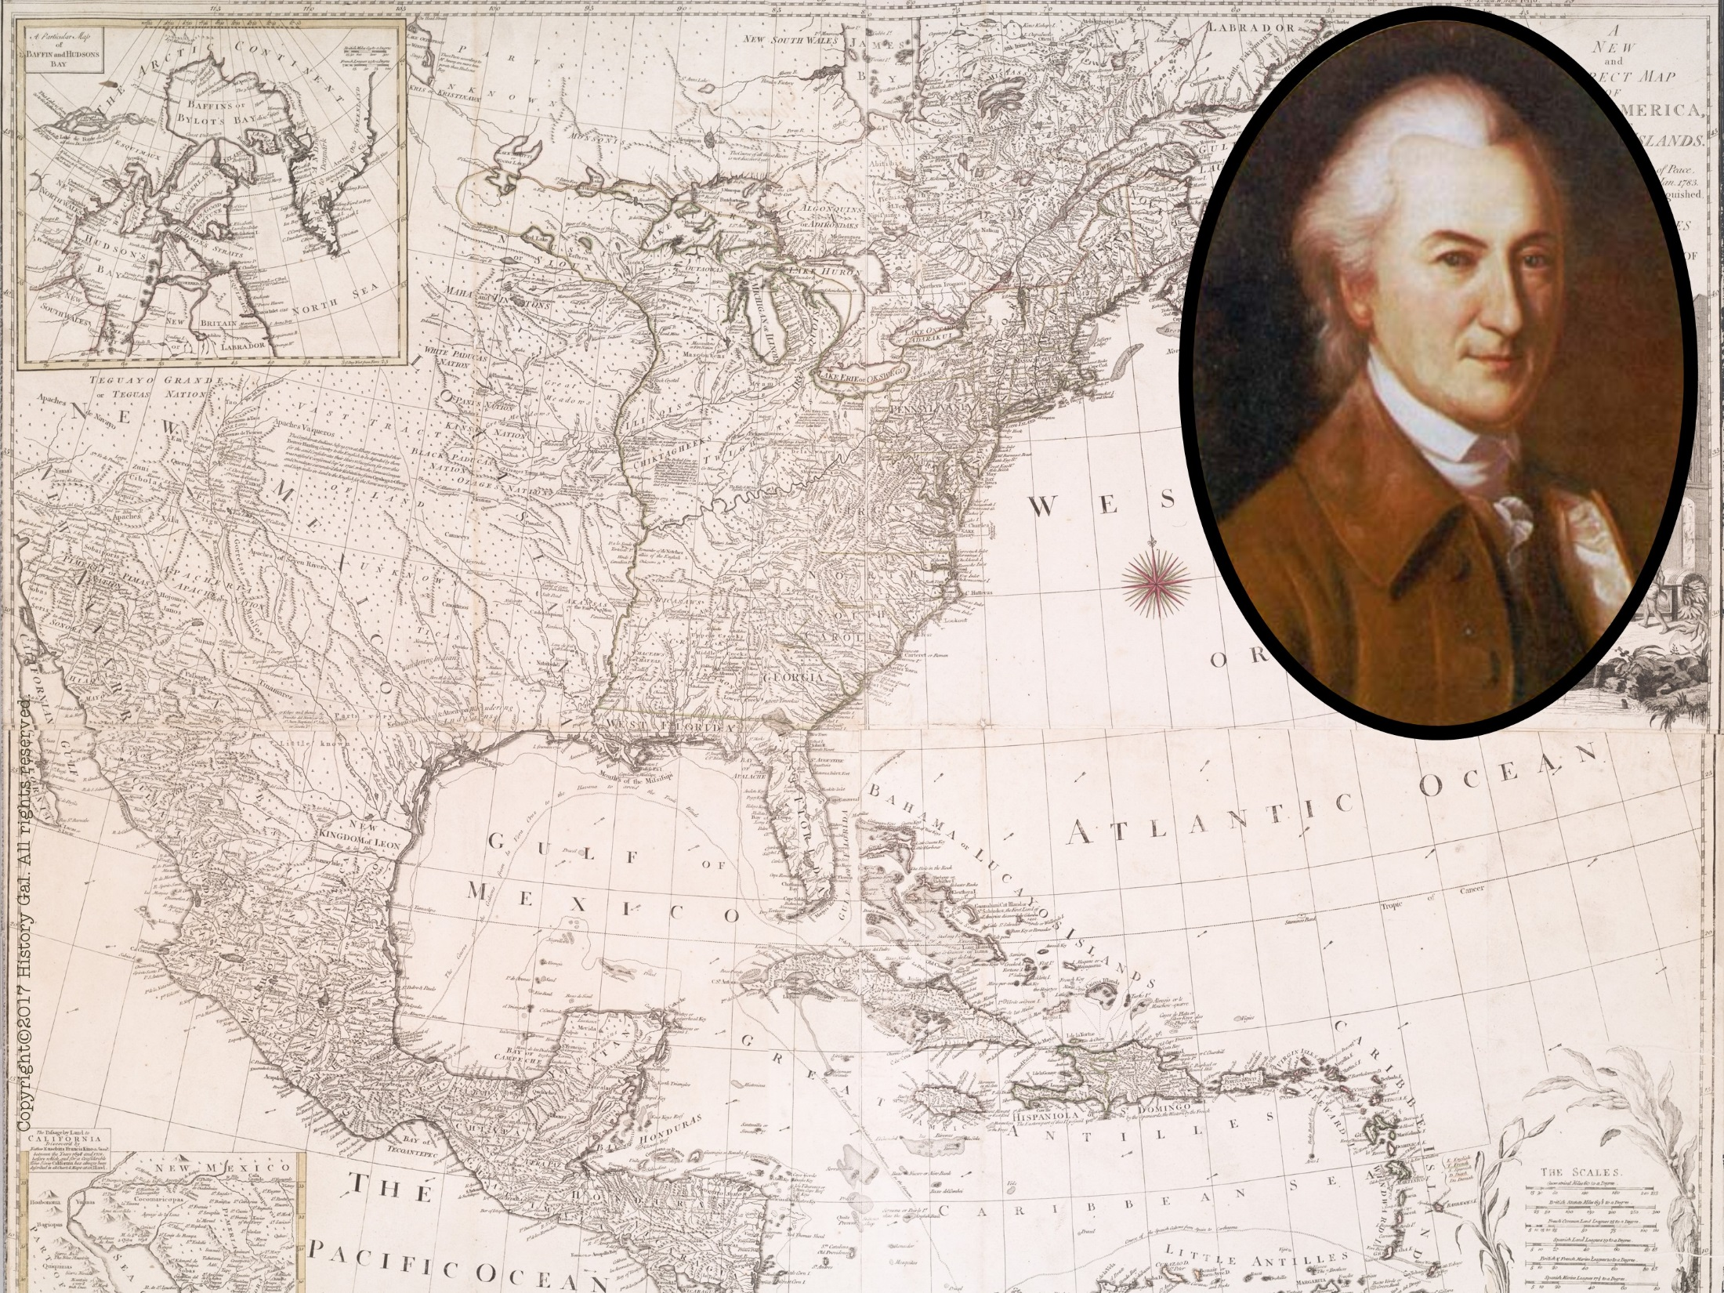
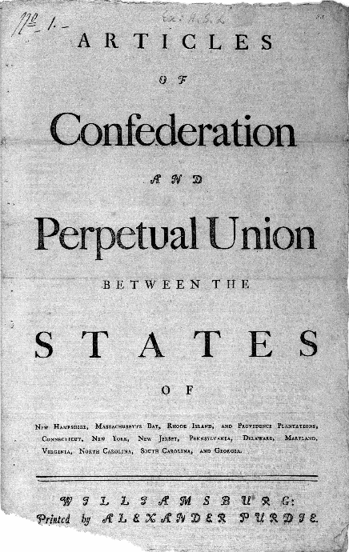
Philadelphia 1776 - JOHN DICKINSON drafted the
nation’s first constitution
called the ARTICLES OF CONFEDERATION
Submitted to the states for ratification (approval)
Ratification was delayed because of land disputes
Ratified in 1781
John Dickinson
John Dickinson

Slide 8
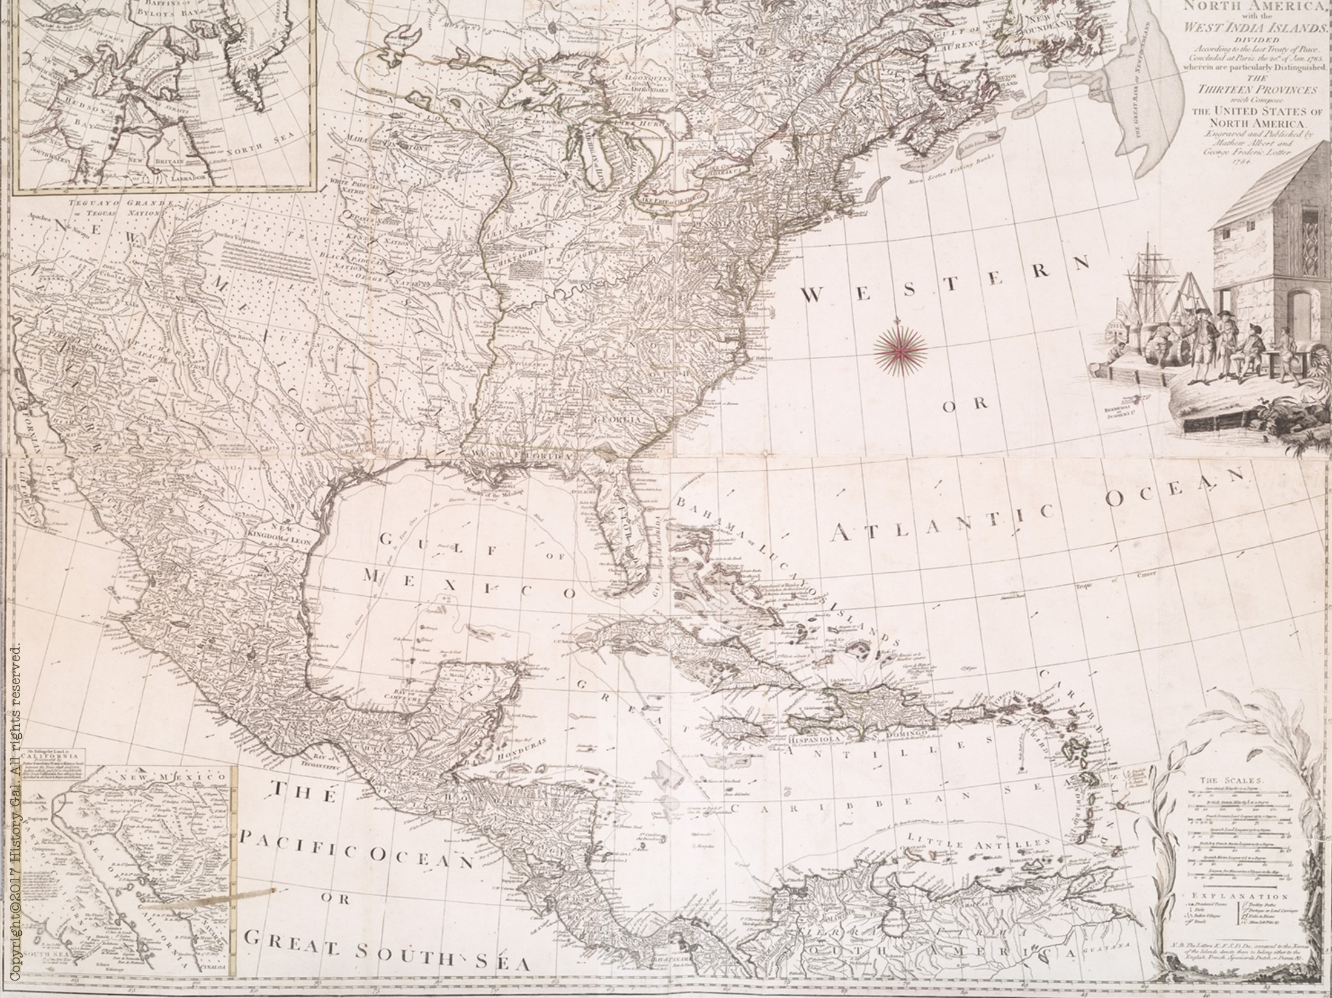
STRUCTURE OF GOVERNMENT
Central government – 1 house (UNICAMERAL) legislature with 1 vote for each state
9 out of 13 states had to approve laws
unanimous vote needed to amend the Articles of Confederation

Slide 9
STRUCTURE OF GOVERNMENT
Powers of the new government: wage war, make treaties, send diplomatic representatives, borrow money
No power to collect taxes, regulate commerce (trade) between the states, enforce its own laws

Slide 10
ACCOMPLISHMENTS
negotiated the Treaty of Paris 1783 (ended the Revolutionary War)
LAND ORDINANCE OF 1785 – public policy for western lands, provided for setting aside one section of land in each township for public education

Slide 11
ACCOMPLISHMENTS
NORTHWEST ORDINANCE OF 1787 – set rules for creating new states, granted limited self-government to that developing territory and prohibited slavery in certain regions
Articles of Confederation Explained

Slide 12
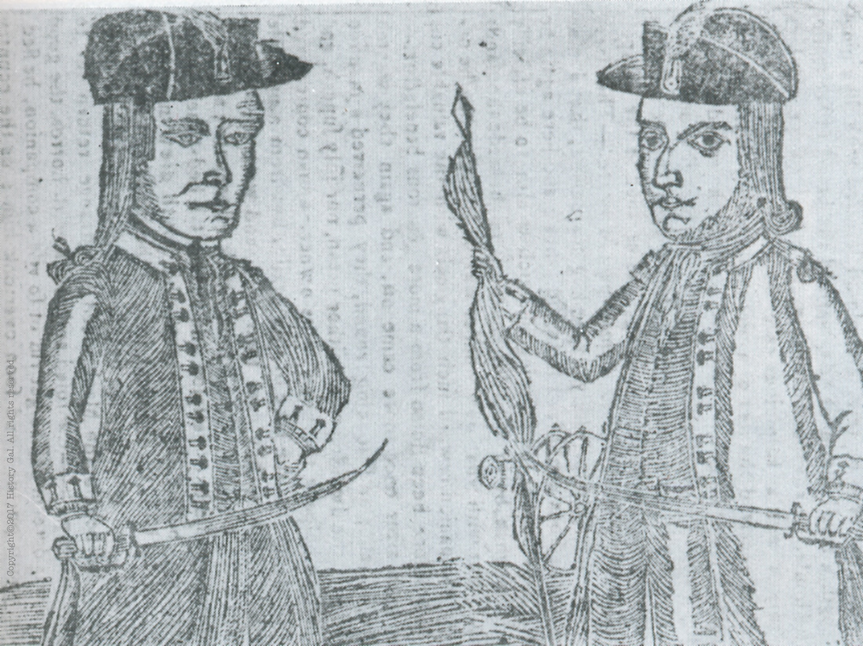
PROBLEMS

Slide 13
#1: Weak central (national) government

Slide 14
#2 Financial Problems:
unpaid war debts, states and congress issued worthless paper money
no power to tax – could only request the states to donate money for national needs

Slide 15
#3: Problems with Foreign (European) nations:
Europe had little respect for a new nation that could not pay its debts
Spain and England expanded their interests in lands west of the new nation

Slide 16
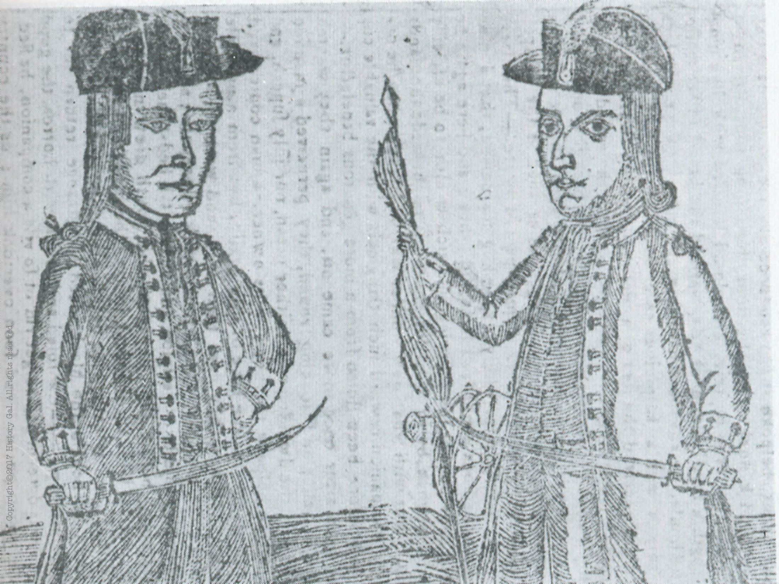
#4: Domestic Problems:
SHAYS’ REBELLION - Summer 1786
Captain Daniel Shays (a MA farmer and war veteran) led other farmers in an uprising against high state taxes, imprisonment for debt and lack of paper money
They stopped the collection of taxes and forced the closings of debtors’ courts
1787 – attempted to steal weapons from the Springfield armory, but the state militia broke it up

Slide 17
Result of Shay’s Rebellion– people realized the national government was powerless to stop such rebellions, convinced many of the need to meet to discuss the weaknesses of the Articles of Confederation
Shay’s Rebellion

Slide 18
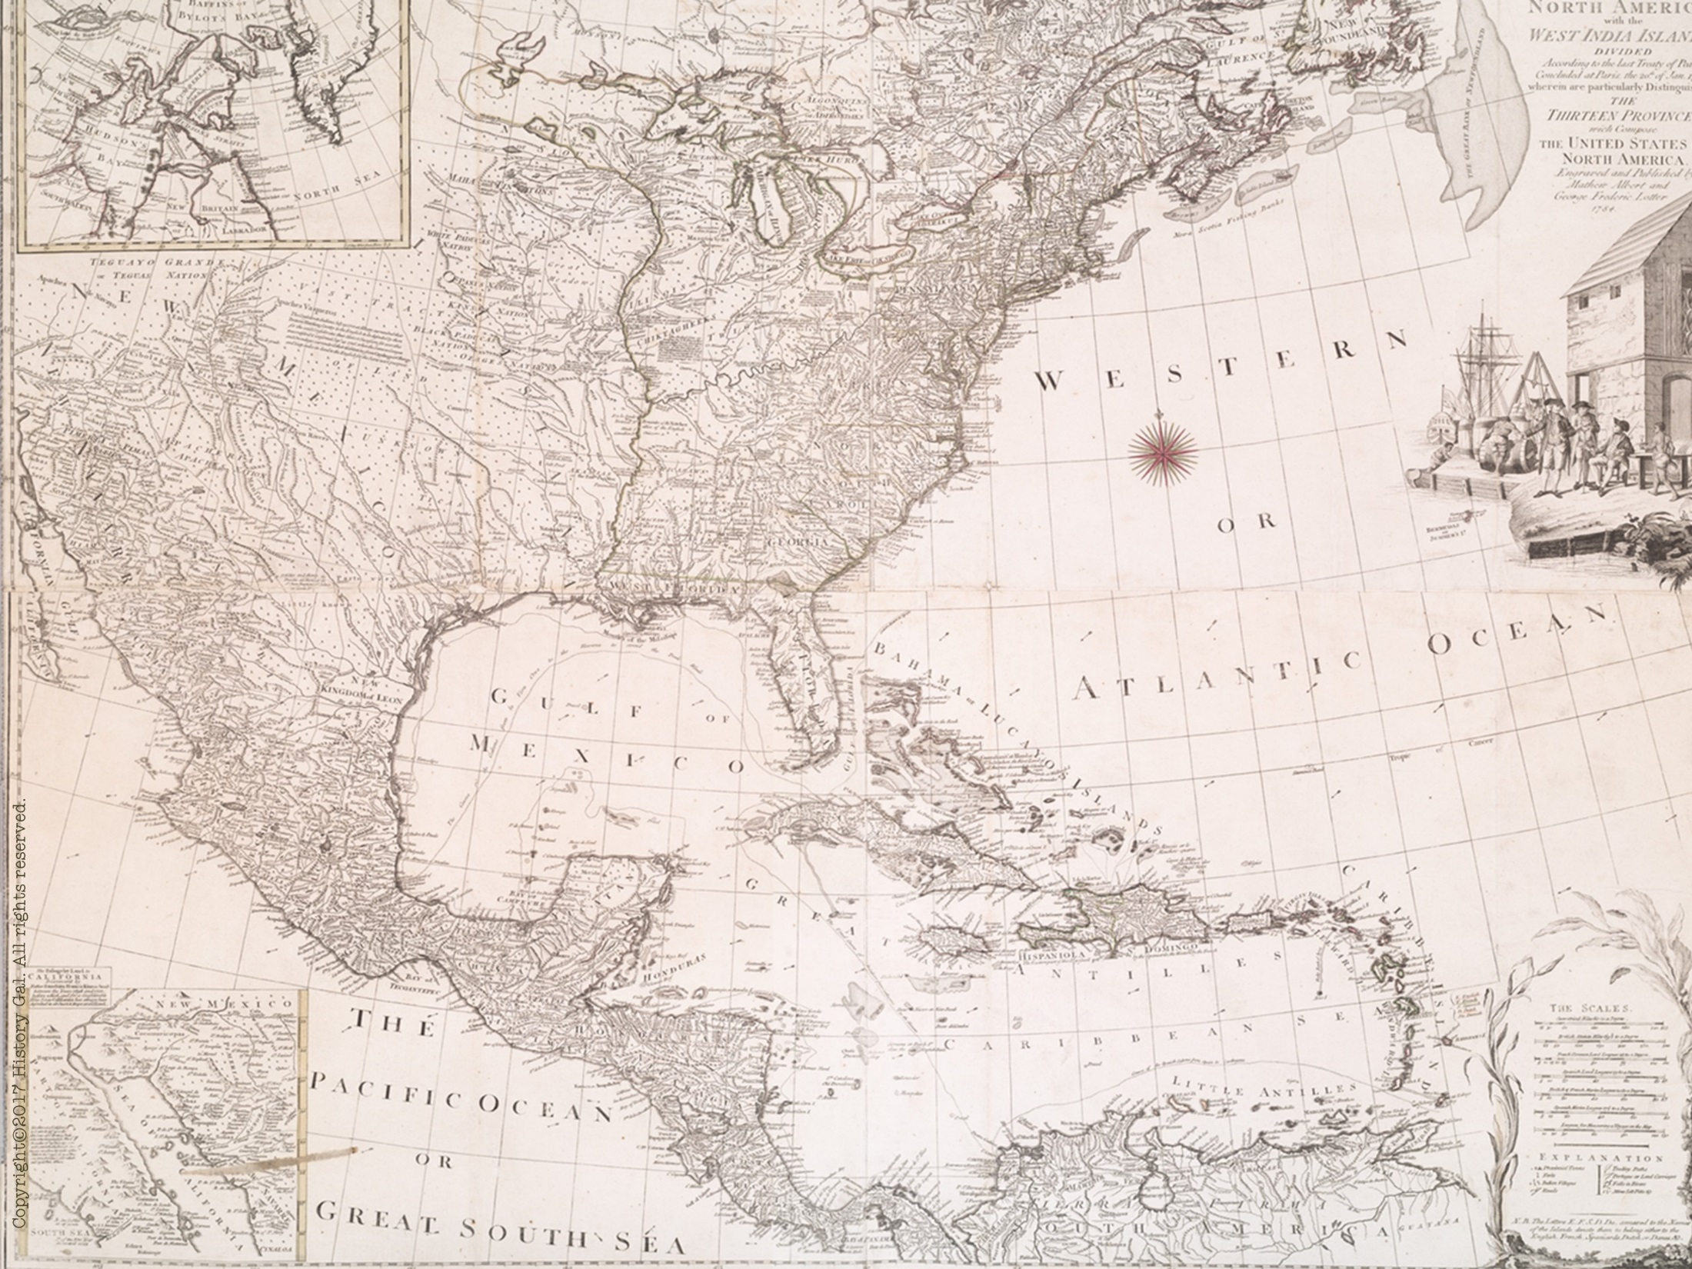
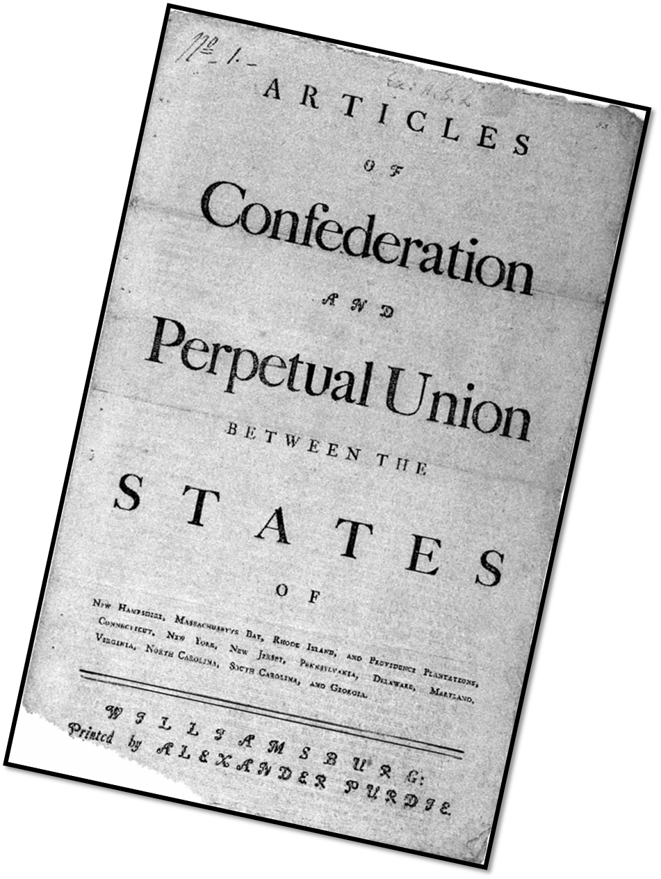
Articles of Confederation:
Time for a change…

Slide 19
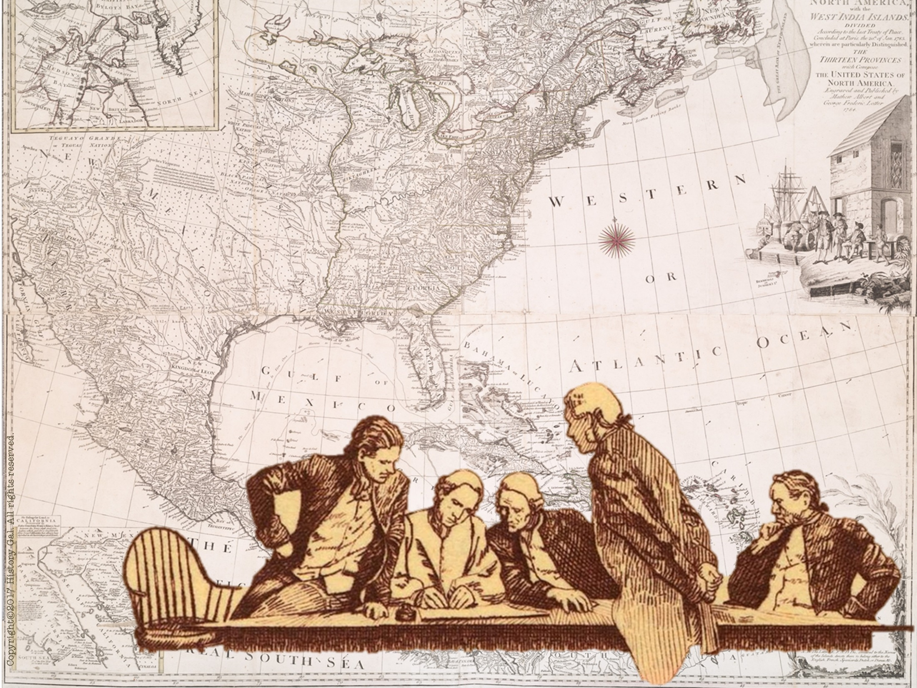
1786 – ANNAPOLIS CONVENTION
5 states sent delegates to discuss improving the commercial (trade) relations between the states
delegates agreed that they needed another convention to revise the Articles and agreed to meet in Philadelphia the following year
Shays’ Rebellion will convince more states of the need to attend the convention
Annapolis Convention

